Slide 1
Cyber Opportunity
CAN ICT Conference 1 Feb 2016
Kathmandu, Nepal
richard.lamb@icann.org
Notes:
Thankyou master of ceremony sigdel/thapa
First like to thank minister Rai, secy Malego, secy Thakur, secy Thapalia, nta chairman Jha, can chairman Dhakal.
and Mr. Aryal of the Nepal Intyernet society for giving me an opportunity to speak.
Having “done time” in the US foreign service on ICT policy, I appreciate the challenges of serving the pubic effectively from within the system. My conversations thus far have revealed very forward looking officials.
You are better men (and women) than I.
WHO AM I? WHAT IS ICANN?

Slide 2
Given inherent boundary-less nature of cyber attacks, there is a need for local, regional, and global cooperation in cyber security - particularly from the bottom up.
Designed by freepik

Slide 3
Bridge building events like this, SANOG just prior, and others are critical in building the human networks that run the Internet “network”.
Sun 1215: Hey Joe – Sorry it is late but are you seeing anything strange headed toward me?
Sat 2230: Hello Bikram – Let me look…Ah yes. Looks like a DDOS attack from an unknown network. Ill see if I can filter it out.
Sun 1220: Thanks. I owe you a beer.
Designed by freepik
Sat 2239: Happy to help…and yes ill take the beer ;-)
Notes:
DoJ example
Treaty will not help here. The attacker is gone by the time official communications take place.
Pursuing the perpetrators after the fact DOES require formal cross-jurisdictional cooperation.
But stopping the attack must happen very quickly between those “at the controls”, i.e., by the network and system engineers at SANOG

Slide 4
For the fast moving Internet the future is now. By the time I formulate a plan (business or otherwise) to address today’s problems, the Internet ecosystem has changed.
Notes:
E.g. today’s concerns: IoT:none/broken, AP other net devices: how to update FW

Slide 5
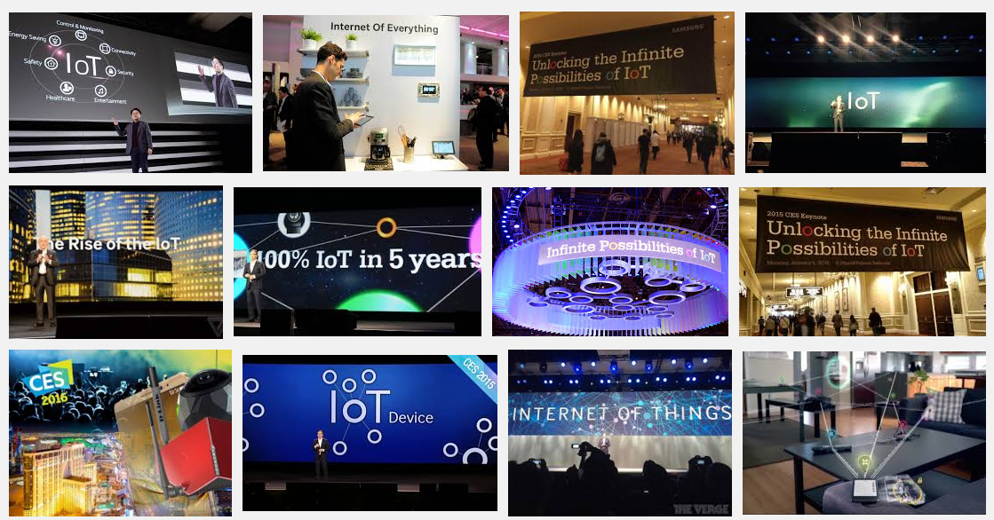
So assume tomorrow is today and that we live in an interconnected Internet of Things. A recent visit to CES:
Notes:
Yes – IoT has become a marketing term blurring the lines between “things”. Could be a light bulb or a car or a medical device …or… a router or a firewall. BTW: That IoT light bulb is connected to the same home network on which you do your banking transactions…hmmm.
Accompanied with hype there is investment and IoT is another example of a lot of investment.

Slide 6
Security is recognized as a missing piece for IoT. The reliance on IoT means it should be built in from the start. Not just a patch.
IoT:
Light bulb
Lock
Car
Heart Pacemaker
Internet Router – Security already built in and understood
Notes:
This is a recognized issue but businesses are too busy focusing forward.
This will be an issue and is therefore an opportunity for those looking ahead with skills.
BTW: That IoT light bulb is connected to the same home network on which you do your banking transactions…hmmm.

Slide 7
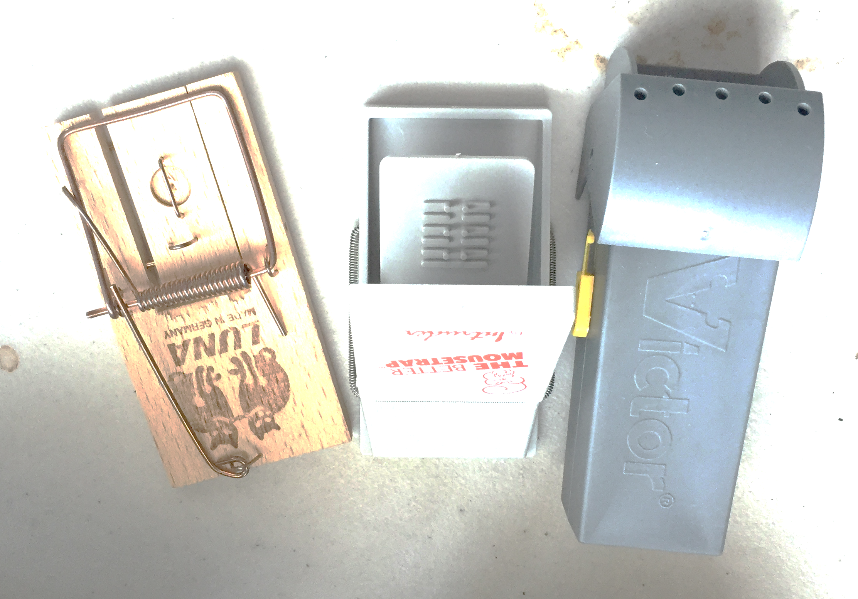
Lets take advantage of the hard won experience and cooperative environment of our network engineers to develop the solutions for “tomorrow’s” IoT!
Don’t just follow – innovate and lead. This is an opportunity to progress technically and benefit economically.
?
Notes:
IoT is not just about H/W. It is about (securing) the services behind the IoTs. That innovation could happen here in Nepal.
I know you have the expertise – I have met many of them personally.
Embrace IPR. Don’t let your ideas get stolen. There is a well established rule of law here.

Slide 8
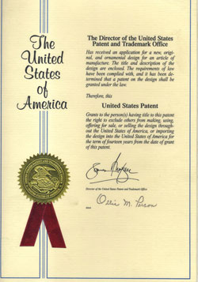
Help engineer dreamers (like me) realize their goals (with rule of law, IP protection, business acumen) and become a source of cyber security solutions .. Not just a consumers.
Xyz Inc.
Notes:
In My Opinion: Do not be afraid to compete in the global IT market. With the right business model (no matter how small) and reasonable intellectual property protection your greatest resource (talent) can make their mark.
I have a few patents.
http://patentfile.org/filing-provisional-patent-at-uspto/
http://www.uspto.gov/web/offices/pac/doc/general/foreign.htm
Thanks to Brant Murphy, Kenneth Chang, Madhuri Herzog of uspto

Slide 9
www.nepalbank.com.np → DNS
←198.1.112.132← DNS
BANK
198.1.112.132
← 6.6.6.6 ← ATTACKER
ATTACKER
6.6.6.6
Notes:
My obligatory DNS / DNSSEC slide.

Slide 10
A thought: Scalable Security for IoT
root
DNS is already there
DNSSEC adds security
com
and crosses organizational boundaries.
google.com
za
co.za
security.co.za
electric.co.za
iotdevices.co.za
water.rickshome.security.co.za
car.rickshome.iotdevices.co.za
aircond.rickshome.electric.co.za
window.rickshome.security.co.za
thermostat.rickshome.iotdevices.co.za
meter.rickshome.electric.co.za
door.rickshome.security.co.za
refrigerator.rickshome.iotdevices.co.za
Animated slide

Slide 11
Thank You
My new favorite word is: Jugaad

