Slide 1
DANE: The Future of Transport Layer Security (TLS)
Dr. Richard Lamb
Santa Venera, Malta
ION Malta
18 September 2017

Slide 2
DNSSEC: A Global Platform for Innovation or.. I* $mell opportunity !
Notes:
*and a few others. See all the patent filings relying on DNSEC !!

Slide 3
Game changing Internet Core Infrastructure Upgrade
“More has happened here today than meets the eye. An infrastructure has been created for a hierarchical security system, which can be purposed and re‐purposed in a number of different ways. ..” – Vint Cerf (June 2010)

Slide 4

Another source of trust on the Internet
CA Certificate roots ~1482
Symantec, Thawte, Godaddy
DNSSEC root - 1
Internet of Things
IoT
Content security “Free SSL” certificates for Web and e-mail and “trust agility” DANE
Cross-organipltional and trans-national authentication and security
Content security Commercial SSL Certificates for Web and e-mail
Crypto currencies and e-commerce?
DANE and other yet to be discovered security innovations, enhancements, and synergies
E-mail security SMIME,
DKIM RFC4871
Securing VoIP
Login security SSHFP RFC4255
Domain Names
https://www.eff.org/observatory
http://royal.pingdom.com/2011/01/12/internet-2010-in-numbers/
Notes:
SSL cert for tata.in can be provided by 1482 CAs including govts!! How do you know who to trust?
The Internet community started by with just trying to secure the DNS but we ended up with something much more. (see Vint Cerf’s quote)
With so many, trust is diluted. Used to be good when there were fewer.
Any one can encrypt. Few can Identify : Encryption != Identity
Examples of this problem: Comodo, MD5 crack, DigiNotar etc.. Failures.
Fact is that DNS has been unfortunately used as an independent authentication tool for some time: e.g. email authentication
Looking forward:
Build and improve on established trust models, e.g., CAs
Greatly expanded SSL usage (currently ~4M/200M)
Make SMIME (secured email - SMIMEA) a reality. All email packages already have support for this. They just don’t have a way to distribute keys. /w DNSSEC – now they do.
May work in concert with in enhancing or extending other cyber security efforts like digital Identities, WebID, BrowserID, CAs, ..
Securing VoIP
Simplify WiFi roaming security
Secure distribution of configurations (e.g., blacklists, anti-virus sigs)
Cryptocurrency??

Slide 5
DNS-Based Authentication of Named Entities (DANE)
Q: How do you know if the TLS/SSL certificate is the correct one?
A: Store the certificate (or fingerprint/hash of it) in the DNS and sign it with DNSSEC
Certificate stored in the DNS is controlled by the domain name holder.
But not just for web pages. Could also be:
Email, voip, chat, pgp ….

Slide 6
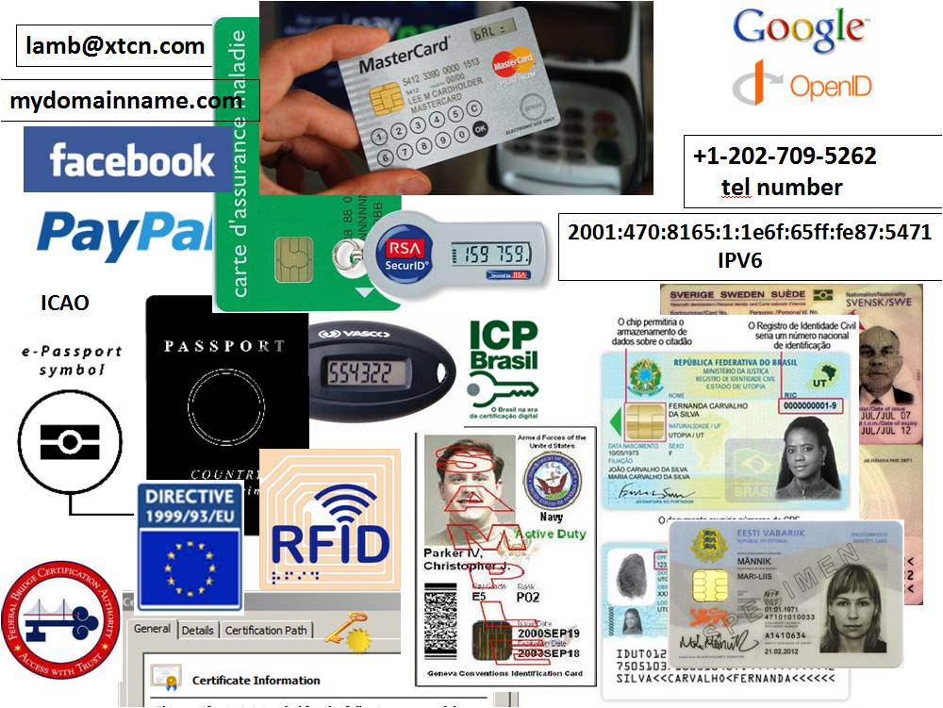
Opportunity: New Security Solutions
Improved Web SSL and certificates for all*
Secured e-mail (e.g., s/mime, pgp) for all*
Securing VoIP
Cross organizational authentication+security
Secured content delivery (e.g. configurations, updates, keys) – Internet of Things
Securing the Smart Grid
Increasing trust in e-commerce
Securing cryptocurrencies and other new models
A Global Built-in PKI
A good ref http://www.internetsociety.org/deploy360/dnssec/
*IETF standards complete and interest by govt procurement.
Notes:
Configuration data examples: anti-virus signatures, blacklists, etc…
Imagine if you could trust “the ‘Net” – again?
Inter email server exchange (SMTP) security using DNSSEC+DANE+TLS is becoming very popular in Germany and elsewhere post-Snowden.
At the 2015 Prague IETF meeting Snowden (via video conference) publicly singled out DNSSEC as a key technology for enhancing privacy.

Slide 7
A thought: Scalable Security for IoT
root
DNS is already there
DNSSEC adds security
com
and crosses organipltional boundaries.
google.com
pl
iot.pl
security.iot.pl
electric.iot.pl
iotdevices.iot.pl
water.rickshome.security.iot.pl
car.rickshome.iotdevices.iot.pl
aircond.rickshome.electric.iot.pl
window.rickshome.security.iot.pl
thermostat.rickshome.iotdevices.iot.pl
meter.rickshome.electric.iot.pl
door.rickshome.security.iot.pl
refrigerator.rickshome.iotdevices.iot.pl
Animated slide

Slide 8
Lots of excitement (and standards) in the Internet
The underlying mechanism that secures all these processes is DANE
RFC6698 (protocol), RFC6394 (use cases), RFC7671 (operational guidance)
RFC7672 SMTP Security
RFC7673 Chat
RFC7929 PGP email
RFC8162 S/MIME email
OpenSSL supports DANE

Slide 9
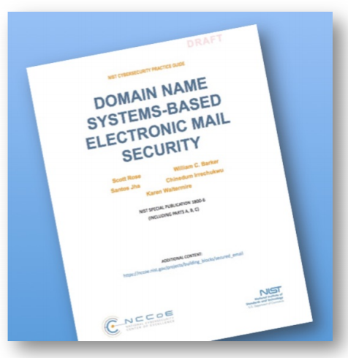
Govt interest?
NIST published Special Publication 1800-6, “DNS-Based E-Mail Security”
https://beta.csrc.nist.gov/publications/detail/sp/1800-6/draft

Slide 10
DNSSEC: Internet infrastructure upgrade to help address today’s needs and create tomorrow’s opportunity. DANE is a key example.

Slide 11


Thank You
Email: richard.lamb@icann.org
ICANN provided KSK Rollover Information and Tools:
Thanks to many including:
Dan York / ISOC
https://www.icann.org/kskroll
https://github.com/iana-org/get-trust-anchor
https://go.icann.org/KSKtest
youtube.com/icannnews
Root Zone DNSSEC Trust Anchor:
linkedin/company/icann
https://data.iana.org/root-anchors
www.icann.org
Call for TCRs:
https://www.iana.org/help/tcr-application

