Slide 1

DNSSEC 101
IGF 2012, Baku, Azerbaijan
6 November 2012
richard.lamb@icann.org

Slide 2
The Business Case for DNSSEC
Cyber security is becoming a greater concern to government, enterprises and end users. DNSSEC is a key tool and differentiator.
DNSSEC is the biggest security upgrade to Internet infrastructure in over 20 years.
DNSSEC is a critical tool in combating the global nature of cyber crime providing a cross-organizational and trans-national platform for innovative security solutions and authentication.
DNSSEC infrastructure deployment has been brisk but requires expertise. Getting ahead of the curve is a competitive advantage.
Notes:
Cyber interest at C-level, and govt mandates. Large US ISP says: it used to be speed, now its security too.
DNS /w DNSSEC: a foothold for trust built into the Internet infrastructure.

Slide 3
Where DNSSEC fits in
DNS converts names (www.tata.in) to numbers (64.37.102.54)
..to identify services such as www and e-mail
..that identify and link customers to business and visa versa

Slide 4
Where DNSSEC fits in
..but CPU and bandwidth advances make legacy DNS vulnerable to MITM attacks
DNS Security Extensions (DNSSEC) introduces digital signatures into DNS to cryptographically protect contents from modification
With DNSSEC fully deployed a entities can be sure the customer gets un-modified data (and visa versa)
Notes:
Discovery of DNS vulnerability: Bellovin 1995 then Aug 2008 Dan Kaminsky reveals DNS vulnerability shortcut.
Being able to cryptographically trust Internet infrastructure data, think about what that means…can I now click and download a .exe file?

Slide 5
The Original Problem:
DNS Cache Poisoning Attack
ISP / ENTERPRISE /
END NODE
ENTERPRISE
www.majorbank.se = 1.2.3.4
www.majorbank.se=?
DNS Resolver
DNS
Server
5.6.7.8
Attacker
www.majorbank.se = 5.6.7.8
Get page
Attacker
webserverwww @ 5.6.7.8
Login page
Username / Password
Error
Password database
Animated slide in .ppt
detailed description at: http://unixwiz.net/techtips/iguide-kaminsky-dns-vuln.html

Slide 6
Argghh! Now all ISP customers get sent to attacker.
www.majorbank.se = 1.2.3.4
www.majorbank.se=?
DNS Resolver
DNS
Server
5.6.7.8
Get page
Attacker
webserverwww @ 5.6.7.8
Login page
Username / Password
Error
Password database
Animated slide in .ppt

Slide 7
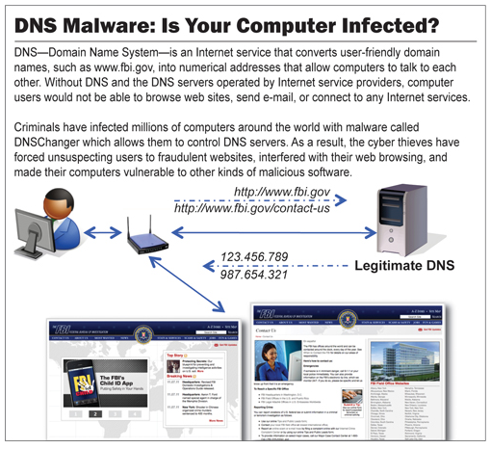
The Bad: DNSChanger - ‘Biggest Cybercriminal Takedown in History’ – 4M machines, 100 countries, $14M
Nov 2011 http://krebsonsecurity.com/2011/11/malware-click-fraud-kingpins-arrested-in-estonia/
End-2-end DNSSEC validation would have avoided the problems
Notes:
end-2-end DNSSEC validation would have avoided the problems.

Slide 8
The Bad: Other DNS hijacks*
25 Dec 2010 - Russian e-Payment Giant ChronoPay Hacked
18 Dec 2009 – Twitter – “Iranian cyber army”
13 Aug 2010 - Chinese gmail phishing attack
25 Dec 2010 Tunisia DNS Hijack
2009-2012 google.*
  April 28 2009 Google Puerto Rico sites redirected in DNS attack
  May 9 2009 Morocco temporarily seize Google domain name
9 Sep 2011 - Diginotar certificate compromise for Iranian users
SSL / TLS doesn't tell you if you've been sent to the correct site, it only tells you if the DNS matches the name in the certificate. Unfortunately, majority of Web site certificates rely on DNS to validate identity.
DNS is relied on for unexpected things though insecure.
*A Brief History of DNS Hijacking - Google
http://costarica43.icann.org/meetings/sanjose2012/presentation-dns-hijackings-marquis-boire-12mar12-en.pdf

Slide 9
The Good: Securing DNS with DNSSEC
Attacker’s record does not validate – drop it
www.majorbank.se = 1.2.3.4
www.majorbank.se=?
DNS Resolver
with DNSSEC
DNS
Server with DNSSEC
1.2.3.4
Attacker
www.majorbank.se = 5.6.7.8
Get page
webserverwww @ 1.2.3.4
Login page
Username / Password
Account Data
Animated slide in .ppt

Slide 10
The Good: Resolver only caches validated records
ISP / ENTERPRISE /
END NODE
www.majorbank.se = 1.2.3.4
ENTERPRISE
www.majorbank.se=?
DNS Resolver
with DNSSEC
DNS
Server with DNSSEC
1.2.3.4
Get page
webserverwww @ 1.2.3.4
Login page
Username / Password
Account Data
Animated slide in .ppt

Slide 11
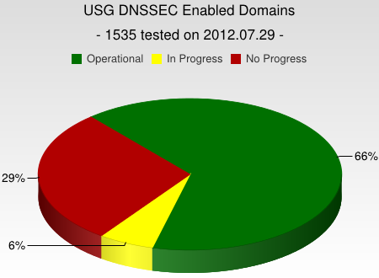
DNSSEC interest from governments
Sweden, Brazil, Czech Republic and others encourage DNSSEC deployment to varying degrees
Mar 2012 - AT&T, CenturyLink (Qwest), Comcast, Cox, Sprint, TimeWarner Cable, and Verizon have pledged to comply and abide by US FCC [1] recommendations that include DNSSEC.. “A report by Gartner found 3.6 million Americans getting redirected to bogus websites in a single year, costing them $3.2 billion.,”[2].
2008 US .gov mandate. ~70% operational. [3]
[1] FCC=Federal Communications Commission=US communications Ministry
[2] http://securitywatch.pcmag.com/security/295722-isps-agree-to-fcc-rules-on-anti-botnet-dnssec-internet-routing
[3] http://www.whitehouse.gov/sites/default/files/omb/memoranda/fy2008/m08-23.pdf
Notes:
Side note: dnssec may help remove chaff in determining the source of cyber attacks. Attribution is one of the the key elements in a successful approach to stemming the tide of cyber attacks.

Slide 12
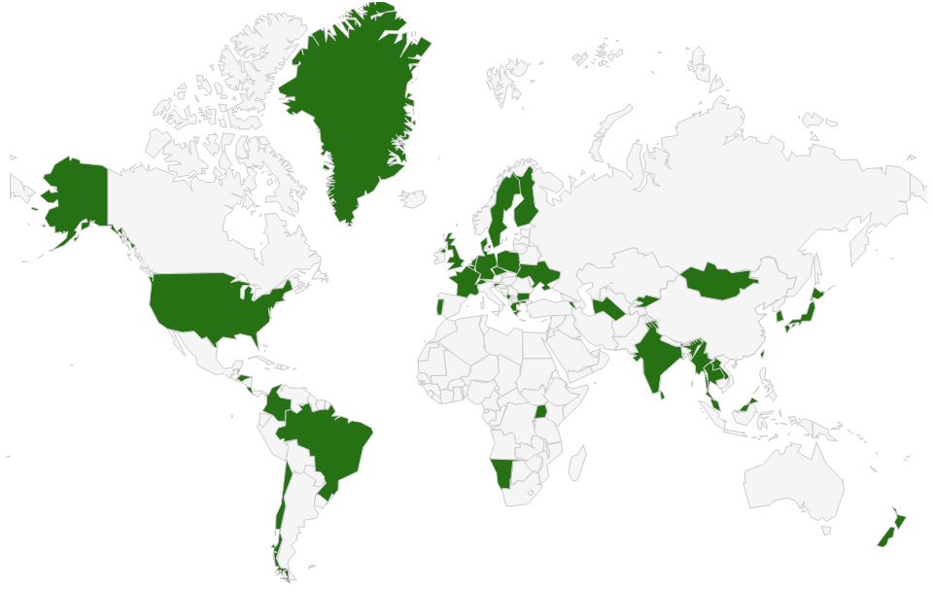

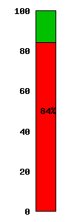
DNSSEC: Where we are
Deployed on 95/316 TLDs (.br, .cz, .co, .ua, .nl, .bg, .kg, .am, .lv, .ug, .mm, .mn, .de, .eu, .uk, .tt, .pl, .in, .lk, .com, .my مليسيا , .asia, .tw 台灣, .kr 한국, .jp, .fr, .post, …)
Root signed** and audited
New gTLDs require it
>84% of domain names could have DNSSEC
Growing ISP support*
3rd party signing solutions: GoDaddy, Binero, VeriSign…***
Vendors support it: ISC/Bind, Microsoft, …
New standards being developed on DNSSEC (e.g., IETF RFC6698 SSL Certificates)
Growing interest from others major players…
*COMCAST Internet (18M), TeliaSonera SE, Sprint,Vodafone CZ,Telefonica CZ, T-mobile NL, SurfNet NL, SANYO Information Technology Solutions JP, others..
**21 TCRs from: TT, BF, RU, CN, US, SE, NL, UG, BR, Benin, PT, NP, Mauritius, CZ, CA, JP, UK, NZ
*** Partial list of registrars: https://www.icann.org/en/news/in-focus/dnssec/deployment
Notes:
Major ISP says security now on checklist for customers
Comcast and >5000 domain names http://blog.comcast.com/2011/12/dnssec-deployment-update.html

Slide 13

The Bad: SSL Dilution of Trust
The Good: DNSSEC = Global “free” PKI
CA Certificate roots ~1482
DNSSEC root - 1
Content security “Free SSL” certificates for Web and e-mail and “trust agility”
Cross-organizational and trans-national identity and authentication
Content security Commercial SSL Certificates for Web and e-mail
Network security IPSECKEY RFC4025
DANE and other yet to be discovered security innovations, enhancements, and synergies
E-mail security
DKIM RFC4871
Securing VoIP
Login security SSHFP RFC4255
Domain Names
https://www.eff.org/observatory
http://royal.pingdom.com/2011/01/12/internet-2010-in-numbers/
Notes:
SSL cert for tata.in can be provided by 1482 CAs including govts!! How do you know who to trust?
The Internet community started by with just trying to secure the DNS but we ended up with something much more. (see Vint Cerf’s quote)
With so many, trust is diluted. Used to be good when there were fewer.
Any one can encrypt. Few can Identify : Encryption != Identity
Comodo, MD5 crack, etc..
Fact is that DNS has been unfortunately used as an independent authentication tool for some time: e.g. email authentication
Build and improve on established trust models, e.g., CAs
Greatly expanded SSL usage (currently ~4M/200M)
Make SMIME (secured email) a reality. All email packages already have support for this. They just don’t have a way to distribute keys. /w DNSSEC – now they do.
May work in concert with in enhancing or extending other cyber security efforts like digital Identities, WebID, BrowserID, CAs, ..
Securing VoIP
Simplify WiFi roaming security
Secure distribution of configurations (e.g., blacklists, anti-virus sigs)

Slide 14
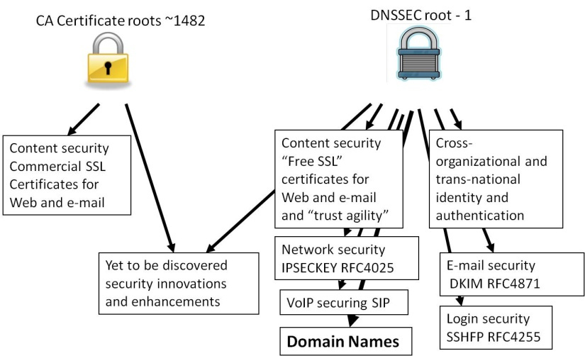
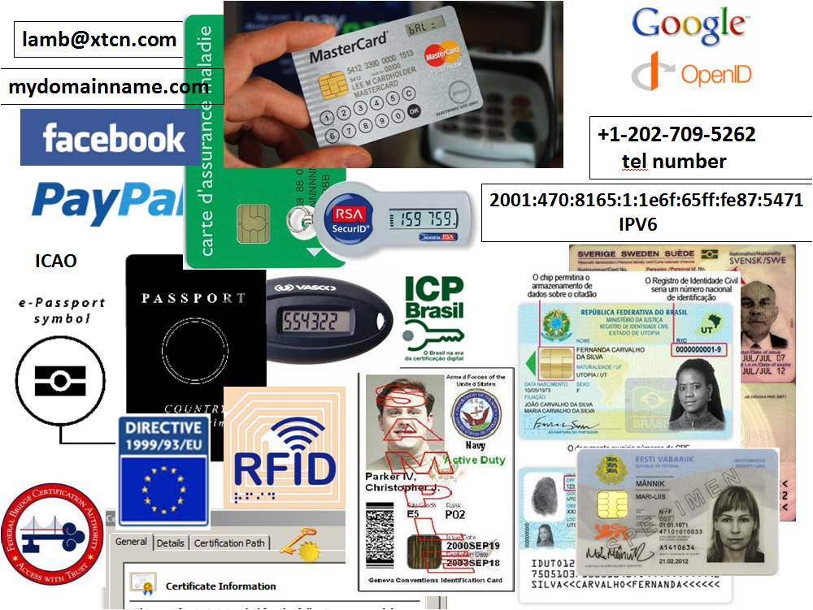
Opportunity: New Security Products
Improved Web SSL and certificates for all*
Secured e-mail (S/MIME) for all*
Validated remote login SSH, IPSEC*
Securing VoIP
Cross organizational digital identity systems
Secured content delivery (e.g. configurations, updates, keys)
Securing Smart Grid efforts
A global PKI
Increasing trust in e-commerce
A good ref http://www.internetsociety.org/deploy360/dnssec/
*IETF standards complete or currently being developed RFC6698
Notes:
Configuration data examples: anti-virus signatures, blacklists, etc…
Imagine if you could trust “the ‘Net” – again?

Slide 15
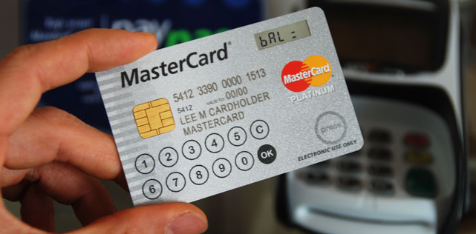




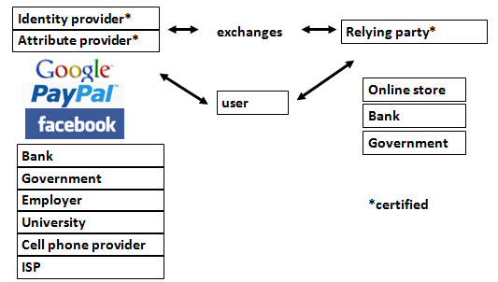
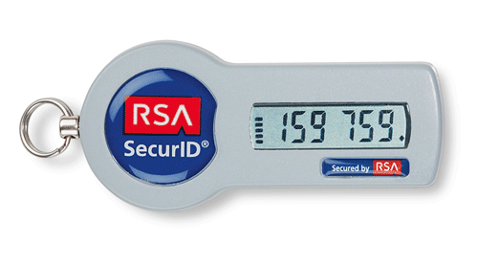

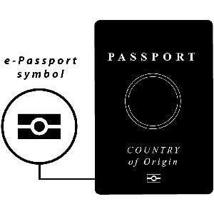

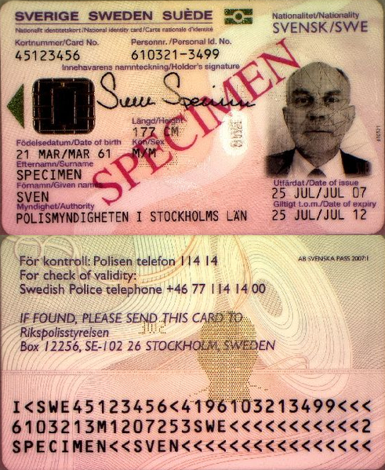
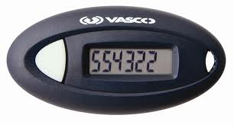

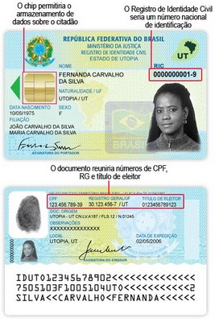

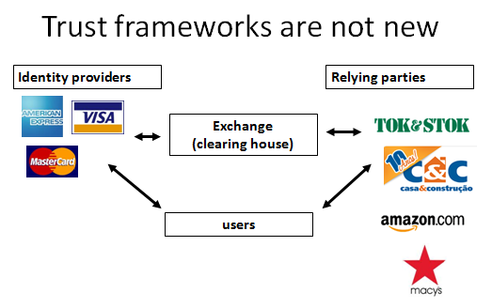

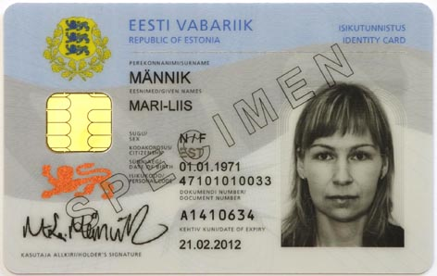

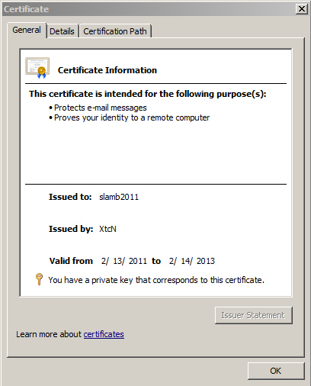

DNS is a part of all IT ecosystems
+1-202-709-5262
VoIP
US-NSTIC effort
OECS ID effort
Smart Electrical Grid
lamb@xtcn.com
mydomainname.com
Notes:
Every time you create an account on a service, logon, buy something you rely on the honesty of DNS.
Even CAs rely on DNS to issue credentials so SSL is suspect. “lazy” CA is as good as “thorough” CA.
PKI and ID systems also rely on DNS to connect to databases to offer services and transfer authentication info.
VoIP relies on the e164 DNS zone as well.
Even with a FOB, you are relying on non-MITM connectivity to the service.

Slide 16
DNSSEC: Classic bottom-up, multi-stakeholder built Internet infrastructure upgrade to help address today’s needs and create tomorrow’s opportunity.

Slide 17
DNSSEC @ the root: A bottom-up, multi-stakeholder operation

Slide 18
Community driven
Listened to calls from global community for deployment:
  Internet community (e.g., RIPE, APNIC, ccNSO…)
  Governments
  Business (e.g., Kaminsky 2008, Press)
Notes:
National cybersecurity strategy – Common goals between agencies through education by all of us.
ccNSO surveys: all will do
DHS Interagency push
Even naysayer Dan came around

Slide 19
Deploying it
Problem
  Bureaucracy and Fear: Hard to change anything that has not changed since 1983. Many excuses not to.
  root - An internationally agreed to single key – right
  Trust me - I will manage the root key. ..uh huh.
Notes:
Deploying it – “the Ugly?”
Root barrier from parts of own USG.

Slide 20
Approach
Eliminate excuses and lead by example – start at root
Solution
  Multi-stakeholder – get buy in up front
  Bottom up – like the Internet itself
  Transparency and Choice
  Draw from existing secure practices and trusted models
Notes:
DNSSEC at the root – a classic example of bottom up Internet development and successful public-private partnership
Transparency and choice = Notice and Choice
Still – much convincing of govts. Optional, no there are no black helicopters in the crypto box.
Public-private partnership with US Department of Commerce and VeriSign (existing DNS management partner)

Slide 21
DNSSEC at the root: result
Deployed 15 July 2010
Completed in ~2years
Biggest upgrade to the Internet’s core infrastructure in 20 years
Set the stage for deployment in rest of hierarchy (e.g., top level domains, end user domains)

Slide 22
Cont…
Got global buy in
Direct stakeholder participation in key management – 21 Trusted Community Representatives made up of respected members of Internet community from 18 countries
  Currently: URUGUAY, BRAZIL, TRINIDAD AND TOBAGO, CANADA, BENIN, SWEDEN, NEPAL, NETHERLANDS, NEW ZEALAND, RUSSIAN FEDERATION, PORTUGAL, JAPAN, MAURITIUS, CHINA, BURKINA FASO,CZECH REPUBLIC, UNITED KINGDOM, USA
Notes:
TCR=Vint Cerf, Kaminsky, Kolkman = Chair of IAB, CNNIC, RU, JP…URUGUAY, BRAZIL, TRINIDAD AND TOBAGO, CANADA, BENIN, SWEDEN, NEPAL, NETHERLANDS, NEW ZEALAND, RUSSIAN FEDERATION, PORTUGAL, JAPAN, MAURITIUS, CHINA, BURKINA FASO,CZECH REPUBLIC, UNITED KINGDOM, USA

Slide 23
Cont….
Enabled DNSSEC deployment throughout hierarchy – need just one key to validate all
Publish, broadcast everything.
Pass 3rd party annual SysTrust audit
ICANN Secure Key Management Facilities in Culpepper, VA and El Segundo, CA. FIPS 140-2 Level 4 crypto, GSA Class 5 safes, multiple tiers, biometrics, etc.
Notes:
Nist requirments for high impact
Learned much from CA’s, auditing firms, (and of all places, DCID 6/9)
Explain the split KSK / ZSK role if asked.

Slide 24
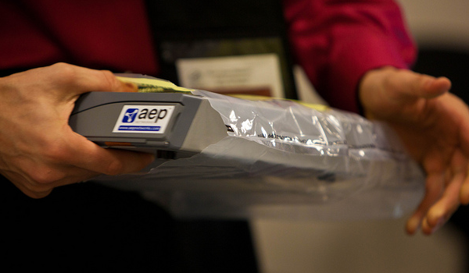
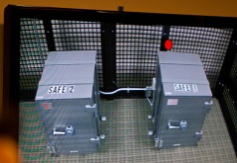
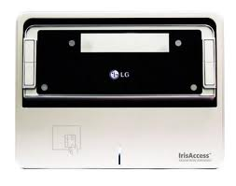

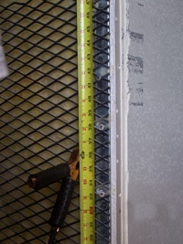
See root-dnssec at http://dns.icann.org/
Notes:
FR, NZ, root, com, UK, DCID 6/9

Slide 25
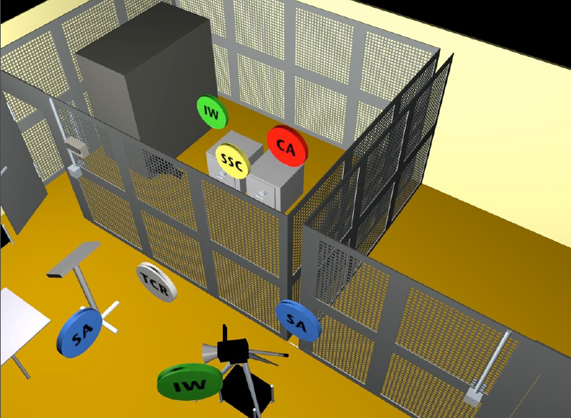

Slide 26
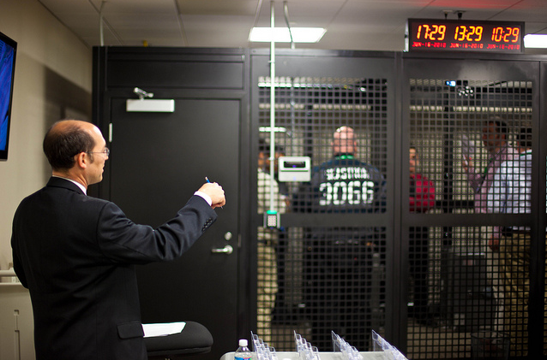
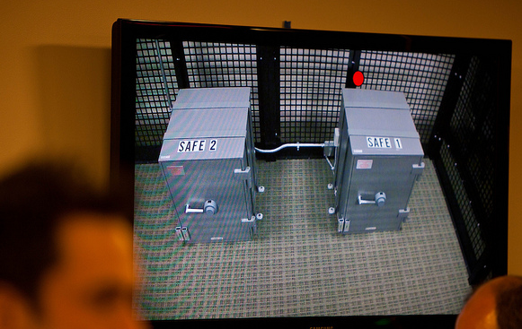
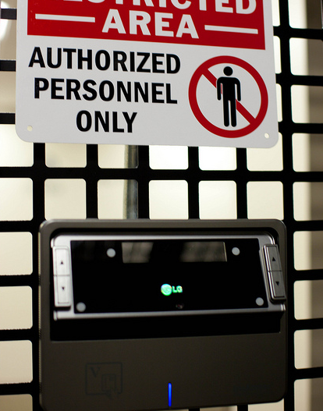
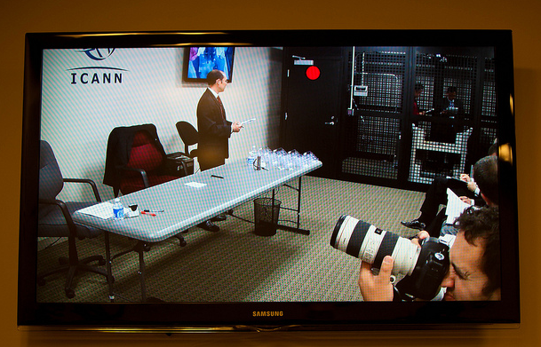
http://www.flickr.com/photos/kjd/sets/72157624302045698/

Slide 27
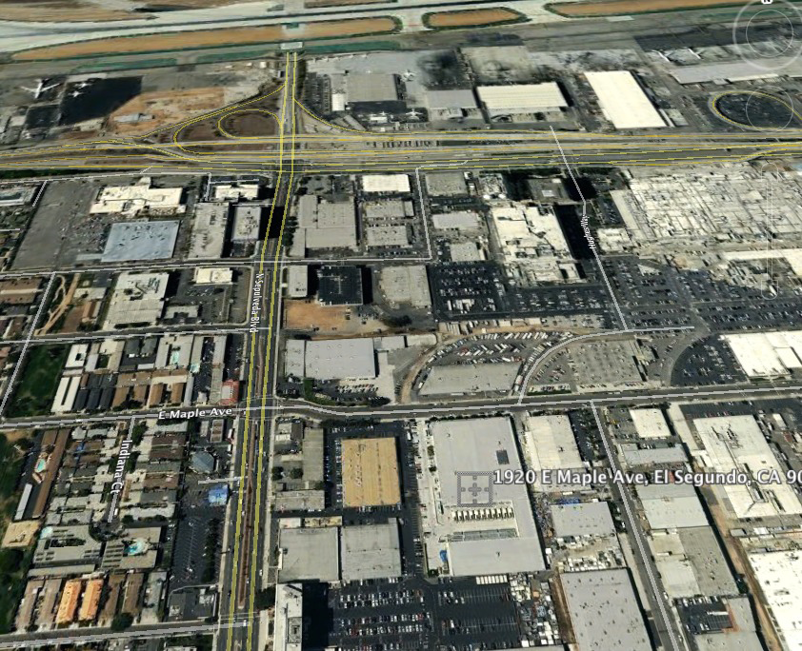

Slide 28
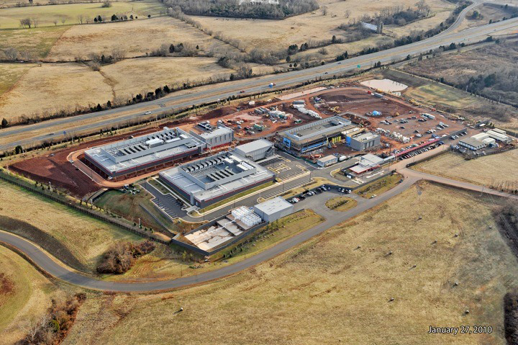

Slide 29
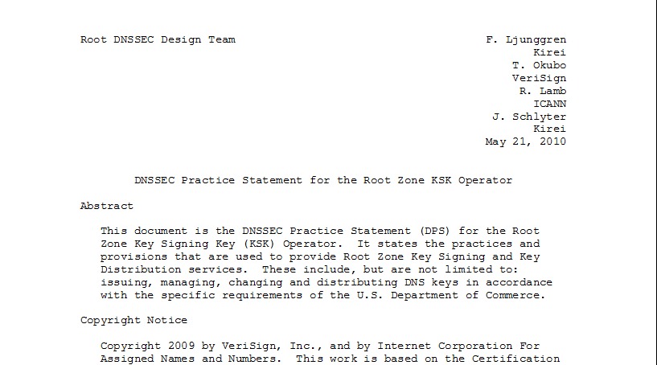
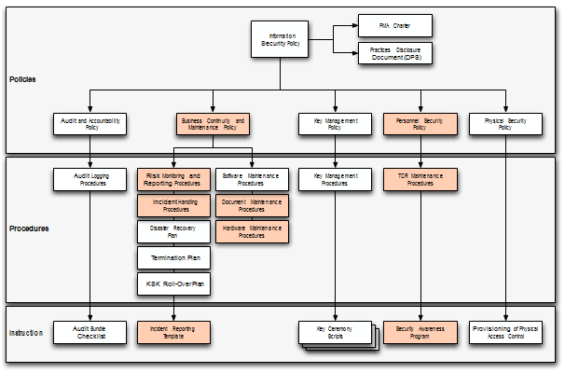
Documentation - Root
91 Pages and tree of other documents!
Root DPS
Notes:
Spells out multiparty controls (e.g., at least two)

Slide 30
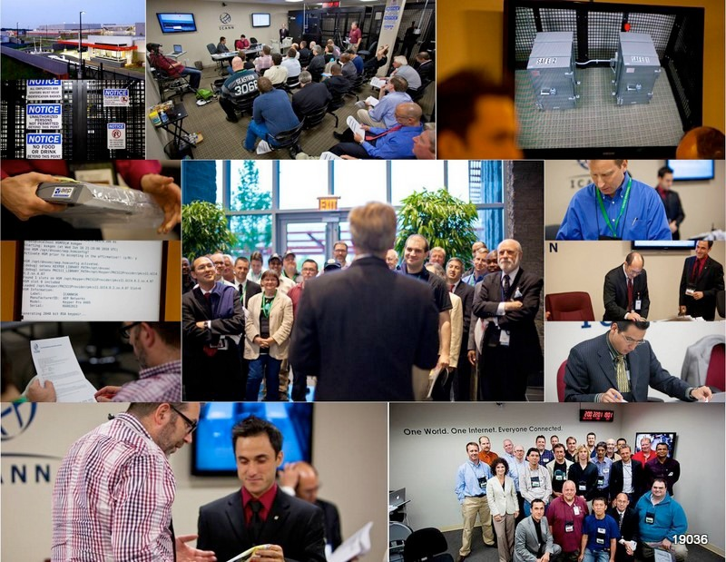
Notes:
Fips 140-2 level 4
Gsa class 5
Biometrics
Multi-person control
Publicly documented
Draw from CA
Dcid 6/9 9 gauge mesh drywall

Slide 31
Summary
DNSSEC multi stakeholder effort from start and at root is a concrete operational example of how successful the bottom-up multi-stakeholder approach can be.
Notes:
Example of Internet style cooperation succeeding where top-down political approaches have been difficult

