Slide 1

The Business Case for DNSSEC
InterOp/ION Mumbai 2012
11 October 2012
richard.lamb@icann.org

Slide 2
The Business Case for DNSSEC
Cyber security is becoming a greater concern to enterprises, government, and end users. DNSSEC is a key tool and differentiator.
DNSSEC is the biggest security upgrade to Internet infrastructure in over 20 years. It is a platform for new security applications (for those that see the opportunity).
DNSSEC infrastructure deployment has been brisk but requires expertise. Getting ahead of the curve is a competitive advantage.
Notes:
Cyber interest at C-level, and govt mandates. Large US ISP says: it used to be speed, now its security too.
DNS /w DNSSEC: a foothold for trust built into the Internet infrastructure.
94/316 tld + required for new gTLDs, 84% domains can deploy dnssec (but only 1% of 200M+) , s/w support,..

Slide 3
Where DNSSEC fits in
DNS converts names (www.tata.in) to numbers (64.37.102.54)
..to identify services such as www and e-mail
..that identify and link customers to business and visa versa

Slide 4
Where DNSSEC fits in
..but CPU and bandwidth advances make legacy DNS vulnerable to MITM attacks
DNS Security Extensions (DNSSEC) introduces digital signatures into DNS to cryptographically protect contents
With DNSSEC fully deployed a business can be sure a customer gets un-modified data (and visa versa)
Notes:
Discovery of DNS vulnerability: Bellovin 1995 then Aug 2008 Dan Kaminsky reveals DNS vulnerability shortcut.
Being able to cryptographically trust Internet infrastructure data, think about what that means…can I now click and download a .exe file?

Slide 5
The Original Problem:
DNS Cache Poisoning Attack
ISP / ENTERPRISE /
END NODE
ENTERPRISE
www.majorbank.se = 1.2.3.4
www.majorbank.se=?
DNS Resolver
DNS
Server
5.6.7.8
Attacker
www.majorbank.se = 5.6.7.8
Get page
Attacker
webserverwww @ 5.6.7.8
Login page
Username / Password
Error
Password database
Animated slide
detailed description at: http://unixwiz.net/techtips/iguide-kaminsky-dns-vuln.html

Slide 6
Argghh! Now all ISP customers get sent to attacker.
www.majorbank.se = 1.2.3.4
www.majorbank.se=?
DNS Resolver
DNS
Server
5.6.7.8
Get page
Attacker
webserverwww @ 5.6.7.8
Login page
Username / Password
Error
Password database
Animated slide

Slide 7
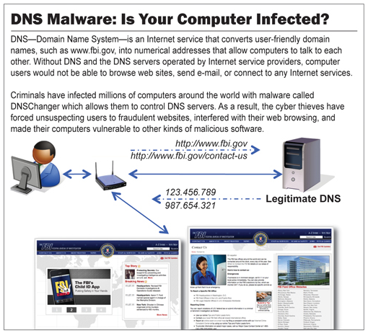
The Bad: DNSChanger - ‘Biggest Cybercriminal Takedown in History’ – 4M machines, 100 countries, $14M
Nov 2011 http://krebsonsecurity.com/2011/11/malware-click-fraud-kingpins-arrested-in-estonia/
End-2-end DNSSEC validation would have avoided the problems
Notes:
end-2-end DNSSEC validation would have avoided the problems.

Slide 8
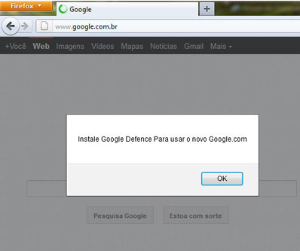
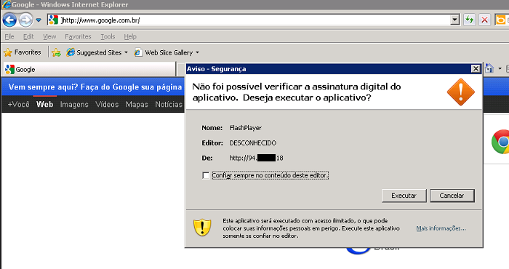
The Bad: Brazilian ISP fall victim to a series of DNS attacks
7 Nov 2011 http://www.securelist.com/en/blog/208193214/Massive_DNS_poisoning_attacks_in_Brazil
End-2-end DNSSEC validation would have avoided the problems
Notes:
1) Rogue insider who added bogus entries to ISP resolvers. ( alguma demanda priveligiada de dentro dos ISP que adicionou a entrada falsa.
2) Hacking of customer premise gateways (mainly home/SOHO routers) with default or easily guessed passwords to add bogus entries. There was possibly some vulnerability hacking in this area as well, but no clear answer on that.

Slide 9
The Bad: Other DNS hijacks*
25 Dec 2010 - Russian e-Payment Giant ChronoPay Hacked
18 Dec 2009 – Twitter – “Iranian cyber army”
13 Aug 2010 - Chinese gmail phishing attack
25 Dec 2010 Tunisia DNS Hijack
2009-2012 google.*
  April 28 2009 Google Puerto Rico sites redirected in DNS attack
  May 9 2009 Morocco temporarily seize Google domain name
9 Sep 2011 - Diginotar certificate compromise for Iranian users
SSL / TLS doesn't tell you if you've been sent to the correct site, it only tells you if the DNS matches the name in the certificate. Unfortunately, majority of Web site certificates rely on DNS to validate identity.
DNS is relied on for unexpected things though insecure.
*A Brief History of DNS Hijacking - Google
http://costarica43.icann.org/meetings/sanjose2012/presentation-dns-hijackings-marquis-boire-12mar12-en.pdf

Slide 10
The Good: Securing DNS with DNSSEC
Attacker’s record does not validate – drop it
www.majorbank.se = 1.2.3.4
www.majorbank.se=?
DNS Resolver
with DNSSEC
DNS
Server with DNSSEC
1.2.3.4
Attacker
www.majorbank.se = 5.6.7.8
Get page
webserverwww @ 1.2.3.4
Login page
Username / Password
Account Data
Animated slide

Slide 11
The Good: Resolver only caches validated records
ISP / ENTERPRISE /
END NODE
www.majorbank.se = 1.2.3.4
ENTERPRISE
www.majorbank.se=?
DNS Resolver
with DNSSEC
DNS
Server with DNSSEC
1.2.3.4
Get page
webserverwww @ 1.2.3.4
Login page
Username / Password
Account Data
Animated slide

Slide 12
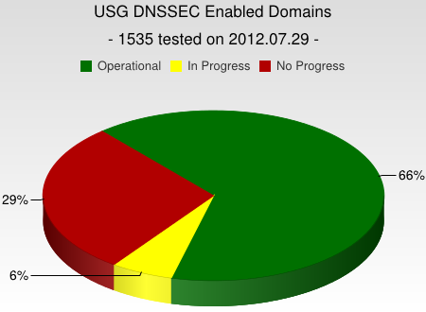
DNSSEC interest from governments
Sweden, Brazil, Netherlands and others encourage DNSSEC deployment to varying degrees
Mar 2012 - AT&T, CenturyLink (Qwest), Comcast, Cox, Sprint, TimeWarner Cable, and Verizon have pledged to comply and abide by US FCC [1] recommendations that include DNSSEC.. “A report by Gartner found 3.6 million Americans getting redirected to bogus websites in a single year, costing them $3.2 billion.,”[2].
2008 US .gov mandate. >60% operational. [3]
[1] FCC=Federal Communications Commission=US communications Ministry
[2] http://securitywatch.pcmag.com/security/295722-isps-agree-to-fcc-rules-on-anti-botnet-dnssec-internet-routing
[3] http://www.whitehouse.gov/sites/default/files/omb/memoranda/fy2008/m08-23.pdf
Notes:
Side note: dnssec may help remove chaff in determining the source of cyber attacks. Attribution is one of the the key elements in a successful approach to stemming the tide of cyber attacks.

Slide 13
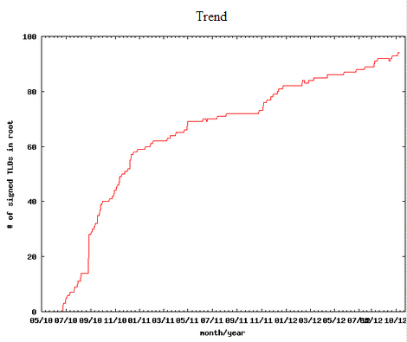
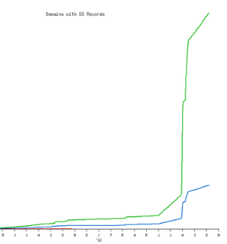
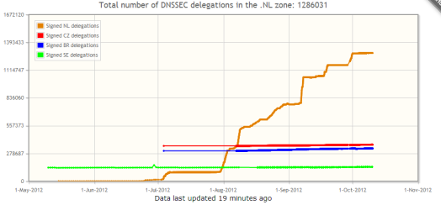
Security as Differentiator and Edge
Differentiator
  Increased cyber security awareness for govts and industry
  Major ISP says security now on checklist for customers
DNSSEC Service and Support
  94/316 TLDs (e.g., .com,.in,.nl,..)
  Growing ISPs adoption*
  Available to 84% of domains
  Vendor support (ISC/BIND, Microsoft..)
  gTLDs (e.g., .bank, .search) require it
*COMCAST Internet (18M), TeliaSonera SE, Sprint,Vodafone CZ,Telefonica CZ, T-mobile NL, SurfNet NL, SANYO Information Technology Solutions JP, others..
Notes:
Studies indicate interest from large search engine. See RIPE paper at
https://labs.ripe.net/Members/gih/counting-dnssec

Slide 14
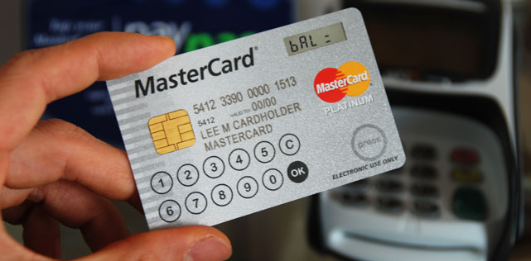




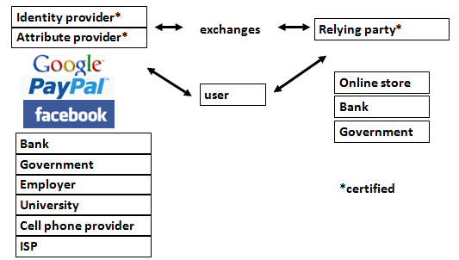
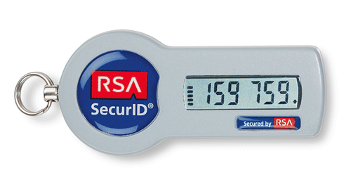

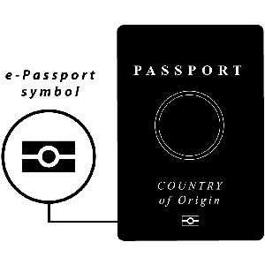

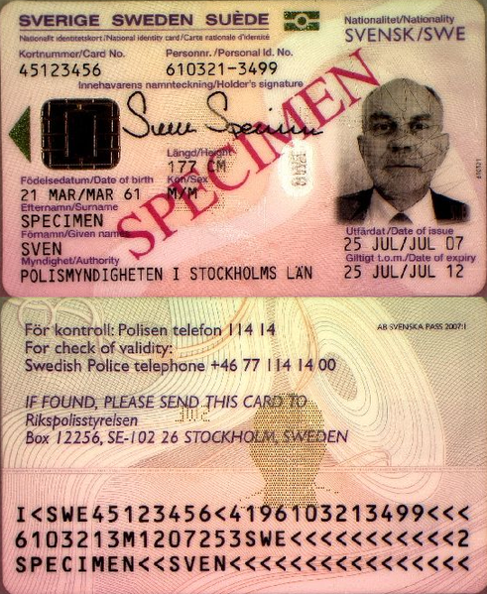
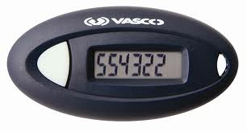

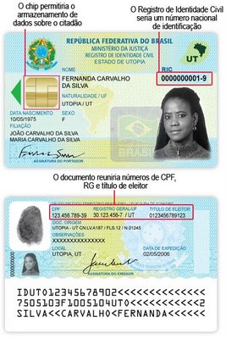

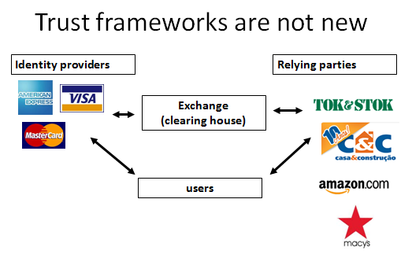

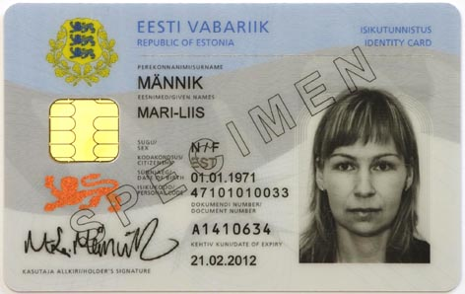

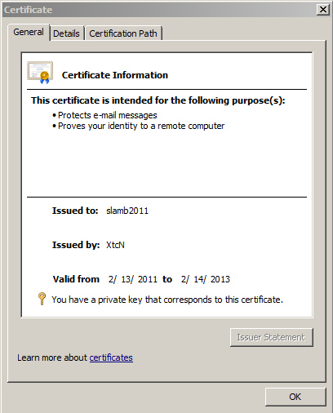

DNS is a part of all IT ecosystems
+1-202-709-5262
VoIP
US-NSTIC effort
OECS ID effort
Smart Electrical Grid
lamb@xtcn.com
mydomainname.com
Notes:
Every time you create an account on a service, logon, buy something you rely on the honesty of DNS.
Even CAs rely on DNS to issue credentials so SSL is suspect. “lazy” CA is as good as “thorough” CA.
PKI and ID systems also rely on DNS to connect to databases to offer services and transfer authentication info.
VoIP relies on the e164 DNS zone as well.
Even with a FOB, you are relying on non-MITM connectivity to the service.

Slide 15

The Bad: SSL Dilution of Trust
The Good: DNSSEC = Global “free” PKI
CA Certificate roots ~1482
DNSSEC root - 1
Content security “Free SSL” certificates for Web and e-mail and “trust agility”
Cross-organizational and trans-national identity and authentication
Content security Commercial SSL Certificates for Web and e-mail
Network security IPSECKEY RFC4025
DANE and other yet to be discovered security innovations, enhancements, and synergies
E-mail security
DKIM RFC4871
Securing VoIP
Login security SSHFP RFC4255
Domain Names
https://www.eff.org/observatory
http://royal.pingdom.com/2011/01/12/internet-2010-in-numbers/
Notes:
SSL cert for tata.in can be provided by 1482 CAs including govts!! How do you know who to trust?
The Internet community started by with just trying to secure the DNS but we ended up with something much more. (see Vint Cerf’s quote)
With so many, trust is diluted. Used to be good when there were fewer.
Any one can encrypt. Few can Identify : Encryption != Identity
Comodo, MD5 crack, etc..
Fact is that DNS has been unfortunately used as an independent authentication tool for some time: e.g. email authentication
Build and improve on established trust models, e.g., CAs
Greatly expanded SSL usage (currently ~4M/200M)
Make SMIME (secured email) a reality. All email packages already have support for this. They just don’t have a way to distribute keys. /w DNSSEC – now they do.
May work in concert with in enhancing or extending other cyber security efforts like digital Identities, WebID, BrowserID, CAs, ..
Securing VoIP
Simplify WiFi roaming security
Secure distribution of configurations (e.g., blacklists, anti-virus sigs)

Slide 16
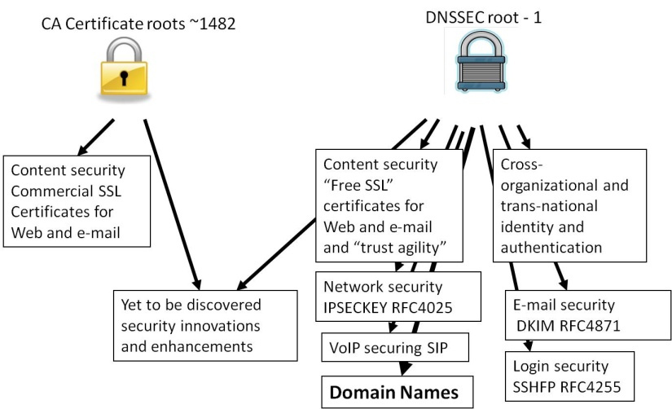
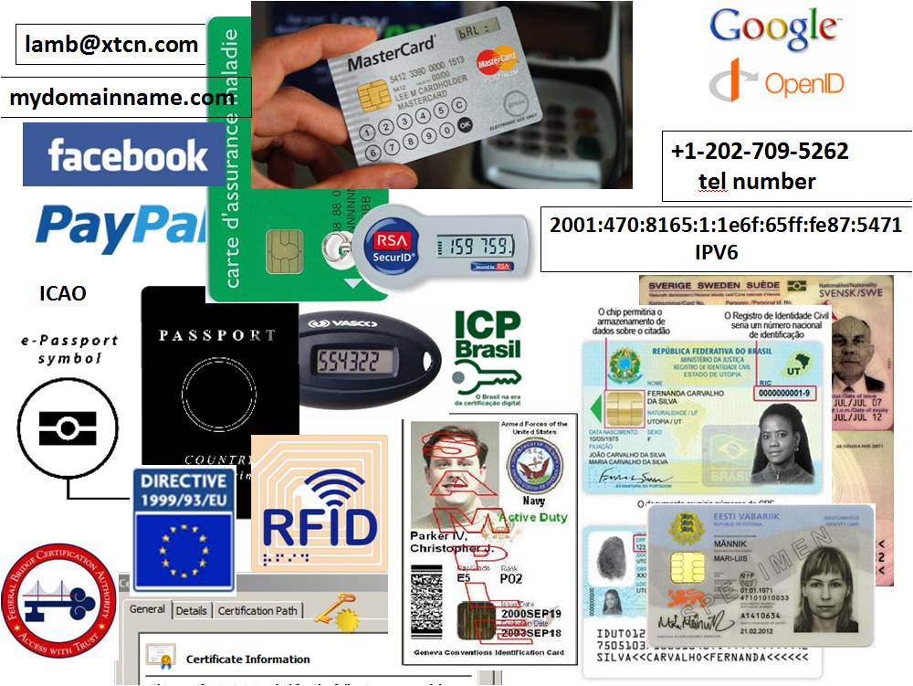
Opportunity: New Security Products
Improved Web SSL and certificates for all*
Secured e-mail (S/MIME) for all*
Validated remote login SSH, IPSEC*
Securing VoIP
Cross organizational digital identity systems
Secured content delivery (e.g. configurations, updates, keys)
Securing Smart Grid efforts
A global PKI
Increasing trust in e-commerce
A good ref http://www.internetsociety.org/deploy360/dnssec/
*IETF standards complete or currently being developed
Notes:
Configuration data examples: anti-virus signatures, blacklists, etc…
Imagine if you could trust “the ‘Net” – again?

Slide 17
DNSSEC: Internet infrastructure upgrade to help address today’s needs and create tomorrow’s opportunity.

Slide 18
The Internet’s Phone Book - Domain Name System (DNS+DNSSEC)
www.majorbank.se = 1.2.3.4
www.majorbank.se=?
DNS Resolver
DNS
Server
1.2.3.4
Get page
webserverwww @ 1.2.3.4
Login page
Username / Password
Account Data
ISP/ HotSpot / Enterprise/ End Node
Majorbank.se (Registrant)
DNS
Server
.se (Registry)
DNS
Server
Animated slide
. (Root)
Notes:
Actually MANY phone books

