Slide 1
DNSSEC Sample Implementation
MENOG 10 Workshop
22 April 2012, Dubai
richard.lamb@icann.org

Slide 2
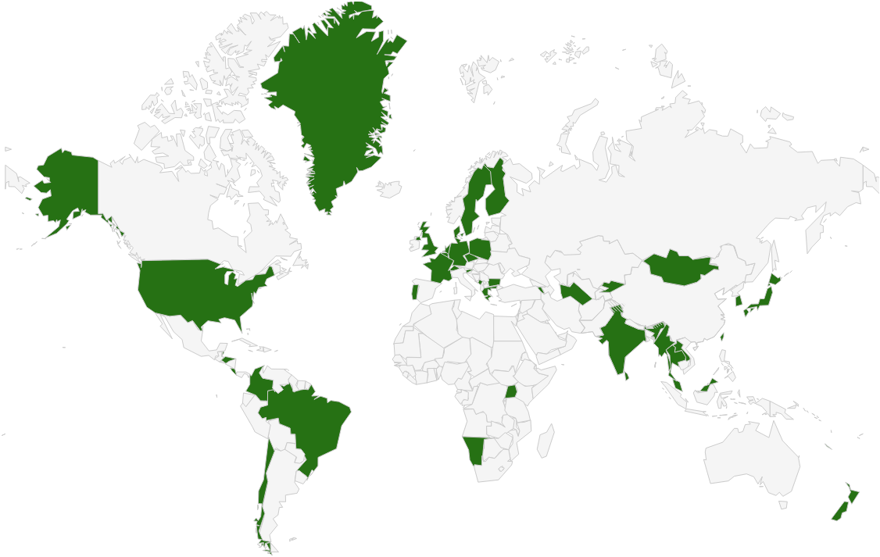

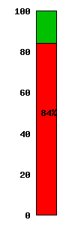
DNSSEC: Where we are
Deployed on 86/313 TLDs (.uk, .fr, .asia, .in, .lk, .kg, .tm, .am, .tw 台灣 台湾, .jp, .cr, .com,…)
Root signed and audited
84% of domain names could have could have DNSSEC deployed on them
Large ISP has turned DNSSEC validation “on”*
A few 3rd party signing solutions (e.g., GoDaddy, VeriSign, Binero,…)
Unbound, BIND, DNSSEC-trigger, vsResolver and other last mile. DANE work almost done
*10 Jan 2012 - All 18M COMCAST Internet customers. Others..TeliaSonera SE,
Vodafone CZ,Telefonica, CZ, T-mobile NL, SurfNet NL
Notes:
DNS over HTTP Chrome-ish, proprietary solutions: MSFT active directory, OpenDNS
All 18M COMCAST Internet customers. Also TeliaSonera SE, Vodafone, Telefonica, CZ, T-mobile NL
US ISP Comcast DNSSEC deployment plan for 18M customers and >5000 domain names http://blog.comcast.com/2011/12/dnssec-deployment-update.html .
http://www.icann.org/en/news/in-focus/dnssec/deployment

Slide 3
Game changing Internet Core Infrastructure Upgrade
“More has happened here today than meets the eye. An infrastructure has been created for a hierarchical security system, which can be purposed and re‐purposed in a number of different ways. ..” – Vint Cerf

Slide 4

Resultant Global PKI
SSL (DANE), E-mail, VOIP security…
CA Certificate roots ~1482
DNSSEC root - 1
Content security “Free SSL” certificates for Web and e-mail and “trust agility” (DANE)
Cross-organizational and trans-national identity and authentication
Content security Commercial SSL Certificates for Web and e-mail
Network security IPSECKEY RFC4025
Yet to be discovered security innovations, enhancements, and synergies
E-mail security
DKIM RFC4871
Securing VoIP
Login security SSHFP RFC4255
Domain Names
https://www.eff.org/observatory
http://royal.pingdom.com/2011/01/12/internet-2010-in-numbers/
Notes:
With so many, trust is diluted. Used to be good when there were fewer.
Any one can encrypt. Few can Identify : Encryption != Identity
Comodo, MD5 crack, etc..
Fact is that DNS has been unfortunately used as an independent authentication tool for some time: e.g. email authentication
Build and improve on established trust models, e.g., CAs
Greatly expanded SSL usage (currently ~4M/200M)
Make SMIME (secured email) a reality. All email packages already have support for this. They just don’t have a way to distribute keys. /w DNSSEC – now they do.
May work in concert with in enhancing or extending other cyber security efforts like digital Identities, WebID, BrowserID, CAs, ..
Securing VoIP
Simplify WiFi roaming security
Secure distribution of configurations (e.g., blacklists, anti-virus sigs)

Slide 5
Design Considerations

Slide 6
Goals
Reliable
Trusted
Cost Effective (for you)
Notes:
Trust – learn from existing formal IT security practices like SysTrust Principles: “Security, Availability,
Processing Integrity, Confidentiality, and Privacy”

Slide 7
Cost Effectiveness

Slide 8
Cost Effectiveness
Risk Assessment
Cost Benefit Analysis

Slide 9
Business Benefits and Motivation
(from “The Costs of DNSSEC Deployment” ENISA report)
Become a reliable source of trust and boost market share and/or reputation of zones;
Lead by example and stimulate parties further down in the chain to adopt DNSSEC;
Earn recognition in the DNS community and share knowledge with TLD’s and others;
Provide assurance to end-user that domain name services are reliable and trustworthy;
Look forward to increasing adoption rate when revenue is an important driver. Deploying DNSSEC can be profitable;

Slide 10
Risk Assessment
Identify your risks
  Reputational
    Competition
    Loss of contract
  Legal / Financial
    Who is the relying party?
    SLA
    Law suits
Build your risk profile
  Determine your acceptable level of risk
Notes:
Acceptable level of risk - e.g. reputtation: no-compromise; An attack can only take place if key compromise goes unnoticed. Can recover otherwise.; Be real: will not protect against terrorist attack; internal collusion – pick a number: 1 in a million?; irrelevancy/non-use: stakeholder involvement.

Slide 11
Vulnerabilities
False expectations
Key compromise
Signer compromise
Zone file compromise
Notes:
False expectations – e.g. lack of “SLA” and or “DPS” to set expectations on compromise recovery for child key (how long) as well as for parent keying material (backup keys, how long). No one can offer perfect security. But
Involve stakeholders to minimize reputational / legal risks.
Insecure DS handling – broken chain of trust
Private key compromise: bad rng, too short; background checks?, threats, bribed -> collusion
bad Signer: unvalidated s/w; vulnerable code.
Undetermined: loss of chain of custody (careless handling, sabotage, environment, access control failure, structure weakness, collusion)

Slide 12
Cost Benefit Analysis
Setting reasonable expectations means it doesn’t have to be expensive

Slide 13
From ENISA Report
“….organizations considering implementing DNSSEC can greatly benefit from the work performed by the pioneers and early adopters.”
Few above 266240 Euros: Big Spenders: DNSSEC as an excuse to upgrade all infrastructure; embrace increased responsibility and trust through better governance.
Most below 36059 Euros: Big Savers: reuse existing infrastructure. Do minimum.

Slide 14
Anticipated Capital and Operating Expense
Being a trust anchor requires mature business processes, especially in key management;
Investment cost also depends on strategic positioning towards DNSSEC: leaders pay the bill, followers can limit their investment;
Financial cost might not outweigh the financial benefits. Prepare to write off the financial investment over 3 to 5 years, needed to gear up end-user equipment with DNSSEC.

Slide 15
Other Cost Analysis
People
  Swedebank – half a FTE
  Occasional shared duties for others
Facilities
  Datacenter space
  Safe ~ $100 - $14000
Crypto Equip ~ $5-$40000
Bandwidth ~ 4 x
http://www.internetdagarna.se/arkiv/2008/www.internetdagarna.se/images/stories/doc/22_Kjell_Rydger_DNSSEC_from_a_bank_perspective_2008-10-20.pdf
Notes:
http://www.internetdagarna.se/arkiv/2008/www.internetdagarna.se/images/stories/doc/22_Kjell_Rydger_DNSSEC_from_a_bank_perspective_2008-10-20.pdf
Too much?
Outsource all
Opportunity for some

Slide 16
Trusted

Slide 17
Trust
Transparent
Secure

Slide 18
Transparency

Slide 19
Transparency
The power of truth
    Transparency floats all boats here
Say what you do
Do what you say
Prove it

Slide 20
Say what you do
Setting expectations
Document what you do and how you do it
Maintain up to date documentation
Define Organization Roles and responsibilities
Describe Services, facilities, system, processes, parameters

Slide 21


Learn from CA successes (and mistakes)
The good:
  The people
  The mindset
  The practices
  The legal framework
  The audit against international accounting and technical standards
The bad:
  Diluted trust with a race to the bottom (>1400 CA’s)
  DigiNotar
    Weak and inconsistent polices and controls
    Lack of compromise notification (non-transparent)
    Audits don’t solve everything (ETSI audit)
Notes:
The people: e.g., Tomofumi Okubo, Fredrik Lundgren, Paul Hoffman, David Miller (AEP)
The people (those willing to share in this secret art)
The mindset (trust in process. not people)
The practices (physical, logical, cryptographic security)
The legal framework (setting expecations. liability limitations)
HEBC/USHER – US university system PKI example.
SysTrust similar to WebTrust – economies of similarity. Number of SSL: 4M/200+M sites Could have many more. Many countries use VRSN for govt dig sign. Why not own country?
ETSI failed for DigiNotar

Slide 22
Say What You Do - Learn from Existing Trust Services
Borrow many practices from SSL Certification Authorities (CA)
  Published Certificate Practices Statements (CPS)
    VeriSign, GoDaddy, etc..
  Documented Policy and Practices (e.g., key management ceremony, audit materials, emergency procedures, contingency planning, lost facilities, etc…)
Notes:
Learn from existing formal IT security practices.
CPS and instructive CA key/backup document for HEBCA: http://usher.internet2.edu/practices/ca1/cps.pdf http://tinyurl.com/34zzmne
CA’s are a good start (they know the trust business) but most of internal Practices are kept private.
Line between current CA offerings and DNS will become blurred – but real CAs provide critical value on the ground, e.g., EV certs.
Note: Cant just copy CPS – usually copyrighted.

Slide 23
Say What You Do - DNSSEC Practices Statement
DNSSEC Policy/Practices Statement (DPS)
  Drawn from SSL CA CPS
  Provides a level of assurance and transparency to the stakeholders relying on the security of the operations.
  Regular re-assessment
  Management signoff
    Formalize - Policy Management Authority (PMA)
Notes:
Policy may be used by TLD mgrs or regulatory authorities to express requirements to registry operator.
Or may simply be the registry’s own standards to follow.
May be one document or two.
RFC for DNS framework / check list in draft (Fredrik Lundgren)
Examples: SE DPS http://www.iis.se/docs/se-dnssec-dps-eng.pdf Root http://www.iana.org/dnssec
Describe PMA

Slide 24
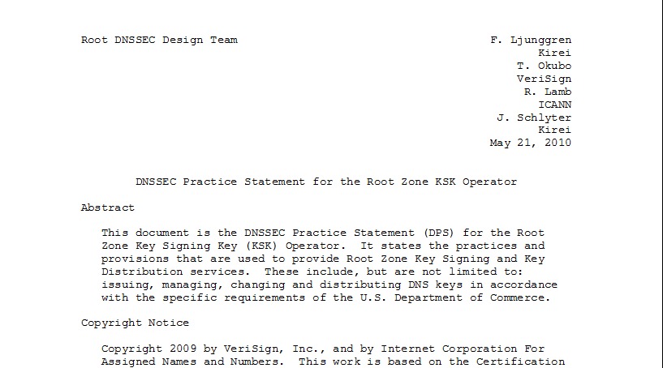
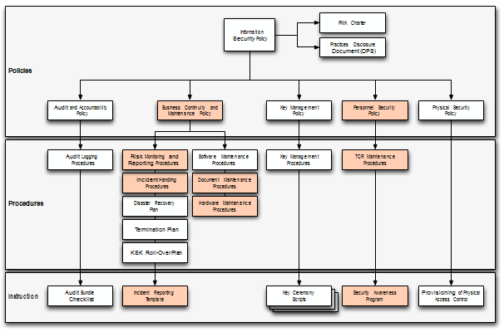
Documentation - Root
91 Pages and tree of other documents!
Root DPS
Notes:
Spells out multiparty controls (e.g., at least two)

Slide 25
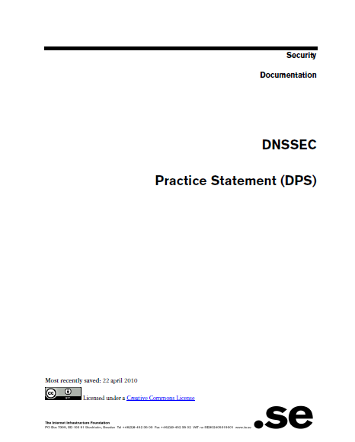
Documentation - .SE
22 pages, Creative Commons License!
.SE DPS
Notes:
Just go through and replace “SE” with “your TLD” for a great starting point for your lawyers.
**BR just had checklists. Bottom line – transparency buys trust.

Slide 26
Do what you say
Follow documented procedures / checklists
Maintain logs, records and reports of each action, including incidents.
Critical operations at Key Ceremonies
  Video
  Logged
  Witnessed

Slide 27
Key Ceremony
A filmed and audited process carefully scripted for maximum transparency at which cryptographic key material is generated or used.
Notes:
Point to root zone key ceremonies document

Slide 28

Prove it
Audits
  3rd party auditor $$
  ISO 27000 $$ etc..
  Internal

Slide 29
Prove it - Audit Material
Key Ceremony Scripts
Access Control System logs
Facility, Room, Safe logs
Video
Annual Inventory
Logs from other Compensating Controls
Incident Reports
Notes:
Some elements above may need to be attested to or signed by management as determined by auditor.
Logs should have entry/exit, open/close, removal/return.
Compensating Controls are your friend – other logs, logging, video etc…

Slide 30
Prove it
Stakeholder Involvement
  Publish updated material and reports
  Participation, e.g. External Witnesses from
      local Internet community
      Government
  Listen to Feedback

Slide 31
Prove it
Be Responsible
  Executive Level Involvement
    In policies via Policy Management Authority
    Key Ceremony participation

Slide 32
Security

Slide 33
Security
Physical
Logical
Crypto

Slide 34
Physical
  Environmental
  Tiers
  Access Control
  Intrusion Detection
  Disaster Recovery

Slide 35
Physical - Environmental
Based on your risk profile
Suitable
  Power
  Air Conditioning
Protection from
  Flooding
  Fire
  Earthquake
Notes:
California reference – risk profile balances operational, cost, and environmental

Slide 36
Physical - Tiers
Each tier should be successively harder to penetrate than the last
  Facility
  Cage/Room
  Rack
  Safe
  System
Think of concentric boxes

Slide 37
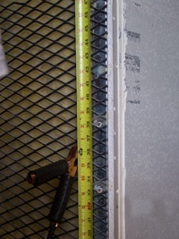
Physical - Tier Construction
Base on your risk profile and regulations
Facility design and physical security on
  Other experience
  DCID 6/9
  NIST 800-53 and related documents
  Safe / container standards
Notes:
Terrorist attack – not protected
Undetected access is worst case
Safe story
EMI – don’t care if HSM rated
Local regulations (e.g. fire)
DCID and various other hard to learn from sources: 9 gague stretched steel, real floor to real ceiling.
DNSSEC at root is rare in that we are sharing such info with public – call it a dividend to the public

Slide 38
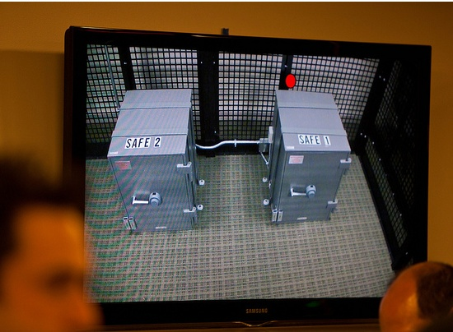
Physical – Safe Tier
Notes:
M of N was 3-of-7 plus SSSC1 SSC2 and multi-person access control to facility

Slide 39
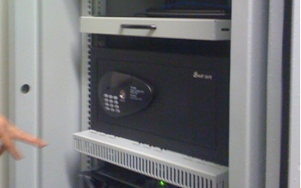
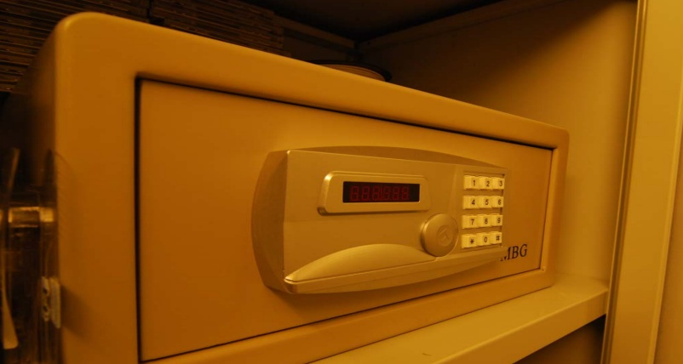
Physical – Safe Tier
Notes:
Looks like your hotel safe – huh. My suggestion – no batteries.

Slide 40
Physical - Access Control
Base on your risk profile
Access Control System
  Logs of entry/exit
  Dual occupancy / Anti-passback
  Allow Emergency Access
High Security: Control physical access to system independent of physical access controls for the facility
Notes:
Facility is ID + guard – log book
Safe is combination – log sheet
Tiers are card+pin+biometric – ACS logging
All filmed by at least facility

Slide 41
Physical - Intrusion Detection
Intrusion Detection System
  Sensors
  Motion
  Camera
Tamper Evident Safes and Packaging
Tamper Proof Equipment
Notes:
Facility: Manned, video monitor (and archived), monitor access to racks/cage/room
Sensors – door, seismic, water
Risk assessment – worst case: undetected/ unnoticed. So focus on detecting where total prevention is impossible. …and have mechanism to recover from compromise.

Slide 42
Physical - Disaster Recovery
Multiple sites
  Mirror
  Backup
Geographical and Vendor diversity
Notes:
Availability !!! So two sites AND backup of material.
Multiple sites from different facility providers.
Off site Backup could be a bank safe deposit box holding a smartcard in a tamper evident bag.

Slide 43
Logical
Authentication (passwords, PINs)
Multi-Party controls
Notes:
Risk:
lost/guessed password
Collusion

Slide 44
Logical - Authentication
Procedural:
  REAL passwords
  Forced regular updates
  Out-of-band checks
Hardware:
  Two-factor authentication
  Smart cards (cryptographic)
Notes:
Risk: guessed password
Password best practices can be found in various commercial standards PCI
Most of this slide is critical for the “child” user interface (that does not benefit from any physical security) for submitting DS records.
Out of band may be an automated phone call or FAX like many services (e.g. GoDaddy, name.com – “courtesy” call) do.
Pass out various embodiments…
In the case of compromise, Out-of-band authentication mechanism is necessary (e.g. should attacker use compromised key to facilitate a legitimate dnskey/ds rollover) - true for parent or child relationship

Slide 45
Logical - Multi-Party Control
Split Control / Separation of Duties
  E.g., Security Officer and System Admin and Safe Controller
M-of-N
  Built in equipment (e.g. HSM)
  Procedural: Split PIN
  Bolt-On: Split key (Shamir, e.g. ssss.c)
Notes:
Risk: Collusion
Separation of Duties: Different departments in same org or different orgs
Explain split PIN and split-key
Can combine ACS+Safe+MofN to greatly reduce collusion probability

Slide 46
Crypto
Algorithms / Key Length
Crypto Hardware

Slide 47
Crypto - Algorithms / Key Length
Factors in selection
  Cryptanalysis
  Regulations
  Network limitations

Slide 48
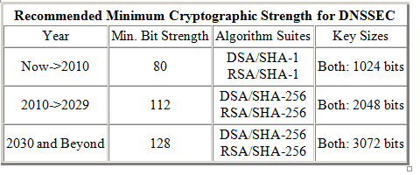
Crypto - Key Length
Cryptanalysis from NIST: 2048 bit RSA SHA256
http://csrc.nist.gov/publications/nistpubs/800-57/sp800-57_PART3_key-management_Dec2009.pdf
Notes:
NIST
http://csrc.nist.gov/publications/nistpubs/800-57/sp800-57_PART3_key-management_Dec2009.pdf
Root rollout did force resolver upgrade to sha256…

Slide 49
Crypto - Algorithms
Local regulations may determine algorithm
  GOST
  DSA
Network limitations
  Fragmentation means shorter key length is better
  ZSK may be shorter since it gets rolled often
  Elliptical is ideal – but not available yet
Notes:
Signature churn not a problem with RSA 1024 or higher
If problems with 1024 – we have a much bigger problem than DNSSEC.
FWIW: RSA 1024 ~ 6 mo – other anecdotal notes, 10 years estimated, 2048 is ok
Elliptical is encumbered by patent rights but cryptographers love it. It may become standard after a few (>5) years
BTW GOST is elliptical…

Slide 50
Crypto - Algorithms
NSEC3 if required
  Protects against zone walking
  Avoid if not needed – adds overhead for small zones
  Non-disclosure agreement?
  Regulatory requirement?
  Useful if zone is large, not trivially guessable (only “www” and “mail”) or structured (ip6.arpa), and not expected to have many signed delegations (“opt-out” avoids recalculation).
Notes:
Use a dynamic / incremental signing solution for the large zones? BIND 9.7.x

Slide 51
Crypto - Hardware
Satisfy your stakeholders
  Doesn’t need to be certified to be secure (e.g., off-line PC)
  Can use transparent process and procedures to instill trust
  But most Registries use or plan to use HSM. Maybe CYA?
AT LEAST USE A GOOD Random Number Generator (RNG)!
Use common standards avoid vendor lock-in.
  Note: KSK rollover may be ~10 years.
Remember you must have a way to backup keys!
Notes:
Off-line PC: Your know secure64 is just a PC with a TPM chip that encrypts a bundle = FIPS 140-2 level 2
NO RNG = a vulnerability. "random numbers too important to be left for chance."
Backup keys – cant use on smartcard key gen. Bad policy if HSM vendor dies too. See CA HEBCA example.

Slide 52
Crypto - Hardware Security Module (HSM)
FIPS 140-2 Level 3
  Sun SCA6000 (~30000 RSA 1024/sec) ~$10000 (was $1000!!)
  Thales/Ncipher nshield (~500 RSA 1024/sec) ~$15000
FIPS 140-2 Level 4
  AEP Keyper (~1200 RSA 1024/sec) ~$15000
  IBM 4765 (~1000 RSA 1024/sec) ~$9000
Recognized by your national certification authority
  Kryptus (Brazil) ~ $2500
Study: http://www.opendnssec.org/wp-content/uploads/2011/01/A-Review-of-Hardware-Security-Modules-Fall-2010.pdf

Slide 53
Crypto - PKCS11
A common interface for HSM and smartcards
  C_Sign()
  C_GeneratePair()
Avoids vendor lock-in - somewhat
Vendor Supplied Drivers (mostly Linux, Windows) and some open source

Slide 54
Crypto - Smartcards / Tokens
Smartcards (PKI) (card reader ~$20)
  Oberthur ~$5-$15
  AthenaSC IDProtect ~$35
  Feitian ~$5-10
Token
  Aladdin/SafeNet USB e-Token ~$50
  SDencrypter micro HSM www.go-trust.com
Open source PKCS11 Drivers available
  OpenSC
Has RNG
Slow ~0.5-10 1024 RSA signatures per second

Slide 55
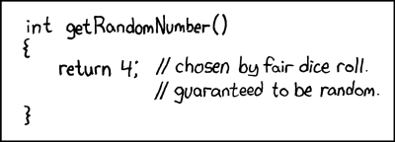

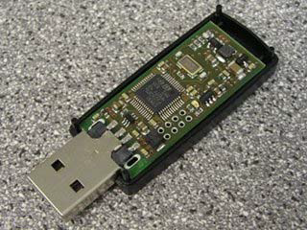
Crypto -Random Number Generator
rand()
Netscape: Date+PIDs
LavaRand
System Entropy /dev/random
Quantum Mechanical $
Standards based (FIPS, NIST 800-90 DRBG)
Coming soon: Intel atomic

Slide 56
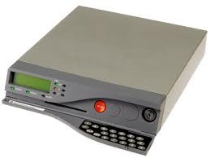
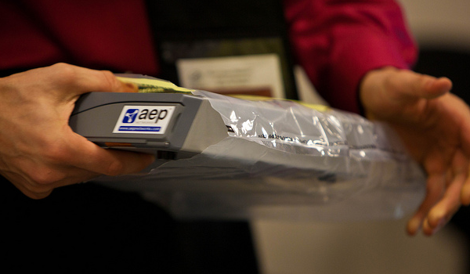
Crypto - FIPS 140-2 Level 4 HSM
Root, .FR, …

Slide 57
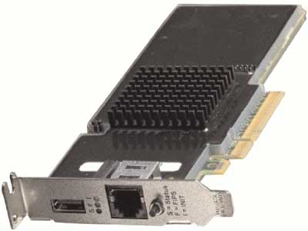
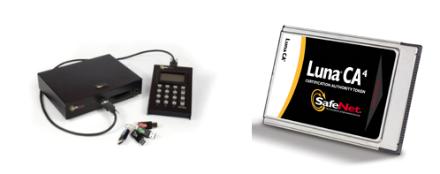
Crypto – FIPS Level 3 HSM
But FIPS 140-2 Level 3 is also common
Many TLDs using Level 3 .com , .se, .uk, .com, etc… $10K-$40K
HSMs (ENISA)

Slide 58

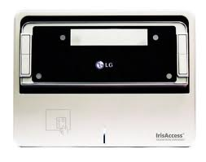
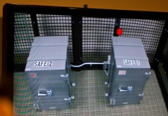
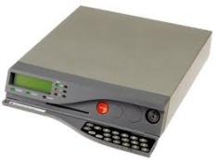
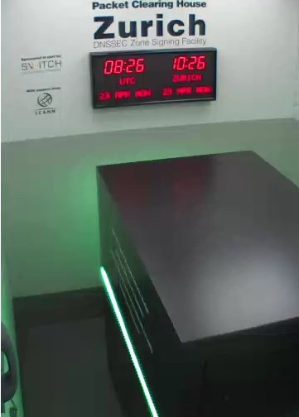
An implementation can be thi$
Notes:
FR, NZ, root, com, UK, DCID 6/9
http://www.pch.net/dnssec/zrh

Slide 59
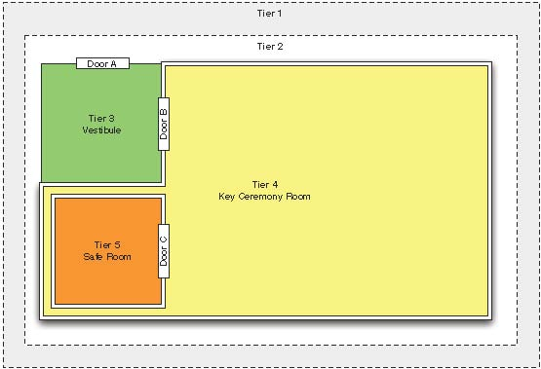
Physical Security

Slide 60
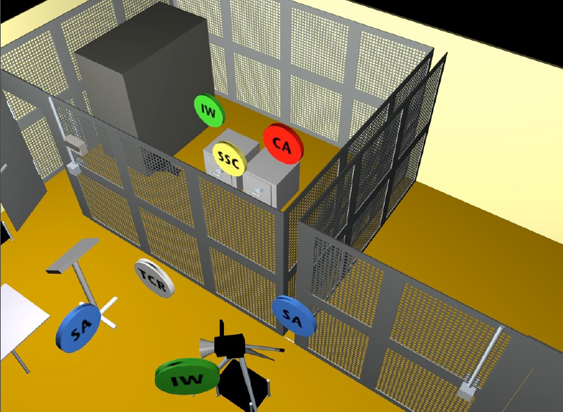

Slide 61
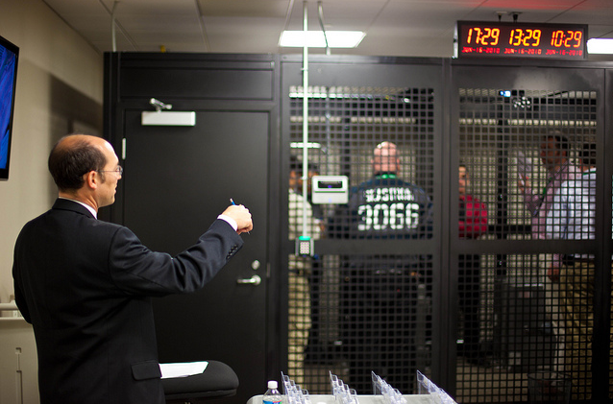
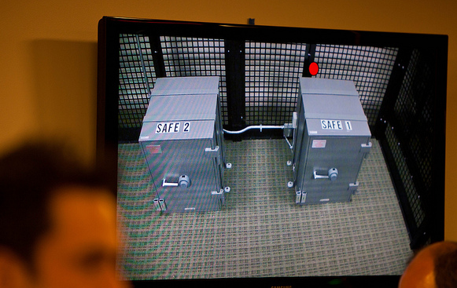
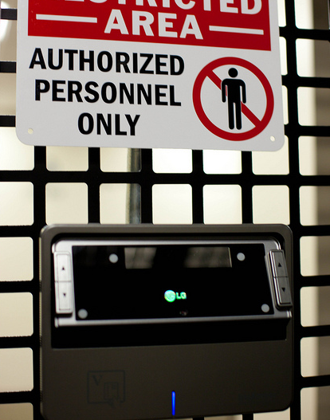
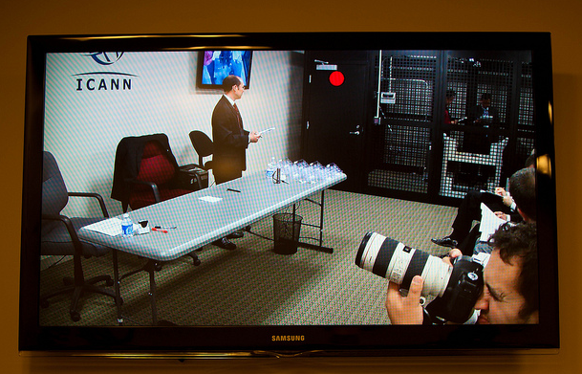
http://www.flickr.com/photos/kjd/sets/72157624302045698/

Slide 62
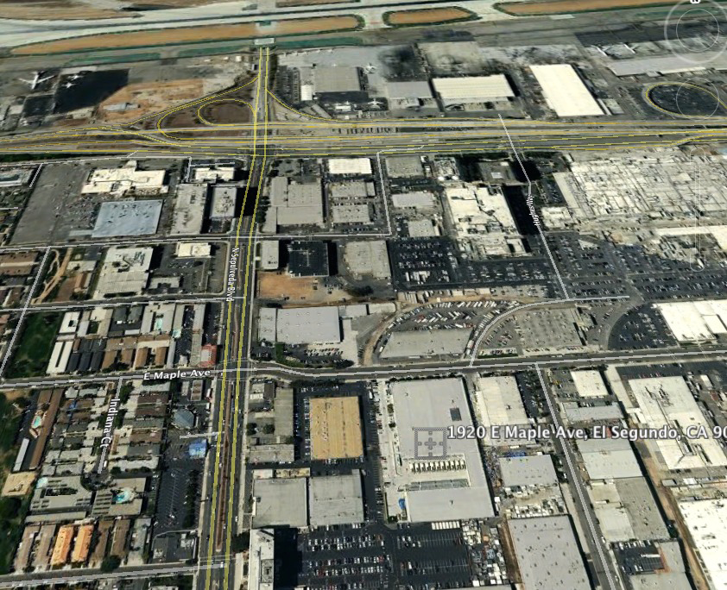

Slide 63
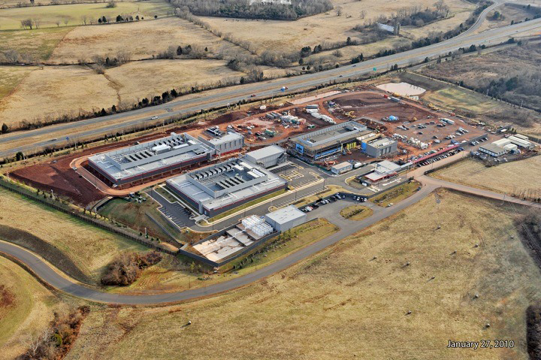

Slide 64
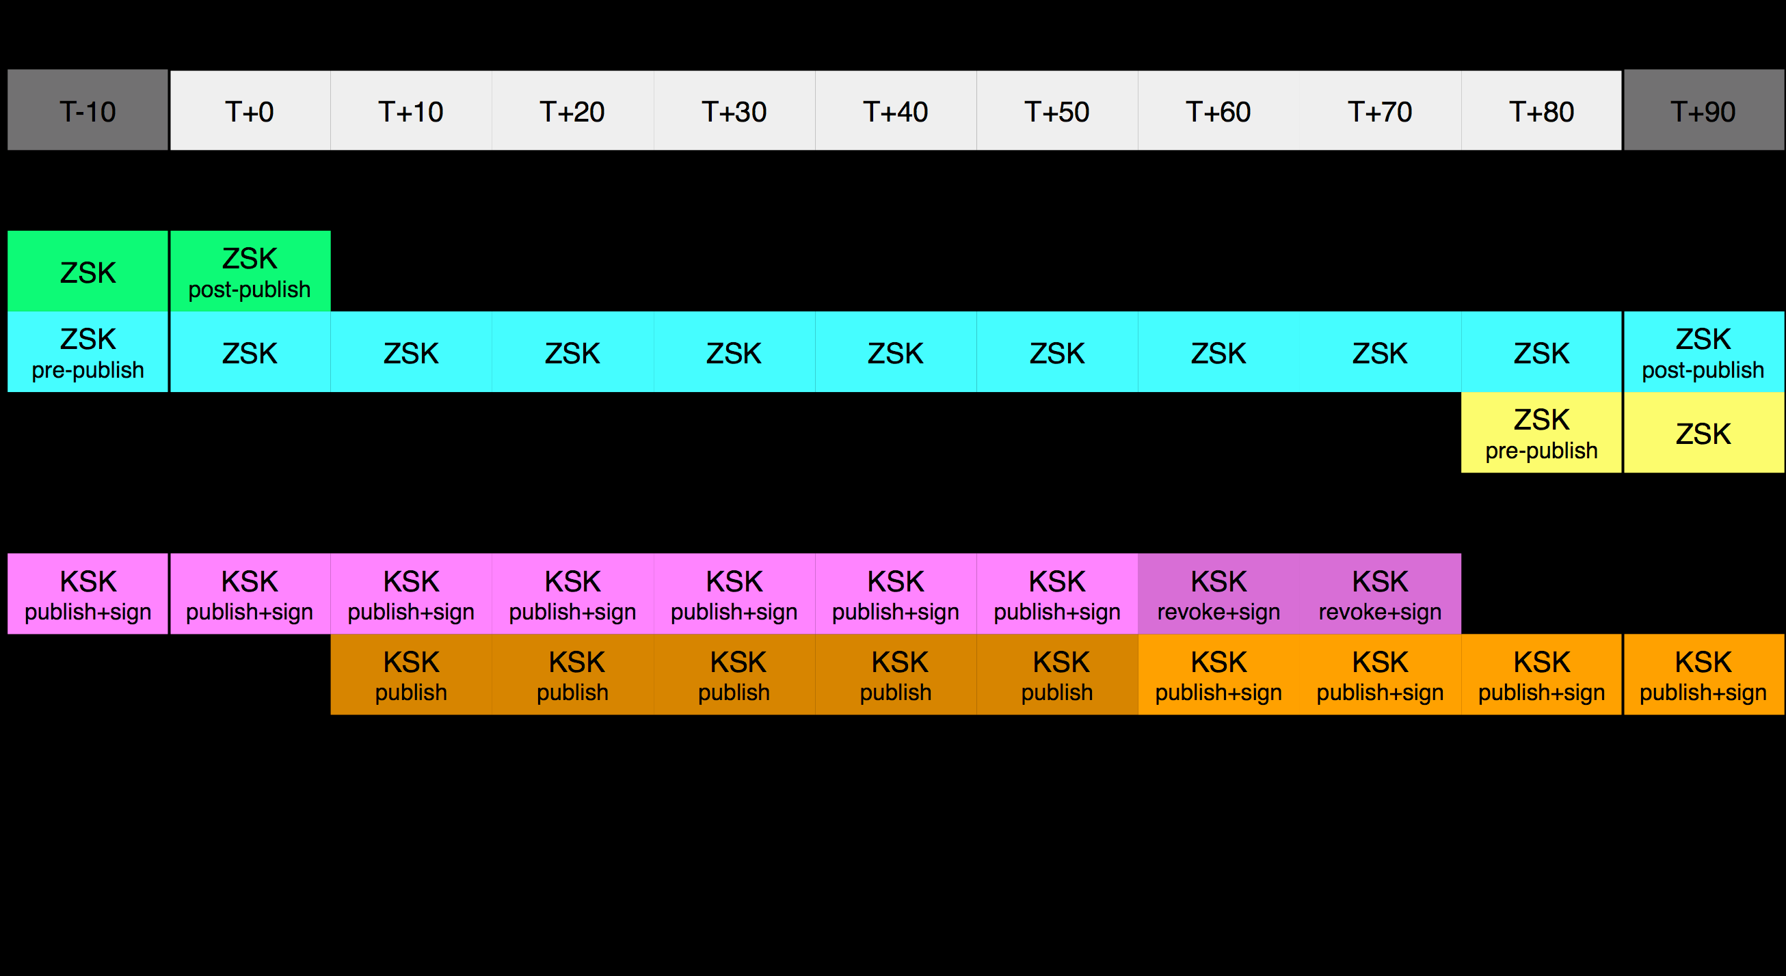
Key Rollover Schedule - Root
https://www.iana.org/dnssec

Slide 65
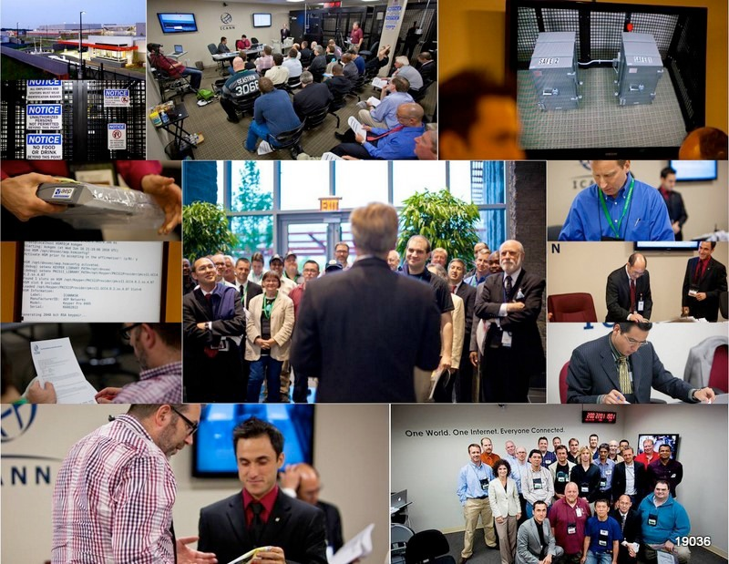
Notes:
Fips 140-2 level 4
Gsa class 5
Biometrics
Multi-person control
Publicly documented
Draw from CA
Dcid 6/9 9 gauge mesh drywall

Slide 66


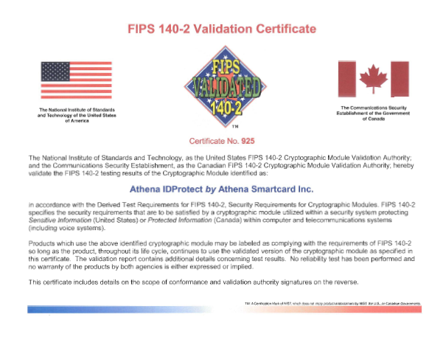
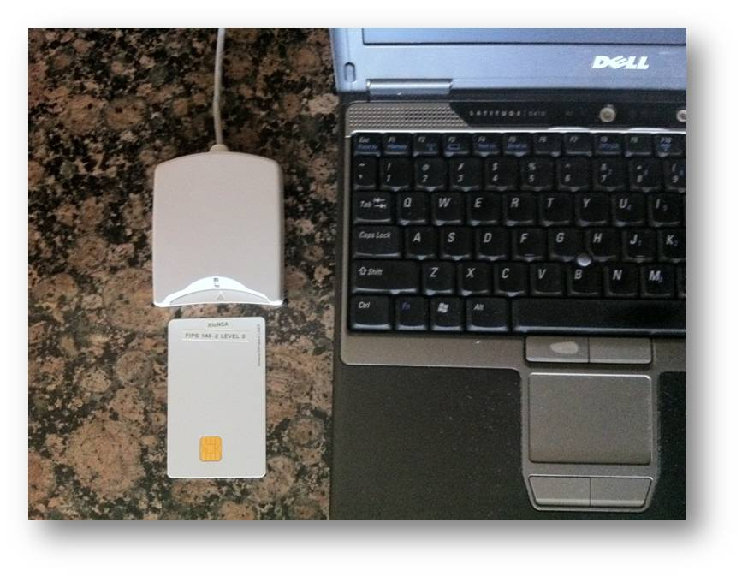
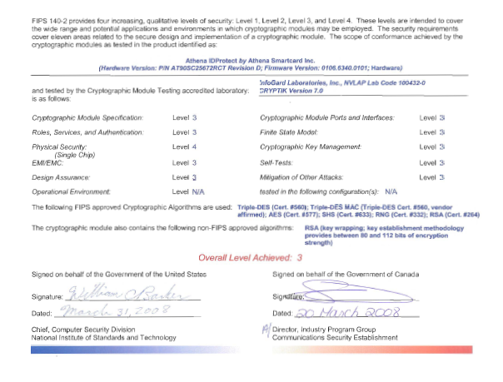
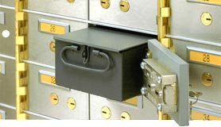
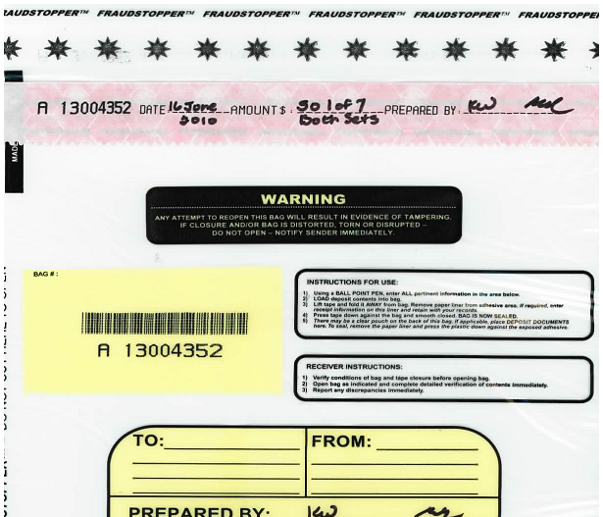
…or this
+
TPM
Notes:
JP, old SE, new CR

Slide 67
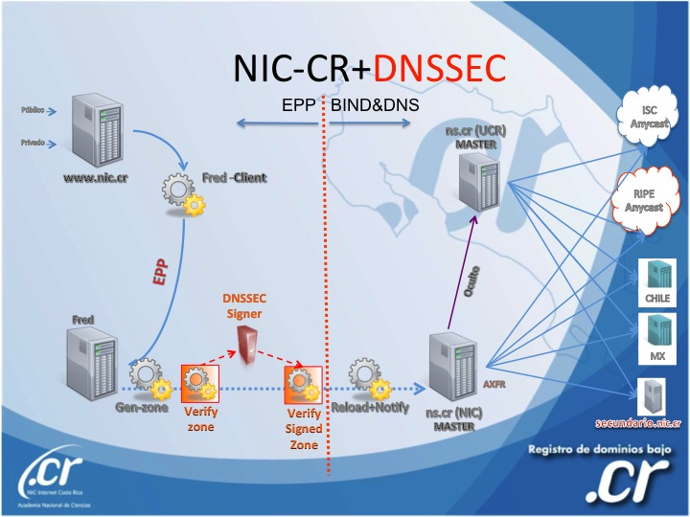
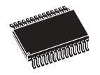
..or this (from .cr)
Transport KSK signed DNSKEY RRsets
unsigned
zone
Sign ZSKs with KSK
Sign zones with ZSK
Offline Laptop with TPM
Online/off-net DNSSEC Signer with TPM
signed
zone
KSK
Transport public half of ZSKs
Generate KSK
ZSKs
Generate ZSKs
Secure Off-line Environment
Notes:
9 March 2012
…and bnonline.fi.cr
http://www.nacion.com/2012-03-15/Tecnologia/Sitios-web-de-bancos-ticos-podran-ser-mas-seguros.aspx

Slide 68
Demo Implementation
Key lengths – KSK:2048 RSA ZSK:1024 RSA
Rollover – KSK:as needed ZSK:90 days
RSASHA256 NSEC3
Physical – HSM/smartcards inside Safe inside Rack inside Cage inside Commercial Data Center
Logical – Separation of roles: cage access, safe combination, HSM/smartcard activation across three roles
Crypto – use FIPS certified smartcards as HSM and RNG
  Generate KSK and ZSK offline using RNG
  KSK use off-line
  ZSK use off-net

Slide 69
Off-Line Key generator and KSK Signer
DATA CENTER
CAGE
RACK
smartcards
SAFE
Flash Drive
KSK+RNG
Live O/S DVD
KSK signed DNSKEYs
Encrypted ZSKs
KSK+RNG
reader
laptop
KSK+RNG

Slide 70
Off-Net Signer
DATA CENTER
CAGE
RACK
zonefile
hidden master
Flash Drive
nameserver
KSK signed DNSKEYs
Encrypted ZSKs
nameserver
signer
firewall
hidden master
nameserver

Slide 71
Key Management
Transport KSK signed DNSKEY RRsets
Sign ZSKs with KSK
unsigned
zone
Sign zones with ZSK
Offline Laptop
and Encrypted ZSKs
Online/off-net DNSSEC Signer
signed
zone
Generate ZSKs
KSK
Generate KSK
Secure Key Generation and Signing Environment

