Slide 1
DNSSEC Implementation
Module 1
MENOG 10 Workshop
22 April 2012, Dubai
richard.lamb@icann.org

Slide 2
Overview
Design Considerations
Demo Implementation
DNSSEC Practices Statement
Demo
Outputs
  Demo Implementation
  Demo DNSSEC Practice Statement
  Demo Key Ceremony Scripts

Slide 3
DNSSEC Update

Slide 4
DNSSEC Update
< 1% DNSSEC still needs to deployed on more domain names.
86/313 top level domain (e.g., .com) have DNSSEC deployed. Internal ICANN-only site:
84% of domain names can have DNSSEC deployed on them.
Notes:
Make it part of all registrations.
List – DE SE(banks) COM NET EDU GOV(USG/OMB-DHS mandate) BR(banks) BG FR
Some deployments have also focused on financial sectors.
Vendors are beginning to adopt DNSSEC into products. Support in MSFT.

Slide 5
BLACKHAT – Jeff Moss, Las Vegas August 04, 2011
Jeff Moss, told the Black Hat Technical Security conference in Las Vegas that now is the time for corporations and organizations to embrace DNSSEC.
If you only call us after the house is on fire, you have very few options, Moss told the conference in emphasizing the need for business to prioritize online security, including adoption of DNSSEC.
If you don’t have a corporate policy or strategy to sign your zone, you should, said Moss, who is the founder of the Black Hat conference. You're not only going to be helping your own organization, you're going to be helping the rest of the Internet.
http://www.itbusinessnet.com/article/ICANN-Security-Chief-Urges-Widespread-Adoption-of-DNSSEC-1620995
Notes:
A presentation last week even pointed out that H/W bit errors causing mis-direction e.g., mic2osoft.com and microsoft.com are common from automated processes – i.e. not fat fingered. Attackers could simply buy bit-squatting domains.

Slide 6
Basic HowTo
For Companies:
  Sign your corporate domain names
  Turn on validation on their DNS resolvers
For Users:
  Ask ISP to turn on validation on their DNS resolvers. (ISP in US with>18M has turned on validation)
For ccTLDs
  Do Yourself / Outsource / Somewhere in between
More Registrars need to support DNSSEC
Notes:
Build your own signer and submit keys to Registrar
Or use Godaddy service (they have home grown system)
Could cost as little as $2/year - VRSN
Popular resolvers all support DNSSEC validation. COMCAST ISP with its 18M customers has turned it on.
Do yourself or ccTLD = Free with PCH as learning and stepping stone to self deployment, or partway
You have many options

Slide 7
Game changing Internet Core Infrastructure Upgrade
“More has happened here today than meets the eye. An infrastructure has been created for a hierarchical security system, which can be purposed and re‐purposed in a number of different ways. ..” – Vint Cerf

Slide 8
Opportunity
Looks like we now have a global, secure database for “free”!
A globally trusted Public Key Infrastructure
Enabler for global security applications
An authentication platform for identification
  Identifying the threat is a key obstacle for cyber security efforts.
Cross-organizational and trans-national
.. A global platform for innovation
Notes:
DNS was already used for verifying accounts, domains, and many other things it shouldn’t have been used for.
With DNSSEC it is now secured.
Never had a global PKI before….
NCIS DEFCON report indicates identity and ipv6 are key.

Slide 9

Sources of Trust on the Internet
CA Certificate roots ~1482
DNSSEC root - 1
Content security Commercial SSL Certificates for Web and e-mail
Content security “Free SSL” certificates for Web and e-mail and “trust agility”
Cross-organizational and trans-national identity and authentication
Network security IPSECKEY RFC4025
Yet to be discovered security innovations and enhancements
E-mail security
DKIM RFC4871
VoIP securing SIP
Login security SSHFP RFC4255
Domain Names
Notes:
With so many, trust is diluted. Used to be good when there were fewer.
Any one can encrypt. Few can Identify : Encryption != Identity
Comodo, MD5 crack, etc..
Fact is that DNS has been unfortunately used as an independent authentication tool for some time: e.g. email authentication

Slide 10
One effort: DANE in IETF
Free SSL Certificates
  Currently ~4M out of 255M sites use SSL. Y-not all?
Improved security for existing and high security (EV) Certificates
  Extra protection around recent CA mistakes
Secure e-mail - S/MIME
  Mature but unused due to difficult PKI deployment.
Timeframe? ~2 years
https://www.eff.org/observatory
http://royal.pingdom.com/2011/01/12/internet-2010-in-numbers/
Notes:
Good collaboration between CA and DNSSEC engineers.
CA’s bring skill to this field. EV certs.
From EFF SSL Observatory and DEFCON 2010 papers
https://www.eff.org/observatory
http://royal.pingdom.com/2011/01/12/internet-2010-in-numbers/
COMODO mistake: reseller signed cert for “mail.google.com” among other things
Independent efforts also exist in Google Chrome browser and Dan Kaminsky

Slide 11
Opportunity for Indigenous Certification Authorities
CAs located in only 52 countries
  'AE', 'AT', 'AU', 'BE', 'BG', 'BM', 'BR', 'CA', 'CH', 'CL', 'CN', 'CO', 'CZ','DE', 'DK', 'EE', 'ES', 'EU', 'FI', 'FR', 'GB', 'HK', 'HU', 'IE', 'IL', 'IN', 'IS', 'IT', 'JP', 'KR', 'LT', 'LV', 'MK', 'MO', 'MX', 'MY', 'NL', 'NO', 'PL', 'PT', 'RO', 'RU', 'SE', 'SG', 'SI', 'SK', 'TN', 'TR', 'TW', 'UK', 'US', 'UY', 'WW', 'ZA'
Even then, some countries are not using their own CAs.
Synergy: Reduced barriers, Alignment with TLD and national interests, DNSSEC operations
Notes:
According to the EFF SSL Observatory datasets, the following countries have control of certificate authorities that are trusted by modern browsers. These are the two-letter ISO country codes included in the CA certificate. The fact that the certificate lists this country code is not a guarantee that the private key is actually in that country, or that the CA could be compelled to sign things by that country's government or laws, but it is highly indicative of that situation.
Macao – has its own 2048 bit CA in XP
 Isn’t used on the Internet*
 Doesn’t use Chinese or Portuguese CA either
 Signs government websites with commercial certificates from US and UK CAs

Slide 12
Achieving full potential
Someday critical industries will come to rely on DNSSEC (or not )-:
Need to focus on weak links in the chain of trust
Registrant →Registrar →Registry →Root
This will require secure IT practices and transparency
…and greater awareness for the consumer
Notes:
Security Confab – big problem is outsourcing. They are only liabl for up to the cost of the product. Your reputation is still on the line. You cannot hide behind the registrar.
Transparency and learning from past experiences (e.g., JNJ Tylenol case) is key.
This makes it a race to the top.

Slide 13
Design Considerations

Slide 14
Goals
Reliable
Trusted
Cost Effective (for you)
Notes:
Trust – learn from existing formal IT security practices like SysTrust Principles: “Security, Availability,
Processing Integrity, Confidentiality, and Privacy”

Slide 15
Cost Effectiveness

Slide 16
Cost Effectiveness
Risk Assessment
Cost Benefit Analysis

Slide 17
Business Benefits and Motivation
(from “The Costs of DNSSEC Deployment” ENISA report)
Become a reliable source of trust and boost market share and/or reputation of zones;
Lead by example and stimulate parties further down in the chain to adopt DNSSEC;
Earn recognition in the DNS community and share knowledge with TLD’s and others;
Provide assurance to end-user that domain name services are reliable and trustworthy;
Look forward to increasing adoption rate when revenue is an important driver. Deploying DNSSEC can be profitable;

Slide 18
Risk Assessment
Identify your risks
  Reputational
    Competition
    Loss of contract
  Legal / Financial
    Who is the relying party?
    SLA
    Law suits
Build your risk profile
  Determine your acceptable level of risk
Notes:
Acceptable level of risk - e.g. reputtation: no-compromise; An attack can only take place if key compromise goes unnoticed. Can recover otherwise.; Be real: will not protect against terrorist attack; internal collusion – pick a number: 1 in a million?; irrelevancy/non-use: stakeholder involvement.

Slide 19
Vulnerabilities
False expectations
Key compromise
Signer compromise
Zone file compromise
Notes:
False expectations – e.g. lack of “SLA” and or “DPS” to set expectations on compromise recovery for child key (how long) as well as for parent keying material (backup keys, how long). No one can offer perfect security. But
Involve stakeholders to minimize reputational / legal risks.
Insecure DS handling – broken chain of trust
Private key compromise: bad rng, too short; background checks?, threats, bribed -> collusion
bad Signer: unvalidated s/w; vulnerable code.
Undetermined: loss of chain of custody (careless handling, sabotage, environment, access control failure, structure weakness, collusion)

Slide 20
Cost Benefit Analysis
Setting reasonable expectations means it doesn’t have to be expensive

Slide 21
From ENISA Report
“….organizations considering implementing DNSSEC can greatly benefit from the work performed by the pioneers and early adopters.”
Few above 266240 Euros: Big Spenders: DNSSEC as an excuse to upgrade all infrastructure; embrace increased responsibility and trust through better governance.
Most below 36059 Euros: Big Savers: reuse existing infrastructure. Do minimum.

Slide 22
Anticipated Capital and Operating Expense
Being a trust anchor requires mature business processes, especially in key management;
Investment cost also depends on strategic positioning towards DNSSEC: leaders pay the bill, followers can limit their investment;
Financial cost might not outweigh the financial benefits. Prepare to write off the financial investment over 3 to 5 years, needed to gear up end-user equipment with DNSSEC.

Slide 23
Other Cost Analysis
People
  Swedebank – half a FTE
  Occasional shared duties for others
Facilities
  Datacenter space
  Safe ~ $100 - $14000
Crypto Equip ~ $5-$40000
Bandwidth ~ 4 x
http://www.internetdagarna.se/arkiv/2008/www.internetdagarna.se/images/stories/doc/22_Kjell_Rydger_DNSSEC_from_a_bank_perspective_2008-10-20.pdf
Notes:
http://www.internetdagarna.se/arkiv/2008/www.internetdagarna.se/images/stories/doc/22_Kjell_Rydger_DNSSEC_from_a_bank_perspective_2008-10-20.pdf
Too much?
Outsource all
Opportunity for some

Slide 24
Reliability

Slide 25
Reliability
Availability: Absolute time matters / Signatures expire: can not set and forget.
raiz. 135957 IN RRSIG DNSKEY 8 0 172800 20110913235959 20110830000000 19036 raiz.
mTOLwTC+jfhKi7P5V/zcLYLwjFUvOqTXGujYQVzeMCJdRlVdlYLxGUmM
..
Complexity: Key management: DNSSEC > DNS

Slide 26
Reliability
Ensuring Availability
  Automate
  Monitor
  Backup Sites
Taming Complexity
  Step-by-step checklists
  Rely on documented processes - not specialists

Slide 27
Reliability - Automation
Pre-gen key material and rollover schedules
  Pre-gen KSK signed DNSKEY RRsets
Scripts
  cronjob dnssec-signzone execution
  check zone before publication

Slide 28
Reliability - Monitor
Early Warning systems
  Impending RRsig expiration
  SOA serial sync between NS

Slide 29
Trusted

Slide 30
Trust
Transparent
Secure

Slide 31
Transparency

Slide 32
Transparency
The power of truth
    Transparency floats all boats here
Say what you do
Do what you say
Prove it

Slide 33
Say what you do
Setting expectations
Document what you do and how you do it
Maintain up to date documentation
Define Organization Roles and responsibilities
Describe Services, facilities, system, processes, parameters

Slide 34
Say What You Do - Learn from Existing Trust Services
Borrow many practices from SSL Certification Authorities (CA)
  Published Certificate Practices Statements (CPS)
    VeriSign, GoDaddy, etc..
    USHER HEBCA, Dartmouth
  Documented Policy and Practices (e.g., key management ceremony, audit materials, emergency procedures, contingency planning, lost facilities, etc…)
Notes:
Learn from existing formal IT security practices.
CPS and instructive CA key/backup document for HEBCA: http://usher.internet2.edu/practices/ca1/cps.pdf http://tinyurl.com/34zzmne
CA’s are a good start (they know the trust business) but most of internal Practices are kept private.
Line between current CA offerings and DNS will become blurred – but real CAs provide critical value on the ground, e.g., EV certs.
Note: Cant just copy CPS – usually copyrighted.

Slide 35
Say What You Do - DNSSEC Practices Statement
DNSSEC Policy/Practices Statement (DPS)
  Drawn from SSL CA CPS
  Provides a level of assurance and transparency to the stakeholders relying on the security of the operations.
  Regular re-assessment
  Management signoff
    Formalize - Policy Management Authority (PMA)
Notes:
Policy may be used by TLD mgrs or regulatory authorities to express requirements to registry operator.
Or may simply be the registry’s own standards to follow.
May be one document or two.
RFC for DNS framework / check list in draft (Fredrik Lundgren)
Examples: SE DPS http://www.iis.se/docs/se-dnssec-dps-eng.pdf Root http://www.iana.org/dnssec
Describe PMA

Slide 36
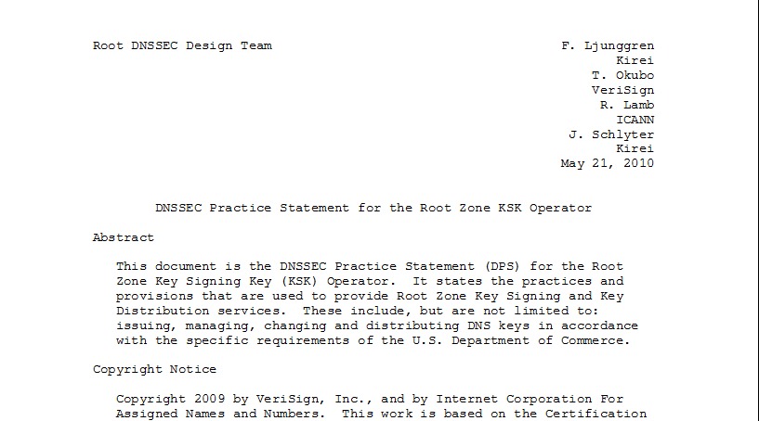
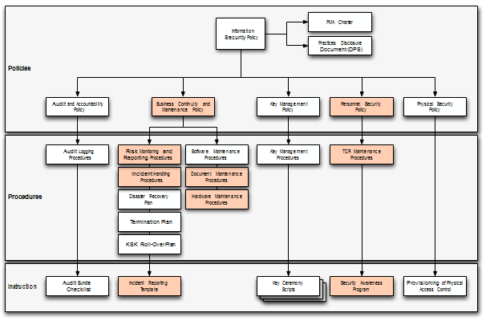
Documentation - Root
91 Pages and tree of other documents!
Root DPS
Notes:
Spells out multiparty controls (e.g., at least two)

Slide 37
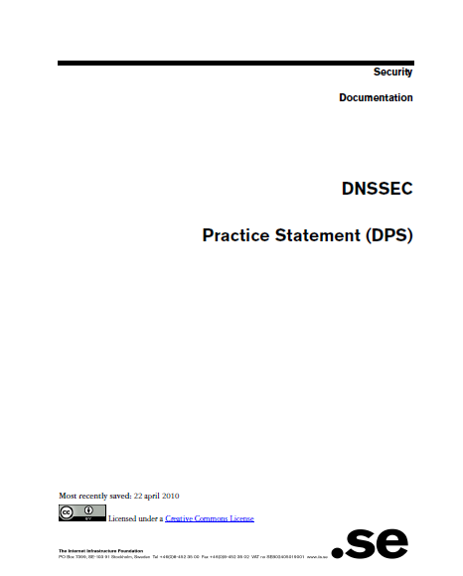
Documentation - .SE
22 pages, Creative Commons License!
.SE DPS
Notes:
Just go through and replace “SE” with “your TLD” for a great starting point for your lawyers.
**BR just had checklists. Bottom line – transparency buys trust.

Slide 38
Do what you say
Follow documented procedures / checklists
Maintain logs, records and reports of each action, including incidents.
Critical operations at Key Ceremonies
  Video
  Logged
  Witnessed

Slide 39
Key Ceremony
A filmed and audited process carefully scripted for maximum transparency at which cryptographic key material is generated or used.
Notes:
Point to root zone key ceremonies document

Slide 40

Prove it
Audits
  3rd party auditor $$
  ISO 27000 $$ etc..
  Internal

Slide 41
Prove it - Audit Material
Key Ceremony Scripts
Access Control System logs
Facility, Room, Safe logs
Video
Annual Inventory
Logs from other Compensating Controls
Incident Reports
Notes:
Some elements above may need to be attested to or signed by management as determined by auditor.
Logs should have entry/exit, open/close, removal/return.
Compensating Controls are your friend – other logs, logging, video etc…

Slide 42
Prove it
Stakeholder Involvement
  Publish updated material and reports
  Participation, e.g. External Witnesses from
      local Internet community
      Government
  Listen to Feedback

Slide 43
Prove it
Be Responsible
  Executive Level Involvement
    In policies via Policy Management Authority
    Key Ceremony participation

Slide 44
Security

Slide 45
Security
Physical
Logical
Crypto

Slide 46
Physical
  Environmental
  Tiers
  Access Control
  Intrusion Detection
  Disaster Recovery

Slide 47
Physical - Environmental
Based on your risk profile
Suitable
  Power
  Air Conditioning
Protection from
  Flooding
  Fire
  Earthquake
Notes:
California reference – risk profile balances operational, cost, and environmental

Slide 48
Physical - Tiers
Each tier should be successively harder to penetrate than the last
  Facility
  Cage/Room
  Rack
  Safe
  System
Think of concentric boxes

Slide 49
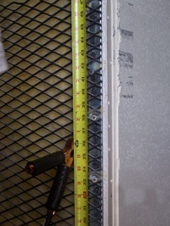
Physical - Tier Construction
Base on your risk profile and regulations
Facility design and physical security on
  Other experience
  DCID 6/9
  NIST 800-53 and related documents
  Safe / container standards
Notes:
Terrorist attack – not protected
Undetected access is worst case
Safe story
EMI – don’t care if HSM rated
Local regulations (e.g. fire)
DCID and various other hard to learn from sources: 9 gague stretched steel, real floor to real ceiling.
DNSSEC at root is rare in that we are sharing such info with public – call it a dividend to the public

Slide 50
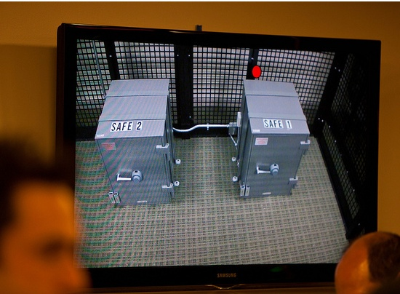
Physical – Safe Tier
Notes:
M of N was 3-of-7 plus SSSC1 SSC2 and multi-person access control to facility

Slide 51
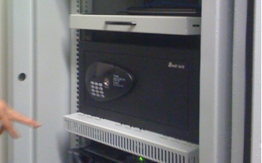
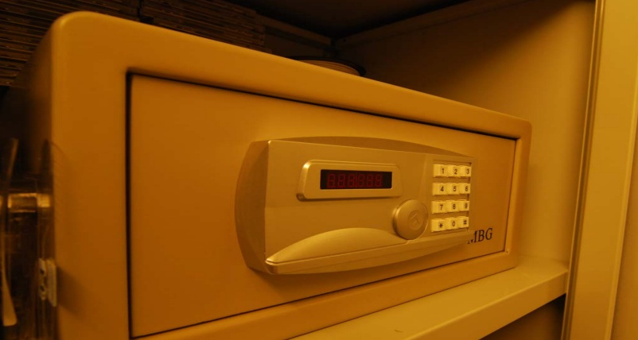
Physical – Safe Tier
Notes:
Looks like your hotel safe – huh. My suggestion – no batteries.

Slide 52
Physical - Access Control
Base on your risk profile
Access Control System
  Logs of entry/exit
  Dual occupancy / Anti-passback
  Allow Emergency Access
High Security: Control physical access to system independent of physical access controls for the facility
Notes:
Facility is ID + guard – log book
Safe is combination – log sheet
Tiers are card+pin+biometric – ACS logging
All filmed by at least facility

Slide 53
Physical - Intrusion Detection
Intrusion Detection System
  Sensors
  Motion
  Camera
Tamper Evident Safes and Packaging
Tamper Proof Equipment
Notes:
Facility: Manned, video monitor (and archived), monitor access to racks/cage/room
Sensors – door, seismic, water
Risk assessment – worst case: undetected/ unnoticed. So focus on detecting where total prevention is impossible. …and have mechanism to recover from compromise.

Slide 54
Physical - Disaster Recovery
Multiple sites
  Mirror
  Backup
Geographical and Vendor diversity
Notes:
Availability !!! So two sites AND backup of material.
Multiple sites from different facility providers.
Off site Backup could be a bank safe deposit box holding a smartcard in a tamper evident bag.

Slide 55
Logical
Authentication (passwords, PINs)
Multi-Party controls
Notes:
Risk:
lost/guessed password
Collusion

Slide 56
Logical - Authentication
Procedural:
  REAL passwords (e.g., 8 characters and mixed)
  Forced regular updates
  Out-of-band checks
Hardware:
  Two-factor authentication
  Smart cards (cryptographic)
Notes:
Risk: guessed password
Password best practices can be found in various commercial standards PCI
Most of this slide is critical for the “child” user interface (that does not benefit from any physical security) for submitting DS records.
Out of band may be an automated phone call or FAX like many services (e.g. GoDaddy, name.com – “courtesy” call) do.
Pass out various embodiments…
In the case of compromise, Out-of-band authentication mechanism is necessary (e.g. should attacker use compromised key to facilitate a legitimate dnskey/ds rollover) - true for parent or child relationship

Slide 57
Logical - Multi-Party Control
Split Control / Separation of Duties
  E.g., Security Officer and System Admin and Safe Controller
M-of-N
  Built in equipment (e.g. HSM)
  Procedural: Split PIN
  Bolt-On: Split key (Shamir, e.g. ssss.c)
Notes:
Risk: Collusion
Separation of Duties: Different departments in same org or different orgs
Explain split PIN and split-key
Can combine ACS+Safe+MofN to greatly reduce collusion probability

Slide 58
Crypto
Algorithms / Key Length
KSK/ZSK Splitting
Effectivity (rollover) Period
Number and Scheduling of keys
Validity Period
Crypto Hardware

Slide 59
Crypto - Algorithms / Key Length
Factors in selection
  Cryptanalysis
  Regulations
  Network limitations

Slide 60
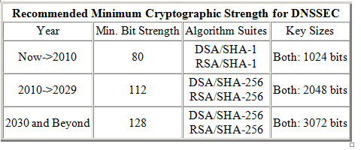
Crypto - Key Length
Cryptanalysis from NIST: 2048 bit RSA SHA256
http://csrc.nist.gov/publications/nistpubs/800-57/sp800-57_PART3_key-management_Dec2009.pdf
Notes:
NIST
http://csrc.nist.gov/publications/nistpubs/800-57/sp800-57_PART3_key-management_Dec2009.pdf
Root rollout did force resolver upgrade to sha256…

Slide 61
Crypto - Algorithms
Local regulations may determine algorithm
  GOST
  DSA
Network limitations
  Fragmentation means shorter key length is better
  ZSK may be shorter since it gets rolled often
  Elliptical is ideal – but not available yet
Notes:
Signature churn not a problem with RSA 1024 or higher
If problems with 1024 – we have a much bigger problem than DNSSEC.
FWIW: RSA 1024 ~ 6 mo – other anecdotal notes, 10 years estimated, 2048 is ok
Elliptical is encumbered by patent rights but cryptographers love it. It may become standard after a few (>5) years
BTW GOST is elliptical…

Slide 62
Crypto - Algorithms
NSEC3 if required
  Protects against zone walking
  Avoid if not needed – adds overhead for small zones
  Non-disclosure agreement?
  Regulatory requirement?
  Useful if zone is large, not trivially guessable (only “www” and “mail”) or structured (ip6.arpa), and not expected to have many signed delegations (“opt-out” avoids recalculation).
Notes:
Use a dynamic / incremental signing solution for the large zones? BIND 9.7.x

Slide 63
Crypto - KSK/ZSK Split
  Any reasonable sized zone will change frequently enough to warrant the ZSK to be on-line
Manage compromise risk of on-line ZSK for frequently changing zone
Flexibility in handling interaction with parent zone
Not difficult to implement
Notes:
ZSK offline/online?
Private keys AND zonefile offline, airgap signing/add RRSIGs+NSEC then transfer, optimal but unrealistic
Dynamic zone? (BIND) Both zone and private ZSK on-line.
=> minimize exposure with “off-net” (firewalled) hidden master and bump in wire
One-way comm ideal (.br and .pr)
Assume ZSK online (but off-net) for changing zone / dynamic zone updates

Slide 64
Crypto – KSK Rollover
Key length sets upper limit on effectivity (rollover) period
Earlier cryptanalysis suggests 2048 bit key is good till 2030 so upper limit is ~20 years
Other factors:
  Practice emergency rollover
  HSM operational considerations
  Trusted employee turnover
  Hard to roll if Trust Anchor. Easy if not.
  Automated TA update - RFC5011
Notes:
KSK is typically offline so effectivity period can be long
(recommended)Long term key generation off-line via air gap, or at minimum, HSM
Practice for emergency: is main reason for KSK rollover (Whit)
(assume KSK is more protected than ZSK otherwise ksk=zsk Teff)
But not too short. more than 10min
HSM 2-5 years for us. Vendor obsolescence, employee turnover, Root or not Root - If not TA then not a problem.

Slide 65
Crypto - KSK Rollover (cont)
Only roll when compromised.
Counter argument is to need to exercise emergency rollover for compromise recovery
No widespread agreement
If the KSK is not used as a Trust Anchor and decision is to do rollovers, not so difficult.
  RFC4641bis suggests ~ 1 year effectivity period since year time-span is easily planned and communicated.
Notes:
Usually not TA. If it is, you would normally be made aware (govt/military/enterprise)
Tests only way to test parent child communication as well.
Operational habit – if Rfc 5011, then TA rollover ok

Slide 66
Crypto – ZSK Rollover
ZSK more frequently accessed: operational considerations
  ZSK compromise less severe since under zone owner control but rollover should happen soon.
If online, exposed to various threats: keep off-net and roll.
Notes:
Operational: Dynamic Zone Updates – then must be online (but may be offnet)

Slide 67
Number and Schedule of Keys
1, 2, or 3 published (DNSKEY) keys for KSK and/or ZSK
  UDP fragmentation on DNSKEY RRset + RRSIGs
  Note: DNSKEY RRset does not need to be signed by ZSK
Pre-publish KSK
  more work for parent w/ extra steps;
  cant pre-verify new DS;
  doesn’t work for combined alg rollover
Double sign for KSK
  only DNSKEYs signed so doesn’t make zone too big
Generally pre-publish for ZSK. Double sign for KSK.
For root we use 1 KSK and 1 ZSK. Pre-publish new ZSK during ZSK rollover and double sign with both KSKs during KSK rollover.
Notes:
Examples: 3 ZSK 2 KSK = .se trailbalzers

Slide 68
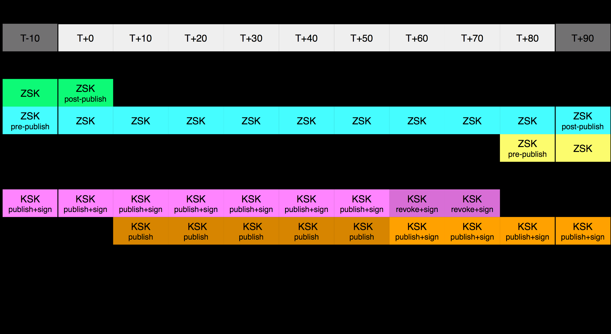
Number and Schedule of Keys (cont)
Example (root)

Slide 69
Crypto - Signature Validity Period
Short to minimize replay attack - quickly recover from compromise
  Max validity period < how long wiling to tolerate replay attack
Long to limit operational risks from equipment failure
  Min validity period > operational failure recovery time.
Validity periods overlap to deal with clock skew
Other Guidelines
  Avoid expiration in cache: Max TTL < validity period/N where N > 2
  Secondaries do not serve expired signatures: SOA expiration < validity period
Notes:
Short validity period protects children against replay and operational risk - but higher operational risk to parent.
Dnskey/NS vs DS (NS not signed)
DS validity period: short to recover from compromise but long enough to cover operator unavailability (weekends) … so typically a week. Also implies signatures must be refreshed in less than this.
A short TTL mitigates these conflicting goals by reducing time in caches. Set to time – say 2 days (root), one day (org, gov,dk, br) or ASAP like one hour (se).
~ rollover time, truck roll frequency
Tradeoff with compromise recovery

Slide 70
Crypto - Hardware
Satisfy your stakeholders
  Doesn’t need to be certified to be secure (e.g., off-line PC)
  Can use transparent process and procedures to instill trust
  But most Registries use or plan to use HSM. Maybe CYA?
AT LEAST USE A GOOD Random Number Generator (RNG)!
Use common standards avoid vendor lock-in.
  Note: KSK rollover may be ~10 years.
Remember you must have a way to backup keys!
Notes:
Off-line PC: Your know secure64 is just a PC with a TPM chip that encrypts a bundle = FIPS 140-2 level 2
NO RNG = a vulnerability. "random numbers too important to be left for chance."
Backup keys – cant use on smartcard key gen. Bad policy if HSM vendor dies too. See CA HEBCA example.

Slide 71
Crypto - Hardware Security Module (HSM)
FIPS 140-2 Level 3
  Sun SCA6000 (~30000 RSA 1024/sec) ~$10000 (was $1000!!)
  Thales/Ncipher nshield (~500 RSA 1024/sec) ~$15000
FIPS 140-2 Level 4
  AEP Keyper (~1200 RSA 1024/sec) ~$15000
  IBM 4765 (~1000 RSA 1024/sec) ~$9000
Recognized by your national certification authority
  Kryptus (Brazil) ~ $2500
Study: http://www.opendnssec.org/wp-content/uploads/2011/01/A-Review-of-Hardware-Security-Modules-Fall-2010.pdf

Slide 72
Crypto - PKCS11
A common interface for HSM and smartcards
  C_Sign()
  C_GeneratePair()
Avoids vendor lock-in - somewhat
Vendor Supplied Drivers (mostly Linux, Windows) and some open source

Slide 73
Crypto - Smartcards / Tokens
Smartcards (PKI) (card reader ~$20)
  Oberthur ~$5-$15
  AthenaSC IDProtect ~$35
  Feitian ~$5-10
Token
  Aladdin/SafeNet USB e-Token ~$50
  SDencrypter micro HSM www.go-trust.com
Open source PKCS11 Drivers available
  OpenSC
Has RNG
Slow ~0.5-10 1024 RSA signatures per second

Slide 74
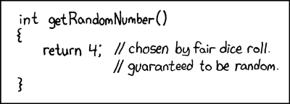

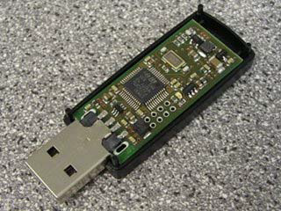
Crypto -Random Number Generator
rand()
Netscape: Date+PIDs
LavaRand
System Entropy /dev/random
Quantum Mechanical $
Standards based (FIPS, NIST 800-90 DRBG)
Coming soon: Intel atomic

Slide 75
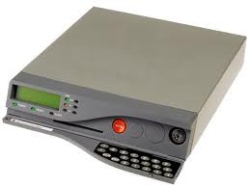
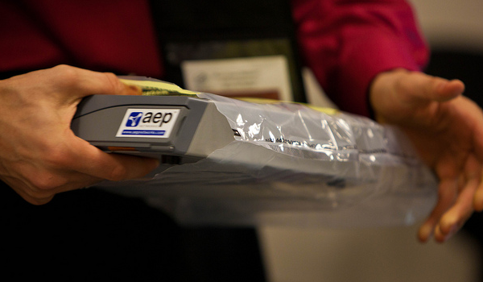
Crypto - FIPS 140-2 Level 4 HSM
Root, .FR, …

Slide 76
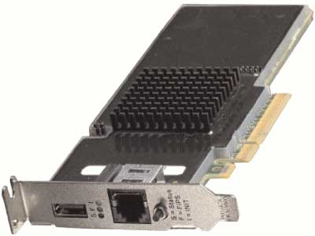
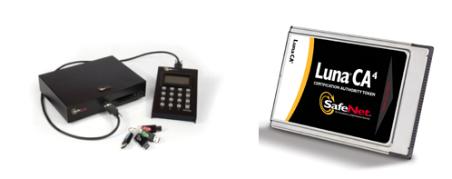
Crypto – FIPS Level 3 HSM
But FIPS 140-2 Level 3 is also common
Many TLDs using Level 3 .com , .se, .uk, .com, etc… $10K-$40K
HSMs (ENISA)

Slide 77
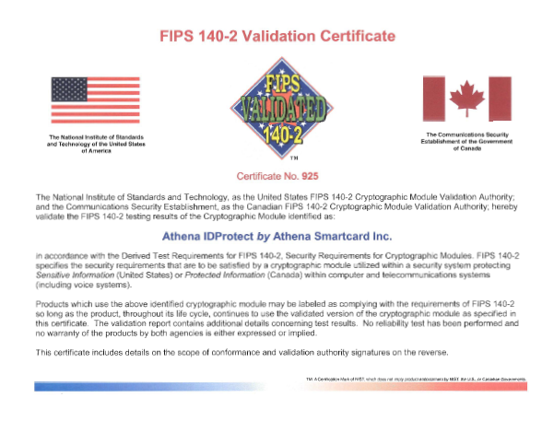
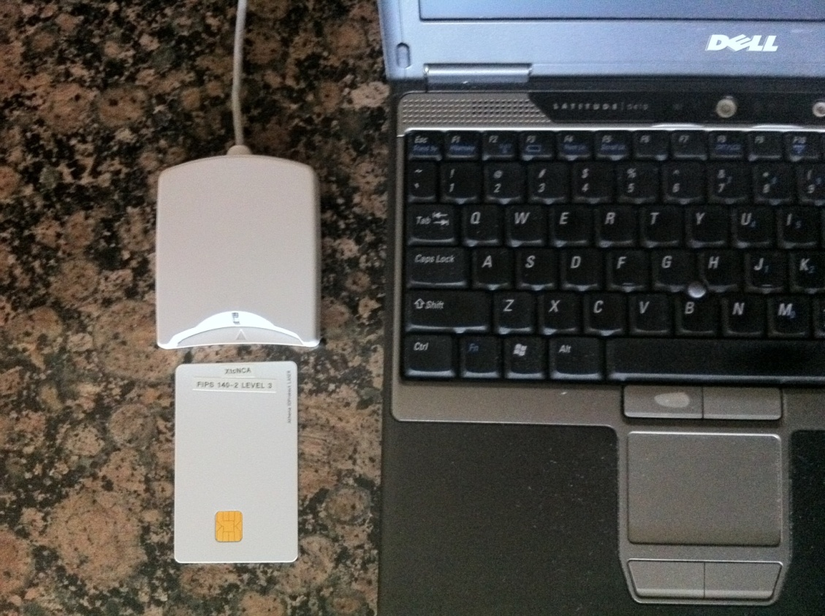
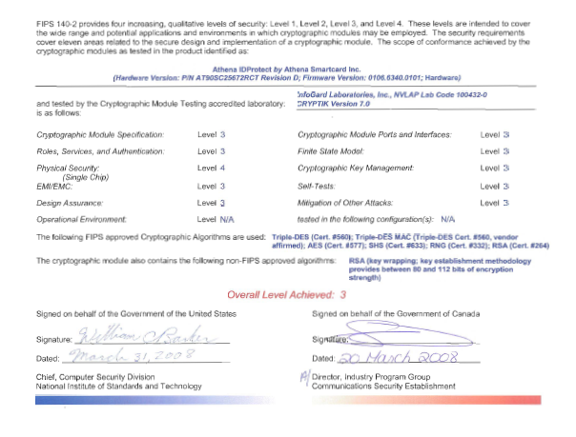
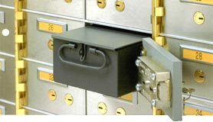
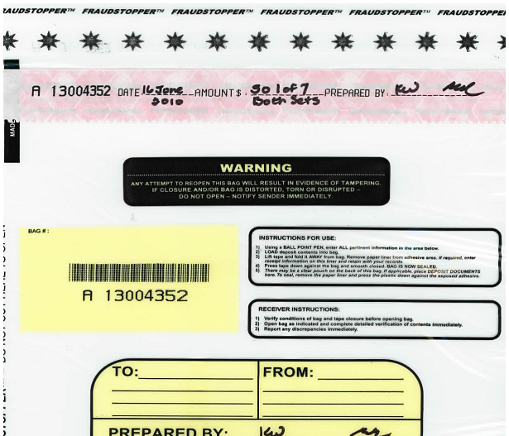
Crypto - But this is also “level 3”
+
Notes:
Safe deposit box, SO and safe deposit box key holder, witnesses, and 10 min.
RNG also certified on card.
Similar to US Higher education PKI.

Slide 78
Crypto - Other Hardware (cont)
Two-Factor
  RSA SecureID
  Vasco “footballs” ~$5
  NagraID cards ~$30
Good for registrant-registrar authentication

Slide 79
Miscellaneous

Slide 80
Tools and Software
BIND
    BIND 9.8.x dynamic zone signing
    dig [+sigchase]
    dnssec-signzone, dnssec-dsfromkey, dnssec-dsfromkey
LDNS
  ldns-*
OpenDNSSEC
PKCS11
  Some tools
  But Not so hard. Plenty of examples out there.
Test Tools
  http://dnsviz.net
  TLDMon - https://www.dns-oarc.net/oarc/services/tldmon
  DNSMON - http://dnsmon.ripe.net/dns-servmon/

Slide 81
Parental policies
  Initial key exchange
    Out of band check even if dnskey available
    Accept DS at minimum
    Verify matching DNSKEY (root does this)
    Awaiting simplifying protocols that update DS in band between parent and child using established crypto relationship (non-TA only)
  Avoid security lameness – no matching DNSKEY for DS : “bogus”
    Child’s careful removal of KSK DNSKEY material
    Advice to child not to remove the KSK before the parent has a DS record for the new KSK in place (otherwise attacker’s zone valid while yours is not)
  Changing DNS operators
    Cooperative (double KSK signed + ZSK pre-pub) - publish your policies. Reasonable TTLs ☺
    Non-cooperative – 10year TTL+validity period for DNSKEY ☹ Solution: ask registry to remove DS
    Proper contractual relationships between all parties is only solution.
Notes:
Chain verification from parent DS prior to publication
Key exchange : (epp for tld-R but no std for R-usr)
Dns is now a “key” – so delegation must be secured .. But Auth* need only be as strong as delegation (though DS is signed and NS is not)
(as an SSL or more since it will be the unique SSL cert identifier)

Slide 82
Demo Implementation

Slide 83
Demo Implementation
Key lengths – KSK:2048 RSA ZSK:1024 RSA
Rollover – KSK:as needed ZSK:90 days
RSASHA256 NSEC3
Physical – HSM inside Safe inside Rack inside Cage inside Commercial Data Center
Logical – Separation of roles: cage access, safe combination, HSM activation across three roles
Crypto – use FIPS certified smartcards as HSM and RNG
  Generate KSK and ZSK offline using RNG
  KSK use off-line
  ZSK use off-net

Slide 84
Off-Line Key generator and KSK Signer
DATA CENTER
CAGE
RACK
smartcards
SAFE
Flash Drive
KSK+RNG
Live O/S DVD
KSK signed DNSKEYs
Encrypted ZSKs
KSK+RNG
reader
laptop
KSK+RNG

Slide 85
Off-Net Signer
DATA CENTER
CAGE
RACK
zonefile
hidden master
Flash Drive
nameserver
KSK signed DNSKEYs
Encrypted ZSKs
nameserver
signer
firewall
hidden master
nameserver

Slide 86
Key Management
Transport KSK signed DNSKEY RRsets
unsigned
zone
Sign ZSKs with KSK
Sign zones with ZSK
Offline Laptop with TPM
Online/off-net DNSSEC Signer
signed
zone
KSK
Transport public half of ZSKs
Generate KSK
ZSKs
Generate ZSKs
Secure Key Generation and Signing Environment

Slide 87
Write DNSSEC Practice Statement

