Slide 1

DNSSEC Deployment: Where We Are (and where we need to be)
MENOG 10, Dubai
30 April 2012
richard.lamb@icann.org

Slide 2
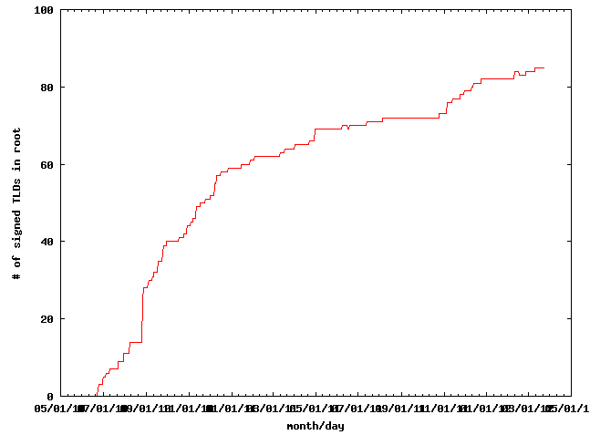
DNSSEC: We have passed the point of no return
Fast pace of deployment at the TLD level
Stable deployment at root
→Inevitable widespread deployment across core infrastructure
Notes:
The genie is out of the bottle.

Slide 3
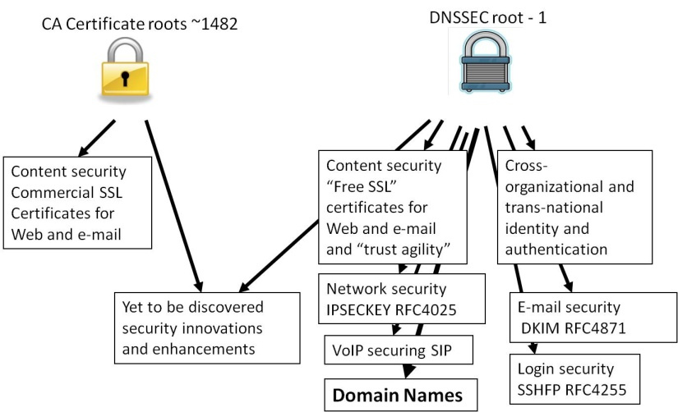
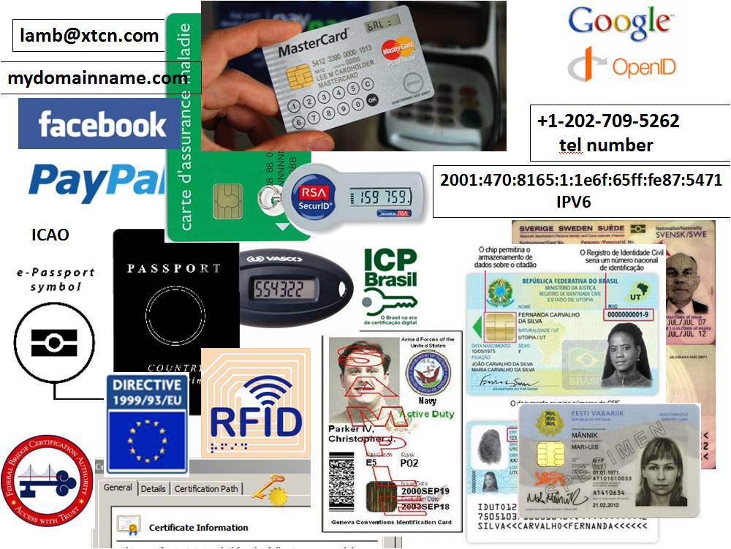
DNSSEC: Plenty of Motivation
DNSChanger (10 Nov 2011), Brazilian ISP (7 Nov 2011), calls by government, etc…
DANE
  Improved Web TLS for all
  Email S/MIME for all
…and
  SSH, IPSEC, VoIP
  Digital identity
  Other content (e.g. configurations, XML, app updates)
  Smart Grid
  A global PKI
http://www.internetsociety.org/deploy360/dnssec/
Notes:
DNS Changer/Ghost Click: 4M PCs across 100 countries - http://www.theregister.co.uk/2011/11/10/botnet_take_down_clean_up/
http://threatpost.com/en_us/blogs/major-dns-cache-poisoning-attack-hits-brazilian-isps-110711
Potentially millions of users effected.
TLD+SSL opportunity and economy - .NG and others.
http://www.fcc.gov/document/chairmans-remarks-cybersecurity-bipartisan-policy-center
http://www.pcworld.com/businesscenter/article/250480/fcc_chairman_calls_on_isps_to_adopt_new_security_measures.html
“A report by Gartner found 3.6 million Americans getting redirected to bogus websites in
a single year, costing them $3.2 billion.,” said Genachowski. and “urge[d] all broadband providers to begin implementing DNSSEC as soon as possible.”

Slide 4
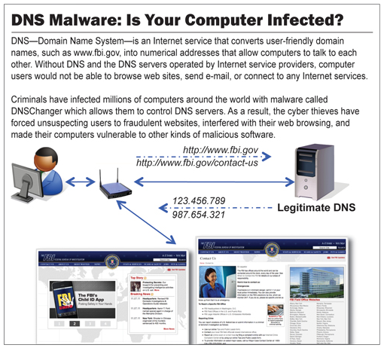
The BAD: DNSChanger - ‘Biggest Cybercriminal Takedown in History’ – 4M machines, 100 countries, $14M
9 Nov 2011
http://krebsonsecurity.com/2011/11/malware-click-fraud-kingpins-arrested-in-estonia/

Slide 5
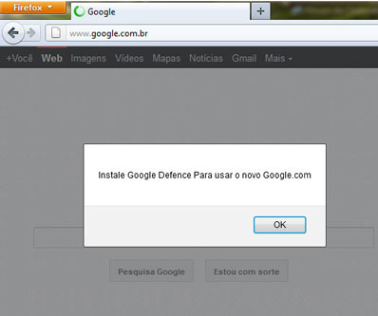
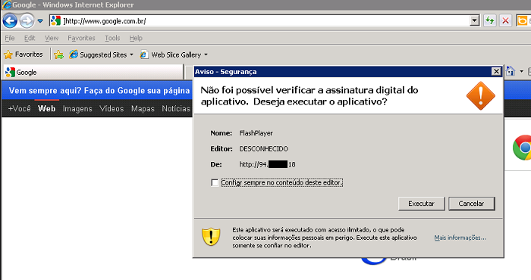
The BAD: Brazilian ISP fall victim to a series of DNS attacks
7 Nov 2011 http://www.securelist.com/en/blog/208193214/Massive_DNS_poisoning_attacks_in_Brazil
Notes:
1) Rogue insider who added bogus entries to ISP resolvers. ( alguma demanda priveligiada de dentro dos ISP que adicionou a entrada falsa.
2) Hacking of customer premise gateways (mainly home/SOHO routers) with default or easily guessed passwords to add bogus entries. There was possibly some vulnerability hacking in this area as well, but no clear answer on that.

Slide 6
The BAD: Other DNS hijacks*
25 Dec 2010 - Russian e-Payment Giant ChronoPay Hacked
18 Dec 2009 – Twitter – “Iranian cyber army”
13 Aug 2010 - Chinese gmail phishing attack
25 Dec 2010 Tunisia DNS Hijack
2009-2012 google.*
  April 28 2009 Google Puerto Rico sites redirected in DNS attack
  May 9 2009 Morocco temporarily seize Google domain name
9 Sep 2011 - Diginotar certificate compromise for Iranian users
SSL / TLS doesn't tell you if you've been sent to the correct site, it only tells you if the DNS matches the name in the certificate. Unfortunately, majority of Web site certificates rely on DNS to validate identity.
DNS is relied on for unexpected things though insecure.
*A Brief History of DNS Hijacking - Google
http://costarica43.icann.org/meetings/sanjose2012/presentation-dns-hijackings-marquis-boire-12mar12-en.pdf

Slide 7
DNSSEC support from government
Sweden, Brazil, and others encourage DNSSEC deployment
22 Mar 2012 - AT&T, CenturyLink, Comcast, Cox, Sprint, TimeWarner Cable, and Verizon have pledged to comply and abide by US FCC recommendations .. “A report by Gartner found 3.6 million Americans getting redirected to bogus websites in a single year, costing them $3.2 billion.,”[1].
2009 .gov mandate [2]
[1] http://securitywatch.pcmag.com/security/295722-isps-agree-to-fcc-rules-on-anti-botnet-dnssec-internet-routing
[2] http://www.whitehouse.gov/sites/default/files/omb/memoranda/fy2008/m08-23.pdf

Slide 8
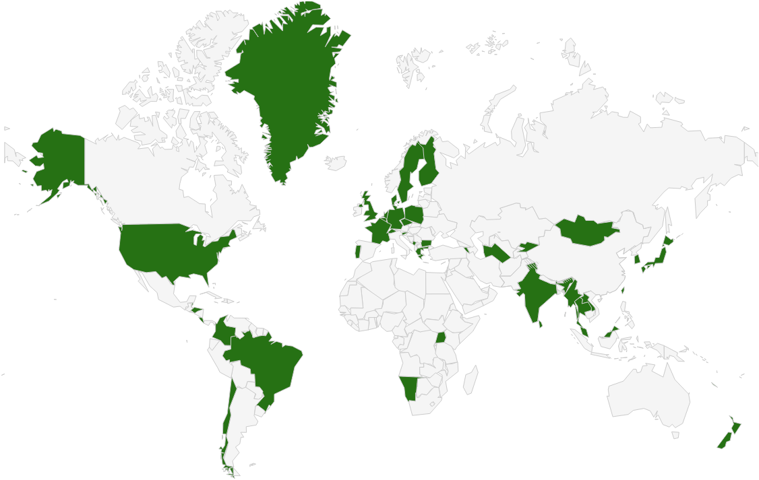
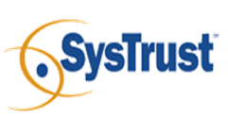
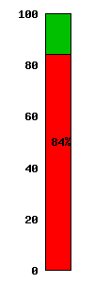
DNSSEC: Where we are
Deployed on 86/313 TLDs (.uk, .fr, .asia, .in, .lk, .kg, .tm, .am, .tw 台灣 台湾, .jp, .cr, .com,…)
Root signed and audited
84% of domain names could have could have DNSSEC deployed on them
Large ISP has turned DNSSEC validation “on”*
A few 3rd party signing solutions (e.g., GoDaddy, VeriSign, Binero,…)
Unbound, BIND, DNSSEC-trigger, vsResolver and other last mile. DANE standard almost done
*Jan 2012 - 18M COMCAST Internet customers. Others..TeliaSonera SE,
Vodafone CZ,Telefonica, CZ, T-mobile NL, SurfNet NL, others..
Notes:
DNS over HTTP Chrome-ish, proprietary solutions: MSFT active directory, OpenDNS
All 18M COMCAST Internet customers. Also TeliaSonera SE, Vodafone, Telefonica, CZ, T-mobile NL
US ISP Comcast DNSSEC deployment plan for 18M customers and >5000 domain names http://blog.comcast.com/2011/12/dnssec-deployment-update.html .
http://www.icann.org/en/news/in-focus/dnssec/deployment

Slide 9
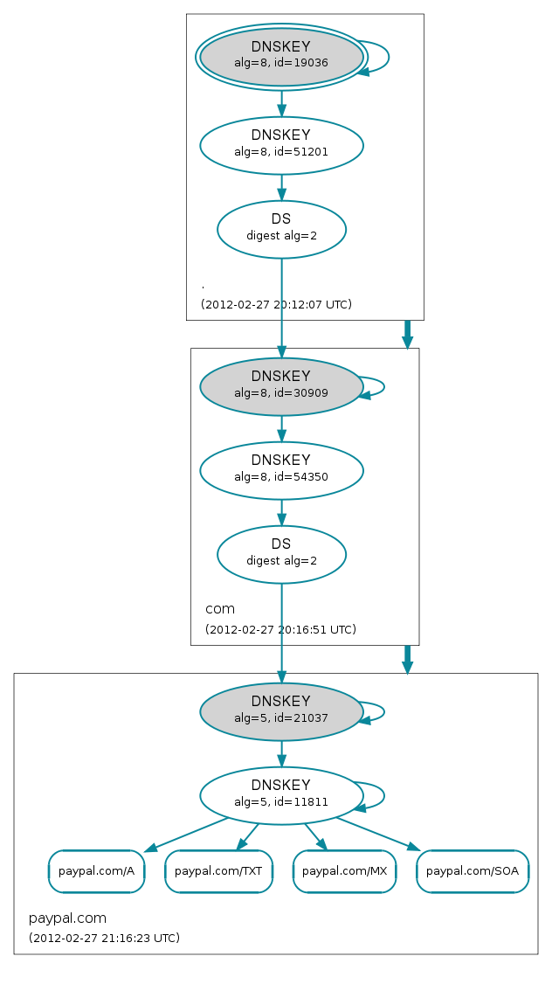
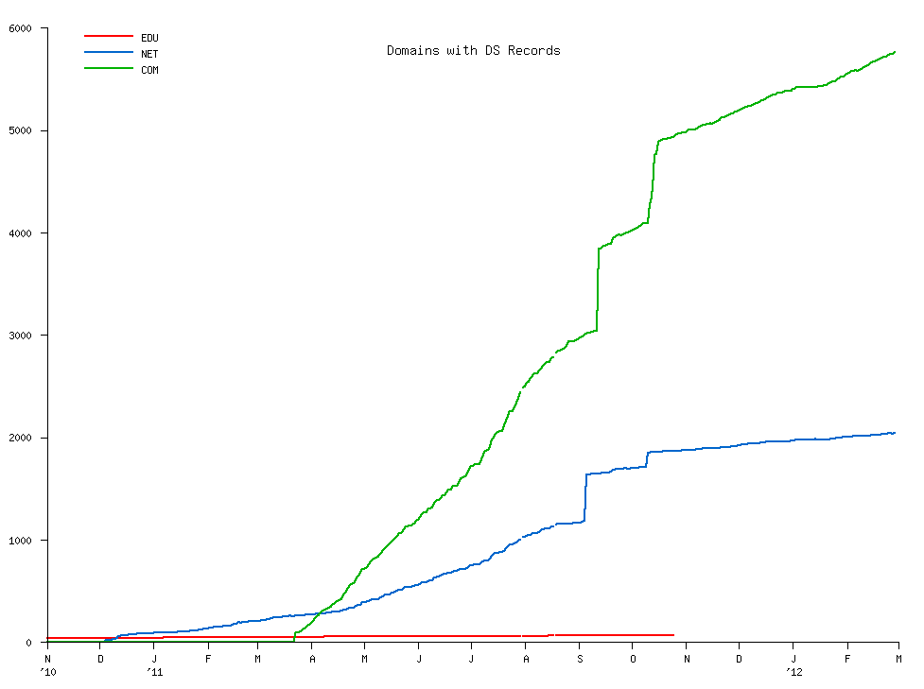
DNSSEC: Where we are
But deployed on < 1% of 2nd level domains. Many have plans. Few have taken the step (e.g., paypal.com*).
DNSChanger and other attacks highlight today’s need.
Innovative security solutions (e.g., DANE) highlight tomorrow’s value.
* http://www.thesecuritypractice.com/the_security_practice/2011/12/all-paypal-domains-are-now-using-dnssec.html
http://www.nacion.com/2012-03-15/Tecnologia/Sitios-web-de-bancos-ticos-podran-ser-mas-seguros.aspx
Notes:
Paypal deploys DNSSEC http://www.thesecuritypractice.com/the_security_practice/2011/12/all-paypal-domains-are-now-using-dnssec.html

Slide 10
What needs to happen
ISPs need to support DNSSEC*.
Domain name holders need to sign.
…all in a trustworthy fashion.
* Tools to test with https://labs.nic.cz/dnssec-validator/
Notes:
Ask 1) how many have dnssec deployed on corporate domains
and 2) if any of their resolvers have validation turned on.
“ISP support for DNSSEC is necessary even in a future in which end points perform all validation. They must be able to, at a minimum, recognize DNSSEC-related traffic and allow it to pass for the smooth functioning of an end-to-end, DNSSEC-secured system.”
Tools like DNS-Trigger, the CZ plug-in, etc help test this.
~6000 .COM 12 Dec 2011
For a virtuous cycle of secure DNSSEC implementations towards full deployment.
…and brings to bear improvements in overall IT security processes and practices that will address growing number of exploits such as hijacking.

Slide 11
Barriers to success
Registrar support*
  chicken and egg
Ease of implementation
  security/crypto/management cost/complexity
  no click and sign
Trust
  insecure practices and processes
  garbage in, garbage out
*http://www.icann.org/en/news/in-focus/dnssec/deployment
Notes:
Joe Klein/Qinetiq/CES – “hard to justify trust as a feature at many apps at the second level domain”
…but with secure IT practices unlike DigiNotar/black tulip etc. Things can spiral into failure if we end up like SSL.
Domain hijacking redux - https://isc.sans.edu/diary.html?storyid=11770
SSAC 044
SSAC 007
DNS-EASY presentation on DNSSEC: how to avoid certain failure

Slide 12
Solutions
Create demand for DNSSEC: Raise awareness of domain holders (content) and users (eyes)
Ease Implementation:
  DNSSEC training drawn from existing implementations
  Key management automation and monitoring
  Crypto: HSM? Smartcard? TPM chip? Soft keys? - all good
Trust: Transparent and Secure processes and practices
  Writing a DPS creates the right mindset for:
    Separation of duties
    Documented procedures
    Audit logging
  Opportunity to improve overall operations using DNSSEC as an excuse
Notes:
CIRA just published a DPS - all based on SE. I have Spanish one as well.

Slide 13


Learn from CA successes
(and mistakes)
The good:
  The people
  The mindset
  The practices
  The legal framework
  The audit against international accounting and technical standards
The bad:
  Diluted trust with a race to the bottom (>1400 CA’s)
  DigiNotar
    Weak and inconsistent polices and controls
    Lack of compromise notification (non-transparent)
    Audits don’t solve everything (ETSI audit)
Notes:
The people: e.g., Tomofumi Okubo, Fredrik Lundgren, Paul Hoffman, David Miller (AEP)
The people (those willing to share in this secret art)
The mindset (trust in process. not people)
The practices (physical, logical, cryptographic security)
The legal framework (setting expecations. liability limitations)
HEBC/USHER – US university system PKI example.
SysTrust similar to WebTrust – economies of similarity. Number of SSL: 4M/200+M sites Could have many more. Many countries use VRSN for govt dig sign. Why not own country?
ETSI failed for DigiNotar

Slide 14

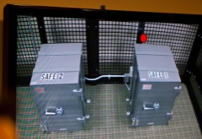
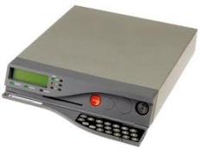
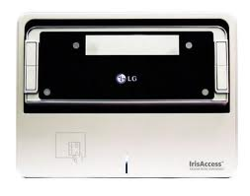
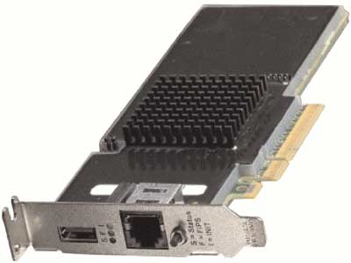
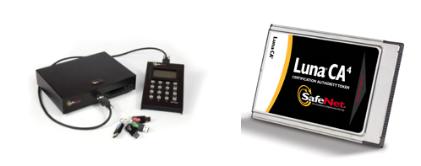
An implementation can be thi$
Notes:
FR, NZ, root, com, UK

Slide 15
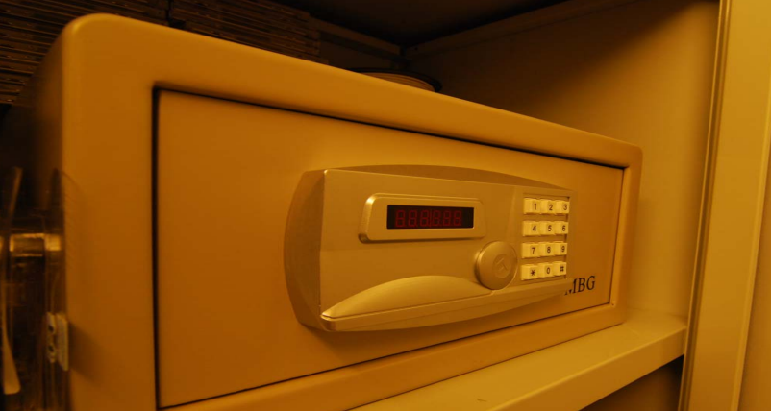

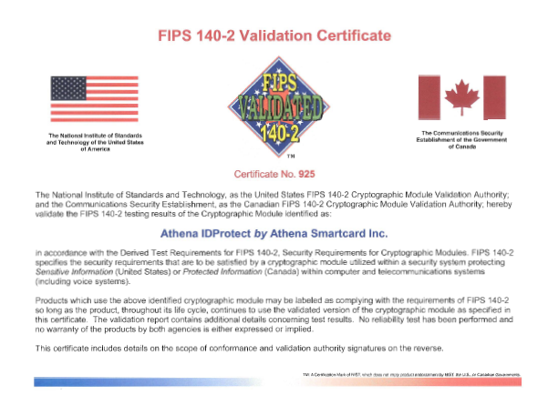
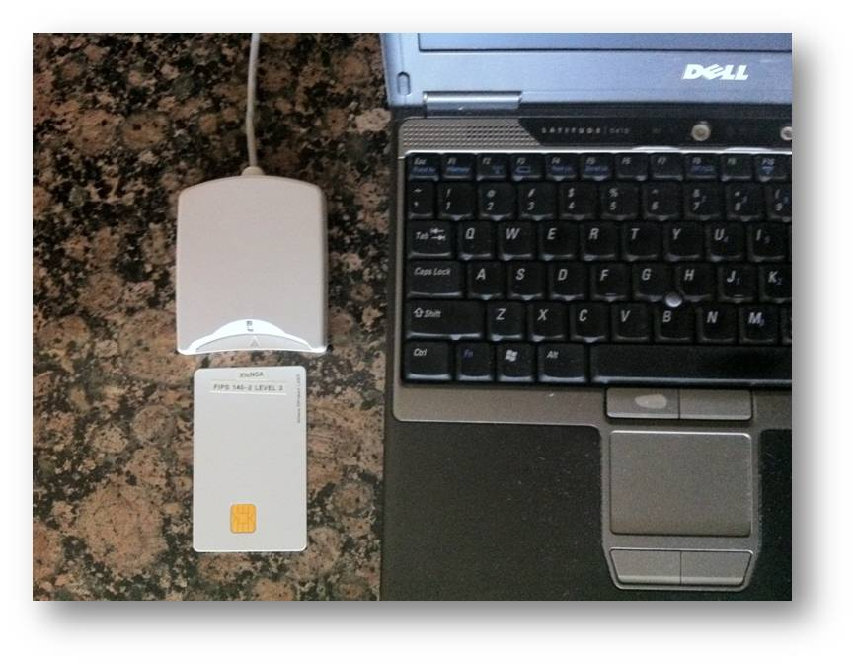
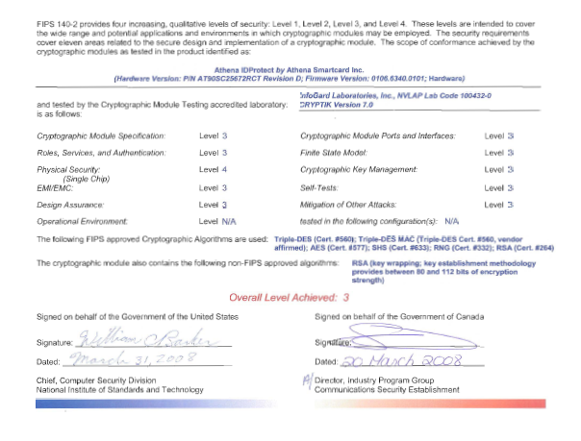
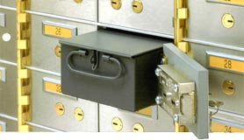
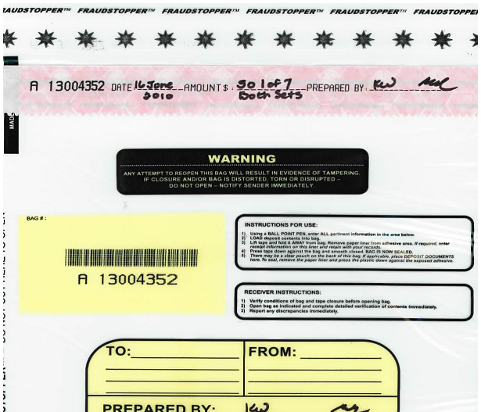
…or this
+
TPM
Notes:
JP, old SE, new CR

Slide 16
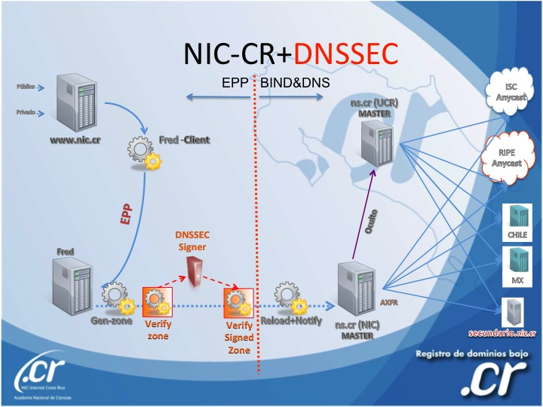
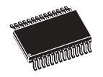
..or this (from .cr)
Transport KSK signed DNSKEY RRsets
unsigned
zone
Sign ZSKs with KSK
Sign zones with ZSK
Offline Laptop with TPM
Online/off-net DNSSEC Signer with TPM
signed
zone
KSK
Transport public half of ZSKs
Generate KSK
ZSKs
Generate ZSKs
Secure Off-line Environment
Notes:
9 March 2012
…and bnonline.fi.cr
http://www.nacion.com/2012-03-15/Tecnologia/Sitios-web-de-bancos-ticos-podran-ser-mas-seguros.aspx

Slide 17
…or even this
Off-line
Off-net
DATA CENTER
CAGE
DATA CENTER
RACK
CAGE
SAFE
RACK
All in tamper evident bags
FD with public ZSKs
zonefile
ZSKs
KSK on FD
Live O/S DVD
signer
laptop
FD with KSK signed DNSKEY RRsets
firewall
hidden master
RNG
Notes:
From LACTLD training I gave in September. Notes from there on simple separation of duties and even ssss.c for M-of-N. Go thru risk analysis, threats and controls
Pull out TEBs.

Slide 18
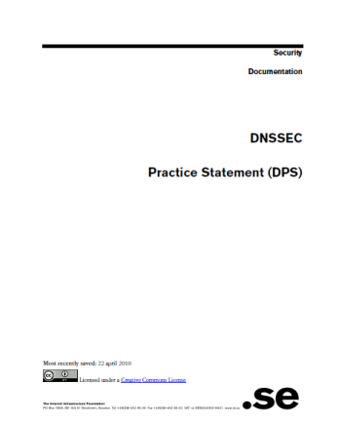
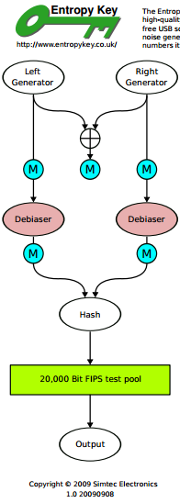

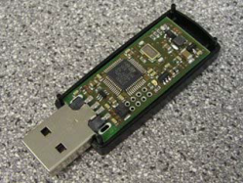
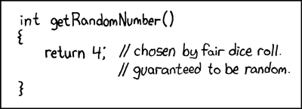
But all must have:
Published practice statement
  Overview of operations
  Setting expectations
    Normal
    Emergency
  Limiting liability
Documented procedures for each operation
Multi person access requirements
Audit logs
Good Random Number Generators
Intel RdRand
15 Feb 12 – “Ron was wrong, Whit is right”
DRBGs
Notes:
CA, NZ, PCH, and others based on pioneering work by SE / Fredrik and RFC draft for DPS. I use one for my training sessions and have one translated into Spanish. I understand JPNIC has one translated into English.
http://cira.ca/knowledge-centre/technology/dnssec/practice-statement/
Recent news of bad random numbers for 10s of 1000’s of SSL certificates (15 Feb). 2 out of 1000 offer no security.
http://www.nytimes.com/2012/02/15/technology/researchers-find-flaw-in-an-online-encryption-method.html?_r=2&hp
DRBG http://csrc.nist.gov/publications/nistpubs/800-90A/SP800-90A.pdf
SysTrust similar to WebTrust – economies of similarity.
Number of SSL: 4M/200+M sites Could have many more.
Many countries use VRSN for govt dig sign. Why not own country?
DNSSEC deployment as an excuse to improve all process (ENISA)
Leverage govt interests in cyber security (+secure smart grid and other infrastructures that rely on DNSSEC) and digital identity efforts.
Opportunity to use DNSSEC requirements and current interest in digital identity systems as an excuse to improve overall DNS and identity ecosystems
DNS/DNSSEC part of all Internet ecosystems.
In order to realize the full benefits of DNSSEC, DNS operators and other entities that make up the chain of trust must embrace transparent IT security processes and practices.
Greater end user and Registrant awareness of the benefits of DNSSEC is needed to drive a virtuous cycle of effective deployment.

Slide 19
Summary
DNSSEC has left the starting gate but without greater support by Registrars, ISPs and domain name holders and trustworthy deployment it...
Building awareness amongst a larger audience based on recent attacks and pronouncements may be the solution.
Drawing on lessons learned from certificate authorities makes sure DNSSEC becomes a source of opportunity and innovation floating all boats
Notes:
Nothing is perfect but forcing thought about secure processes and practices helps solve many exisiting problems. Doing the DPS is the mesuarble exercize that provides this.
Just Ask. I have seen them all. I am happy to do a training session here. Its my job.
Ask 1) how many have dnssec deployed on corporate domains
and 2) if any of their resolvers have validation turned on.

Slide 20
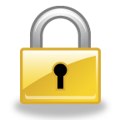
Resultant Global PKI
SSL (DANE), E-mail, VOIP security…
CA Certificate roots ~1482
DNSSEC root - 1
Content security “Free SSL” certificates for Web and e-mail and “trust agility” (DANE)
Cross-organizational and trans-national identity and authentication
Content security Commercial SSL Certificates for Web and e-mail
Network security IPSECKEY RFC4025
Yet to be discovered security innovations, enhancements, and synergies
E-mail security
DKIM RFC4871
Securing VoIP
Login security SSHFP RFC4255
Domain Names
https://www.eff.org/observatory
http://royal.pingdom.com/2011/01/12/internet-2010-in-numbers/
Notes:
With so many, trust is diluted. Used to be good when there were fewer.
Any one can encrypt. Few can Identify : Encryption != Identity
Comodo, MD5 crack, etc..
Fact is that DNS has been unfortunately used as an independent authentication tool for some time: e.g. email authentication
Build and improve on established trust models, e.g., CAs
Greatly expanded SSL usage (currently ~4M/200M)
Make SMIME (secured email) a reality. All email packages already have support for this. They just don’t have a way to distribute keys. /w DNSSEC – now they do.
May work in concert with in enhancing or extending other cyber security efforts like digital Identities, WebID, BrowserID, CAs, ..
Securing VoIP
Simplify WiFi roaming security
Secure distribution of configurations (e.g., blacklists, anti-virus sigs)

Slide 21
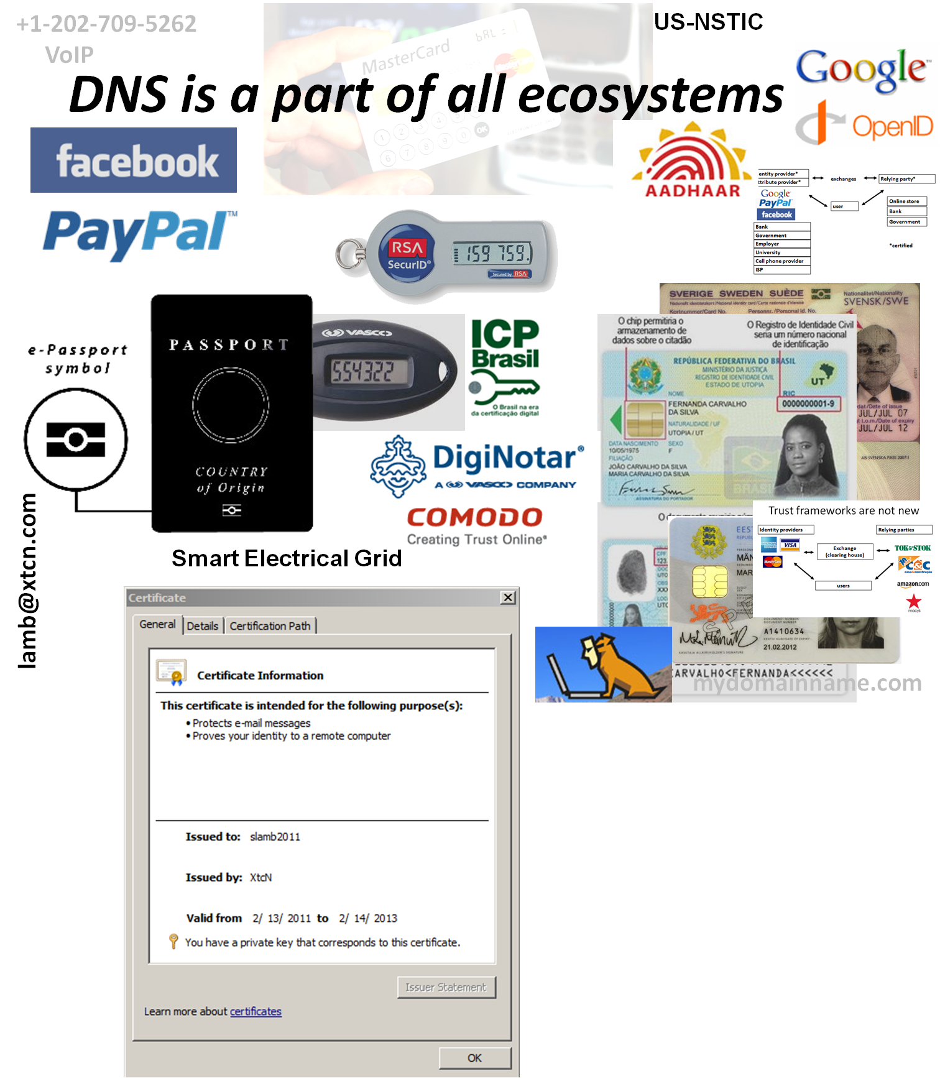



OECS ID effort
Notes:
Smart Electrical Grid effort - Not just reading meters

