Slide 1
ICANN’s multi-stakeholder approach
OAS-CICTE REMJA/OAS + WEF Cyber Crime Workshop, Montevideo, Uruguay
10 July 2012
richard.lamb@icann.org

Slide 2
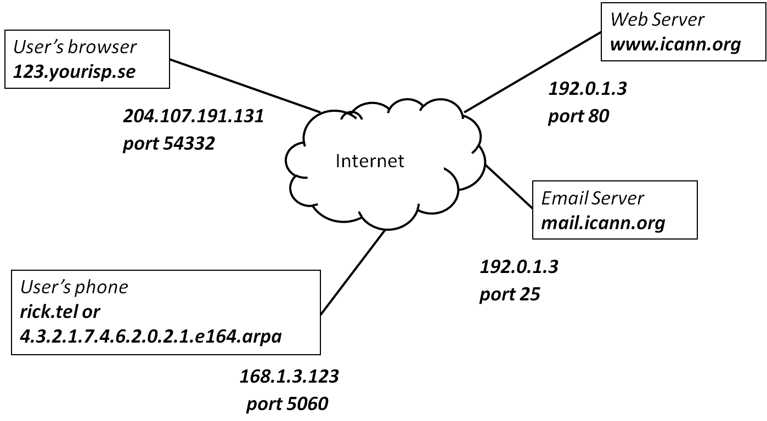
What is ICANN?
IANA function
coordinate unique identifiers (root and top-level domain names, IP address allocation, protocol number assignments, time zone database, other…)
DNS operations (L-root, DNSSEC, ICANN managed domains)
Policy and multi-stakeholder support
Facilitator
Delegation of registry and registrar functions
Education/ training/ awareness
Collaboration on other, non-domain name issues
Notes:
Budapest Convention

Slide 3
What is ICANN?
We are NOT a
Law enforcement agency
Court of law
Government agency
ICANN Cannot unilaterally
Suspend domain names
Transfer domain names
Immediately terminate a registrar’s contract
ICANN can enforce contracts on registries and registrars
Notes:
Budapest Convention
ICANN does not play a role in policing the Internet or operationally combating criminal behavior.
ICANN does not have a role in the use of the Internet related to cyber-espionage and cyber war.
ICANN does not have a role in determining what constitutes illicit conduct on the Internet.
ICANN IS able to enforce its contracts on registries & registrars

Slide 4
What is ICANN?
Security Team is LE contact point
Participation via
Government Advisory Council (GAC)
Security Team provides “basic training”, “speak to X for Y”, workshops, collaborate with LE, Security and operational communities
Direct meetings like with any other stakeholder
Notes:
Budapest Convention
ICANN does not play a role in policing the Internet or operationally combating criminal behavior.
ICANN does not have a role in the use of the Internet related to cyber-espionage and cyber war.
ICANN does not have a role in determining what constitutes illicit conduct on the Internet.
ICANN IS able to enforce its contracts on registries & registrars

Slide 5
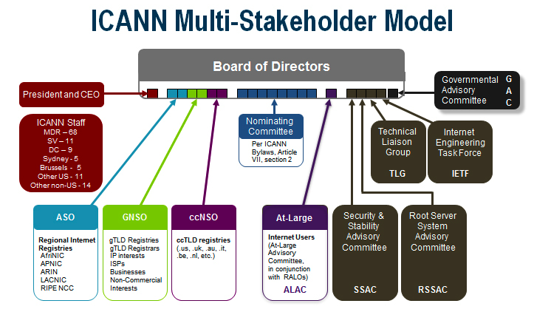

Slide 6
The Internet’s Phone Book - Domain Name System (DNS)
www.majorbank.se = 1.2.3.4
www.majorbank.se=?
DNS Resolver
DNS
Server
1.2.3.4
Get page
webserverwww @ 1.2.3.4
Login page
Username / Password
Account Data
ISP/Enterprise
Majorbank.se (Registrant)
DNS
Server
.se (Registry)
DNS
Server
. (Root)
Notes:
Actually MANY phone books

Slide 7
Caching Responses for Efficiency
www.majorbank.se = 1.2.3.4
www.majorbank.se=?
DNS Resolver
DNS
Server
1.2.3.4
Get page
webserverwww @ 1.2.3.4
Login page
Username / Password
Account Data

Slide 8
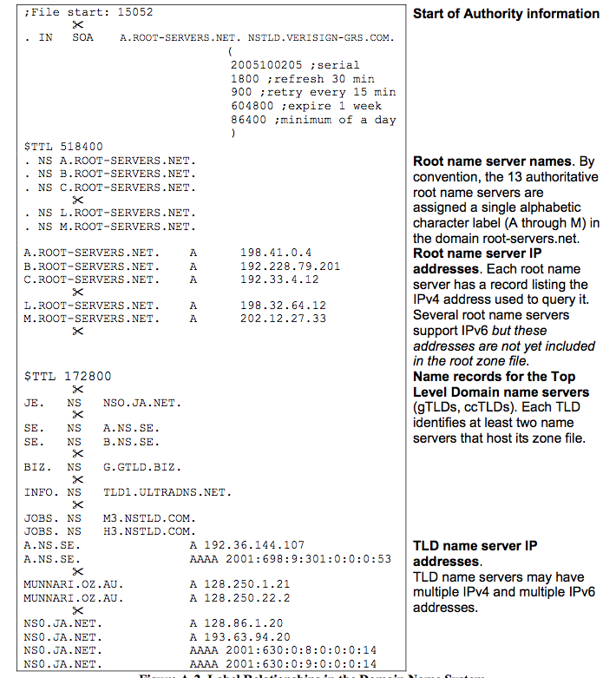
Just a bunch of zone files
Here is root
zone file
courtesy Dave Piscitello, ICANN

Slide 9
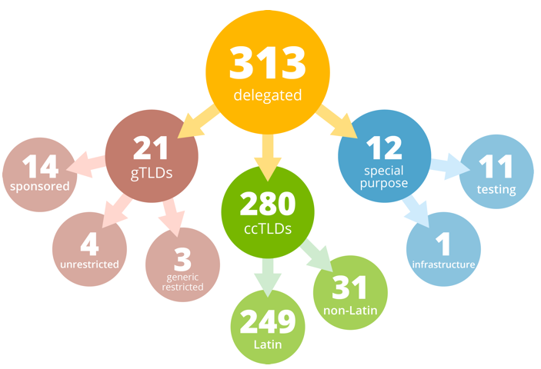
DNS 101 continued..
gTLD = Global Top Level Domain .com, .museum…and soon .yourdomainhere...
ccTLD = Country Code TLD .uy, .br, .cl, .se, .cn, .ru
TLDs operated by Registries
Root (ICANN) has entries for TLDs; TLDs have entries for domain names
Domains sold to Registrants thru Registrars
Registrant ←→Registrar←→Registry←→Root
google.com←→GoDaddy←→.com←→ .
Google Inc←→GoDaddy Inc←→VeriSign Inc←→ICANN
background courtesy Kim Davies, ICANN

Slide 10
Why do I care?
For example:
IP address or domain name of suspect
WHOIS protocol
Contact owner, Registrar, or Registry
Obtain other information collected by Registrar
Other examples:
http://www.icann.org/about/staff/security/guidance-domain-seizures-07mar12-en.pdf
Notes:
See: Domain Seizures paper at http://blog.icann.org/2012/03/thought-paper-on-domain-seizures-and-takedowns/
http://www.icann.org/about/staff/security/guidance-domain-seizures-07mar12-en.pdf
http://securityskeptic.typepad.com/the-security-skeptic/2012/05/making-sense-of-shutdowns-takedowns-seizures-and-more.html

Slide 11
Conficker
Created 250-50000 pseudo-random domains/day for C&C across 116 TLDs
Instant actions based on established international relationships with ccTLD and gTLDs (Crain) –wow!
Unprecedented act of coordination and collaboration (MSFT, ICANN, Registries, AV, researchers)
Lessons: private sector collaboration; public-private info sharing; support to LE; legislative reform.
Notes:
2008, 2009, … Model for cyber defense. See the book “the worm”

Slide 12
Registrar Accreditation Agreement (RAA)
Registrars sign contract /wICANN to become accredited
Required for com, gtlds, … Not for ccTLDs
Stakeholders: Registrars, LE, privacy, community, ICANN
Accurate/validated WHOIS (…also ICANN community efforts for common machine readable format with tiered access)
Major progress – LE and Registrars now agree in principle
http://prague44.icann.org/meetings/prague2012/presentation-raa-negotiations-summary-03jun12-en.pdf
Notes:
ICANN received due diligence recommendations from LE (AU-AFP, US-DOJ/FBI, NZ-NZP, CA-RCMP, UK-SOCA) Seoul 2009
Also inputs from APWG. From Costa Rica CICTE mtg: “need more transparency in RAA negotiations”
(link to RAA LE summary, …accrediting proxy/privacy services, balance against privacy concerns)

Slide 13
The Problem: DNS Cache Poisoning Attack
www.majorbank.se = 1.2.3.4
www.majorbank.se=?
DNS Resolver
DNS
Server
5.6.7.8
Attacker
www.majorbank.se = 5.6.7.8
Get page
Attacker
webserverwww @ 5.6.7.8
Login page
Username / Password
Error
Password database

Slide 14
Argghh! Now all ISP customers get sent to attacker.
www.majorbank.se = 1.2.3.4
www.majorbank.se=?
DNS Resolver
DNS
Server
5.6.7.8
Get page
Attacker
webserverwww @ 5.6.7.8
Login page
Username / Password
Error
Password database

Slide 15
Securing The Phone Book - DNS Security Extensions (DNSSEC)
Attacker’s record does not validate – drop it
www.majorbank.se = 1.2.3.4
www.majorbank.se=?
DNS Resolver
with DNSSEC
DNS
Server with DNSSEC
1.2.3.4
Attacker
www.majorbank.se = 5.6.7.8
Get page
webserverwww @ 1.2.3.4
Login page
Username / Password
Account Data
Notes:
So DNSSEC is a good thing.

Slide 16
Resolver only caches validated records
www.majorbank.se = 1.2.3.4
www.majorbank.se=?
DNS Resolver
with DNSSEC
DNS
Server with DNSSEC
1.2.3.4
Get page
webserverwww @ 1.2.3.4
Login page
Username / Password
Account Data
Notes:
So DNSSEC is a good thing.

Slide 17
DNSSEC
Bellovin 1995, Kaminsky 2008
Deployed on root 2010: Biggest security upgrade to Internet in 20 years
DNS Changer 2011
Web accounts, SSL certificates, configuration, ..
Future innovation and opportunities
Only possible with unprecedented international multi-stakeholder, bottom-up managed and trusted root key (including representatives from Uruguay, Brazil, Trinidad)
Notes:
Started with Kaminsky (Blackhat/Defcon 2008) discovery and collaborative effort with researchers + vendors to release patch in place before going public.
Biggest Cybercriminal Takedown in History’ – 4M machines, 100 countries, $14M

Slide 18
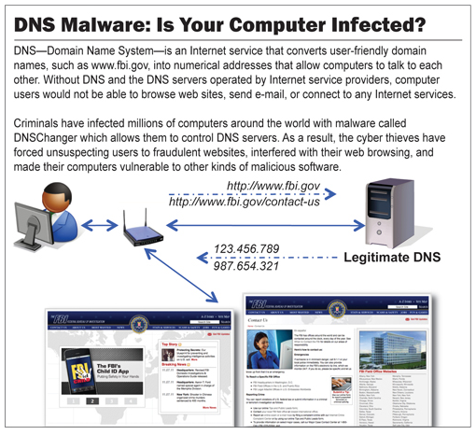
DNSChanger - ‘Biggest Cybercriminal Takedown in History’ – 4M machines, 100 countries, $14M
9 Nov 2011
http://krebsonsecurity.com/2011/11/malware-click-fraud-kingpins-arrested-in-estonia/
Notes:
Also Google “History or DNS Hijacking”…*A Brief History of DNS Hijacking - Google
http://costarica43.icann.org/meetings/sanjose2012/presentation-dns-hijackings-marquis-boire-12mar12-en.pdf
25 Dec 2010 - Russian e-Payment Giant ChronoPay Hacked
18 Dec 2009 – Twitter – “Iranian cyber army”
13 Aug 2010 - Chinese gmail phishing attack
25 Dec 2010 Tunisia DNS Hijack
2009-2012 google.*
April 28 2009 Google Puerto Rico sites redirected in DNS attack
May 9 2009 Morocco temporarily seize Google domain name
9 Sep 2011 - Diginotar certificate compromise for Iranian users
SSL / TLS doesn't tell you if you've been sent to the correct site, it only tells you if the DNS matches the name in the certificate. Unfortunately, majority of Web site certificates rely on DNS to validate identity.
DNS is relied on for unexpected things though insecure.

Slide 19
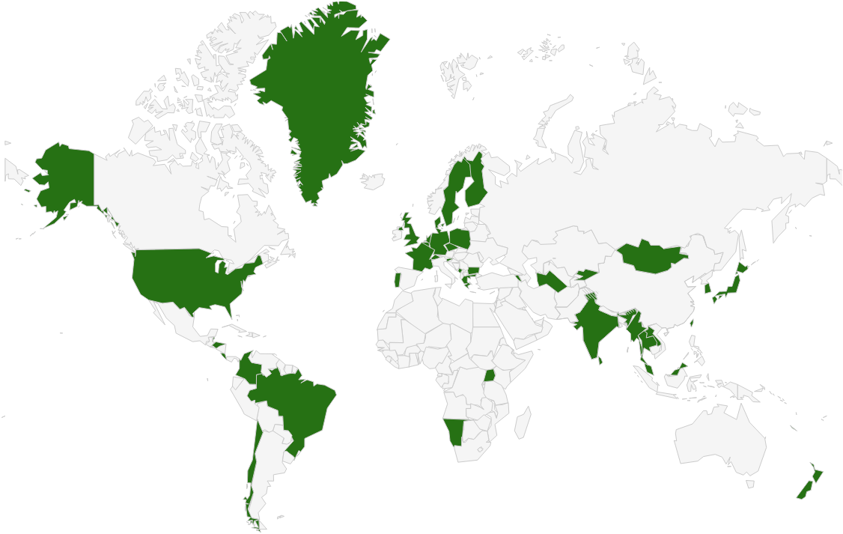

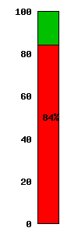
DNSSEC: Where we are
Deployed on 88/313 TLDs (.cl, .br, .cr, .co, .pr, .hn, .us, .lk, .eu, .tw 台灣, 한국, .com,…)
Root signed and audited
84% of domain names could have could have DNSSEC deployed on them
Large ISPs have or have agreed to support DNSSEC*
A few 3rd party signing solutions (e.g., GoDaddy, VeriSign, Binero,…)
Supported by majority of DNS implementations
Required for new gTLDs
*COMCAST 18M Internet customers. Others..TeliaSonera SE, Vodafone CZ,Telefonica, CZ, T-mobile NL, SurfNet NL, ..
http://securitywatch.pcmag.com/security/295722-isps-agree-to-fcc-rules-on-anti-botnet-dnssec-internet-routing
Notes:
DNS over HTTP Chrome-ish, proprietary solutions: MSFT active directory, OpenDNS
All 18M COMCAST Internet customers. Also TeliaSonera SE, Vodafone, Telefonica, CZ, T-mobile NL
US ISP Comcast DNSSEC deployment plan for 18M customers and >5000 domain names http://blog.comcast.com/2011/12/dnssec-deployment-update.html .
http://www.icann.org/en/news/in-focus/dnssec/deployment
USG mandate: http://www.whitehouse.gov/sites/default/files/omb/memoranda/fy2008/m08-23.pdf

Slide 20
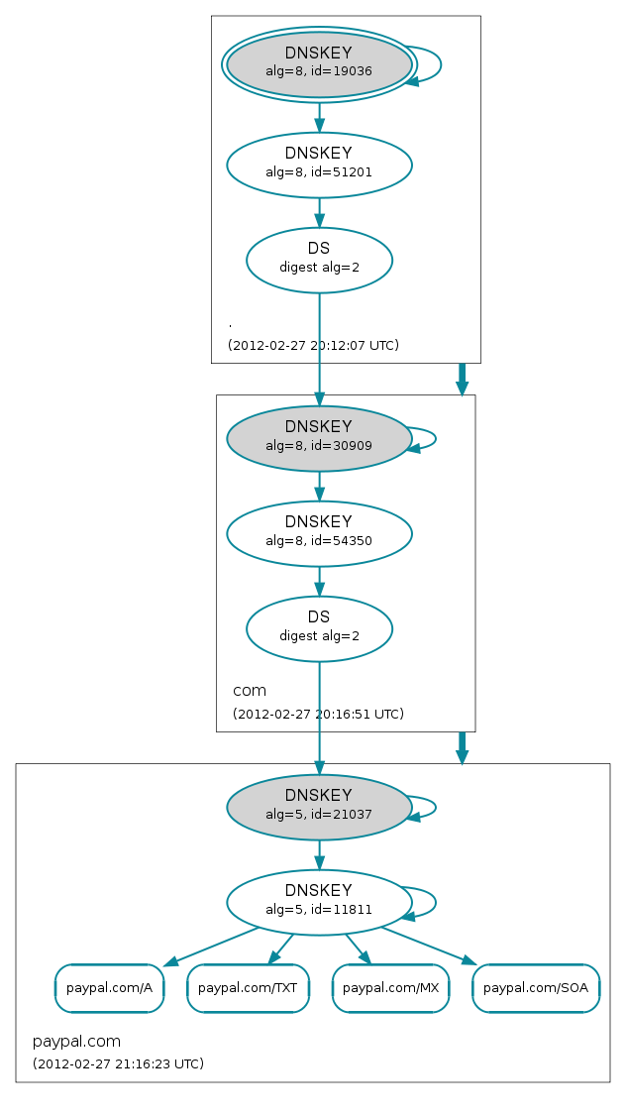
DNSSEC: Where we are
But deployed on < 1% of 2nd level domains. Many have plans. Few have taken the step (e.g., paypal.com*).
DNSChanger and other attacks highlight today’s need.
Innovative security solutions (e.g., DANE) highlight tomorrow’s value.
Need to raise Registrant and end user awareness
*http://www.thesecuritypractice.com/the_security_practice/2011/12/all-paypal-domains-are-now-using-dnssec.html
http://www.nacion.com/2012-03-15/Tecnologia/Sitios-web-de-bancos-ticos-podran-ser-mas-seguros.aspx
Approx 0.5M have DNSSEC
http://www.internetsociety.org/deploy360/dnssec/
Notes:
Paypal deploys DNSSEC http://www.thesecuritypractice.com/the_security_practice/2011/12/all-paypal-domains-are-now-using-dnssec.html

Slide 21
Unexpected reliance on DNS
Web accounts
SSL dilution of trust →Diginotar/Comodo
Configuration, s/w updates, …
Lack of trust in e-commerce → negative economic impact
Imagine if you could trust “the ‘Net”?

Slide 22
DNSSEC Future
DANE
Improved Web TLS for all
Email S/MIME for all
…and
SSH, IPSEC, VoIP
Digital identity
Other content (e.g. configurations, XML, app updates)
Smart Grid
A global PKI

Slide 23
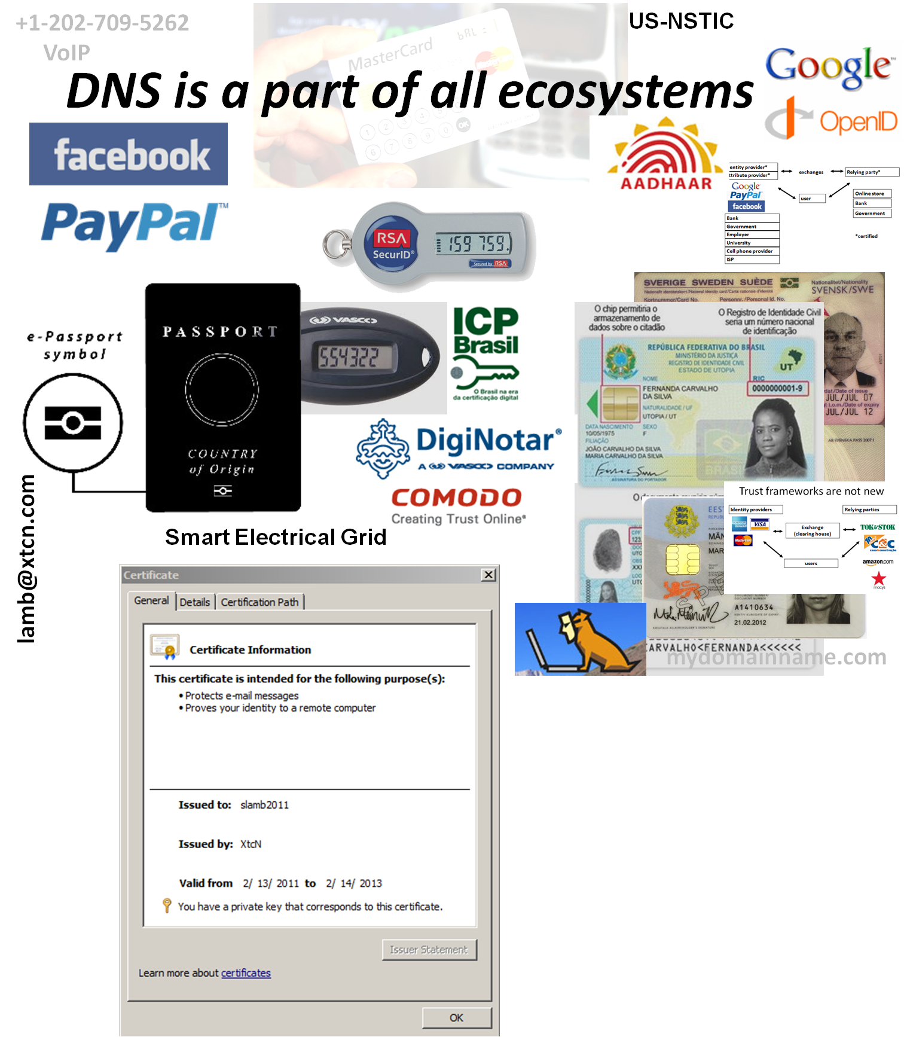



OECS ID effort
Notes:
Smart Electrical Grid effort - Not just reading meters

Slide 24
Summary
The bottom-up, multi-stakeholder approach works
Personal relationships are critical
Public Private collaboration is essential
Notes:
May contact ICANN or LACNIC for assistance

Slide 25
ICANN Security Team:
Thank You
Jeff Moss, VP & Chief Security Officer
Geoff Bickers, Director of Security Operations
John Crain, Sr. Director, SSR
Whitfield Diffie, VP InfoSec & Cryptography
Patrick Jones, Sr. Director, Security
Dr. Richard Lamb, Sr. Program Manager, DNSSEC
Dave Piscitello, Sr. Security Technologist
Sean Powell, Information Security Engineer

