Slide 1

DNSSEC Update
SANOG 27
Kathmandu, Nepal
January 2016
Richard.Lamb@icann.org

Slide 2
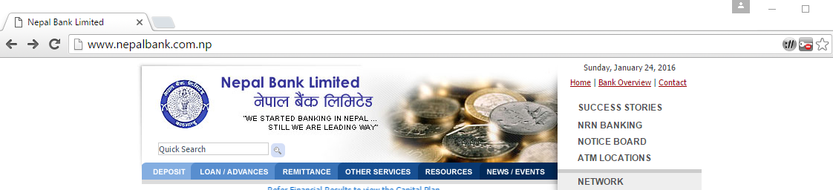
DNS Basics
DNS converts names (www.nepalbank.com.np) to numbers (198.1.112.132)
..to identify services such as www and e-mail
..that identify and link customers to business and visa versa

Slide 3
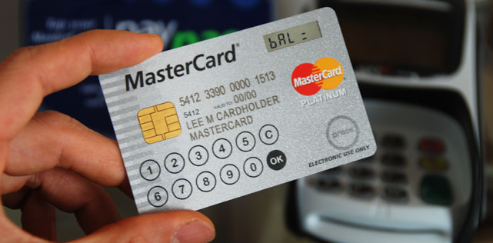





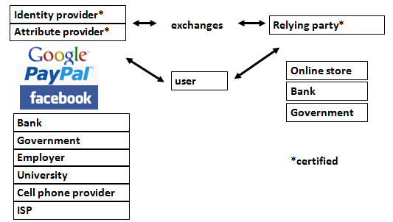
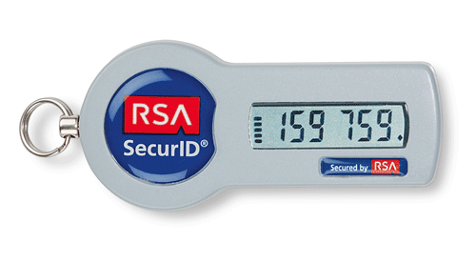

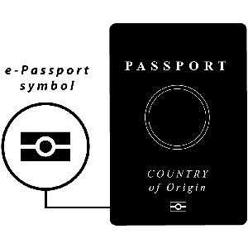

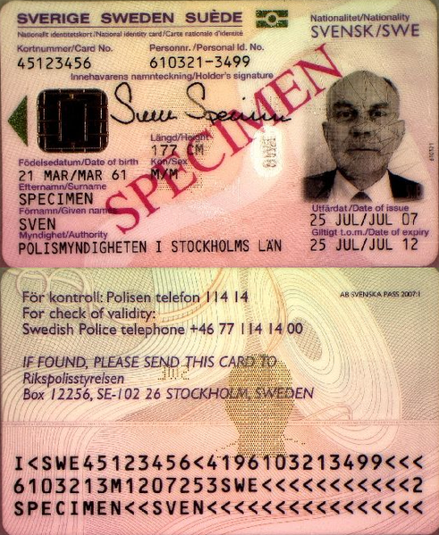
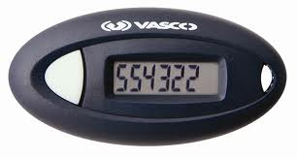

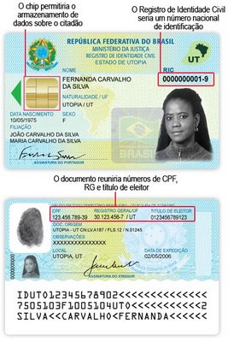

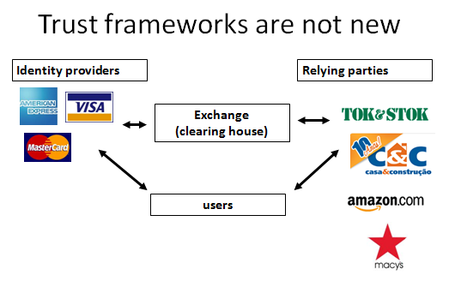

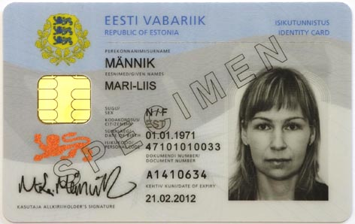

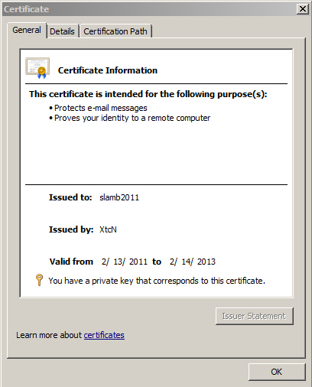

DNS is a part of all IT ecosystems
(much more than one expects)
US-NSTIC effort
+1-202-709-5262
VoIP
OECS ID effort
Smart Electrical Grid
lamb@xtcn.com
mydomainname.com
Notes:
Every time you create an account on a service, logon, buy something you rely on the honesty of DNS.
Even CAs rely on DNS to issue credentials so SSL is suspect. “lazy” CA is as good as “thorough” CA.
PKI and ID systems also rely on DNS to connect to databases to offer services and transfer authentication info.
VoIP relies on the e164 DNS zone as well.
Even with a FOB, you are relying on non-MITM connectivity to the service.

Slide 4
Where DNSSEC fits in
CPU and bandwidth advances make legacy DNS vulnerable to MITM attacks
DNS Security Extensions (DNSSEC) introduces digital signatures into DNS to cryptographically protect contents
With DNSSEC fully deployed a business can be sure a customer gets un-modified data (and visa versa)
Notes:
Discovery of DNS vulnerability: Bellovin 1995 then Aug 2008 Dan Kaminsky reveals DNS vulnerability shortcut.
Being able to cryptographically trust Internet infrastructure data, think about what that means…can I now click and download a .exe file?

Slide 5
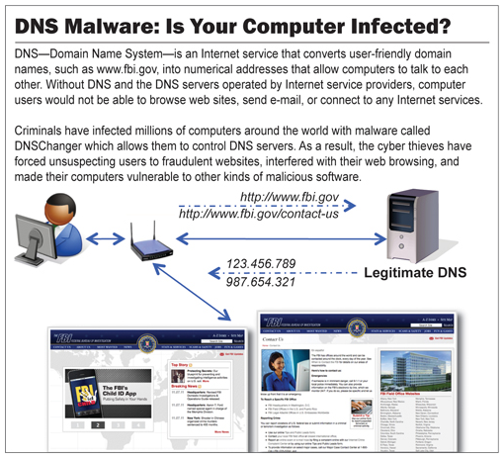
The Bad: DNSChanger - ‘Biggest Cybercriminal Takedown in History’ – 4M machines, 100 countries, $14M
Nov 2011 http://krebsonsecurity.com/2011/11/malware-click-fraud-kingpins-arrested-in-estonia/
End-2-end DNSSEC validation would have avoided the problems
Notes:
end-2-end DNSSEC validation would have avoided the problems.

Slide 6
The Internet’s Phone Book - Domain Name System (DNS)
www.majorbank.se = 1.2.3.4
www.majorbank.se=?
DNS Resolver
DNS
Server
1.2.3.4
Get page
webserverwww @ 1.2.3.4
Login page
Username / Password
Account Data
ISP
Majorbank (Registrant)
DNS Hierarchy
root
se
com
majorbank.se
www.majorbank.se
Notes:
Actually MANY phone books

Slide 7
Caching Responses for Efficiency
www.majorbank.se = 1.2.3.4
www.majorbank.se=?
DNS Resolver
DNS
Server
1.2.3.4
Get page
webserverwww @ 1.2.3.4
Login page
Username / Password
Account Data

Slide 8
The Problem:
DNS Cache Poisoning Attack
www.majorbank.se = 1.2.3.4
www.majorbank.se=?
DNS Resolver
DNS
Server
5.6.7.8
Attacker
www.majorbank.se = 5.6.7.8
Get page
Attacker
webserverwww @ 5.6.7.8
Login page
Username / Password
Error
Password database

Slide 9
Argghh! Now all ISP customers get sent to attacker.
www.majorbank.se = 1.2.3.4
www.majorbank.se=?
DNS Resolver
DNS
Server
5.6.7.8
Get page
Attacker
webserverwww @ 5.6.7.8
Login page
Username / Password
Error
Password database

Slide 10
Securing The Phone Book - DNS Security Extensions (DNSSEC)
Attacker’s record does not validate – drop it
www.majorbank.se = 1.2.3.4
www.majorbank.se=?
DNS Resolver
with DNSSEC
DNS
Server with DNSSEC
1.2.3.4
Attacker
www.majorbank.se = 5.6.7.8
Get page
webserverwww @ 1.2.3.4
Login page
Username / Password
Account Data
Notes:
So DNSSEC is a good thing.

Slide 11
Resolver only caches validated records
www.majorbank.se = 1.2.3.4
www.majorbank.se=?
DNS Resolver
with DNSSEC
DNS
Server with DNSSEC
1.2.3.4
Get page
webserverwww @ 1.2.3.4
Login page
Username / Password
Account Data
Notes:
So DNSSEC is a good thing.

Slide 12
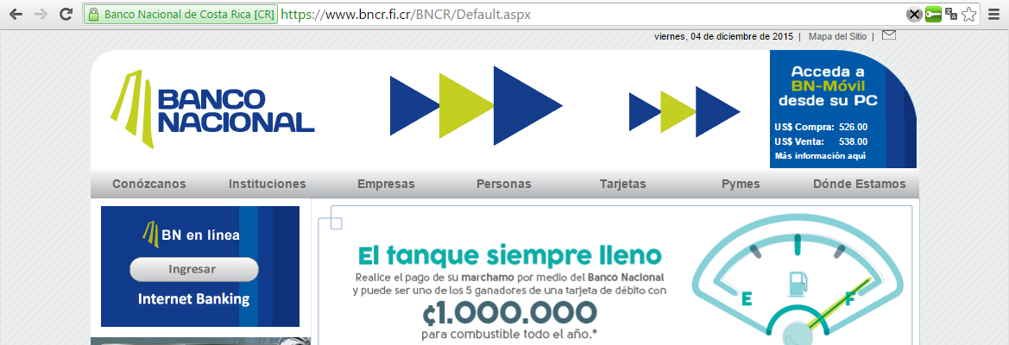
Securing it
DNS converts names (www.bncr.fi.cr) to numbers (201.220.29.26)
Make sure we get the right numbers (DNSSEC)
Verify the identity and encrypt data
DNSSEC
SSL
Notes:
Plug in to show DNSEC lock available at https://www.dnssec-validator.cz/

Slide 13
The Bad: Other DNS hijacks*
25 Dec 2010 - Russian e-Payment Giant ChronoPay Hacked
18 Dec 2009 – Twitter – “Iranian cyber army”
13 Aug 2010 - Chinese gmail phishing attack
25 Dec 2010 Tunisia DNS Hijack
2009-2012 google.*
  April 28 2009 Google Puerto Rico sites redirected in DNS attack
  May 9 2009 Morocco temporarily seize Google domain name
9 Sep 2011 - Diginotar certificate compromise for Iranian users
SSL / TLS doesn't tell you if you've been sent to the correct site, it only tells you if the DNS matches the name in the certificate. Unfortunately, majority of Web site certificates rely on DNS to validate identity.
DNS is relied on for unexpected things though insecure.
*A Brief History of DNS Hijacking - Google
http://costarica43.icann.org/meetings/sanjose2012/presentation-dns-hijackings-marquis-boire-12mar12-en.pdf

Slide 14
The Business Case for DNSSEC
Cyber security is becoming a greater concern to enterprises, government, and end users. DNSSEC is a key tool and differentiator.
DNSSEC is the biggest security upgrade to Internet infrastructure in over 20 years. It is a platform for new security applications (for those that see the opportunity).
DNSSEC infrastructure deployment has been brisk but requires expertise. Getting ahead of the curve is a competitive advantage.
Notes:
Cyber interest at C-level, and govt mandates. Large US ISP says: it used to be speed, now its security too.
DNS /w DNSSEC: a foothold for trust built into the Internet infrastructure.
94/316 tld + required for new gTLDs, 84% domains can deploy dnssec (but only 1% of 200M+) , s/w support,..

Slide 15
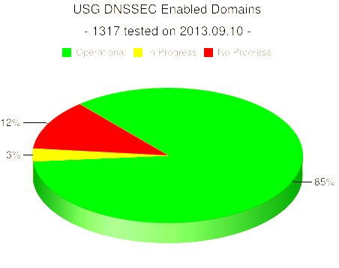
DNSSEC interest from governments
Sweden, Brazil, Netherlands, Czech Republic and others encourage DNSSEC deployment to varying degrees
Mar 2012 - AT&T, CenturyLink (Qwest), Comcast, Cox, Sprint, TimeWarner Cable, and Verizon have pledged to comply and abide by US FCC [1] recommendations that include DNSSEC.. “A report by Gartner found 3.6 million Americans getting redirected to bogus websites in a single year, costing them $3.2 billion.,”[2].
2008 US .gov mandate. 85% operational. [3]
[1] FCC=Federal Communications Commission=US communications Ministry
[2] http://securitywatch.pcmag.com/security/295722-isps-agree-to-fcc-rules-on-anti-botnet-dnssec-internet-routing
[3] http://www.whitehouse.gov/sites/default/files/omb/memoranda/fy2008/m08-23.pdf
http://fedv6-deployment.antd.nist.gov/snap-all.html
Notes:
Side note: dnssec may help remove chaff in determining the source of cyber attacks. Attribution is one of the the key elements in a successful approach to stemming the tide of cyber attacks.

Slide 16
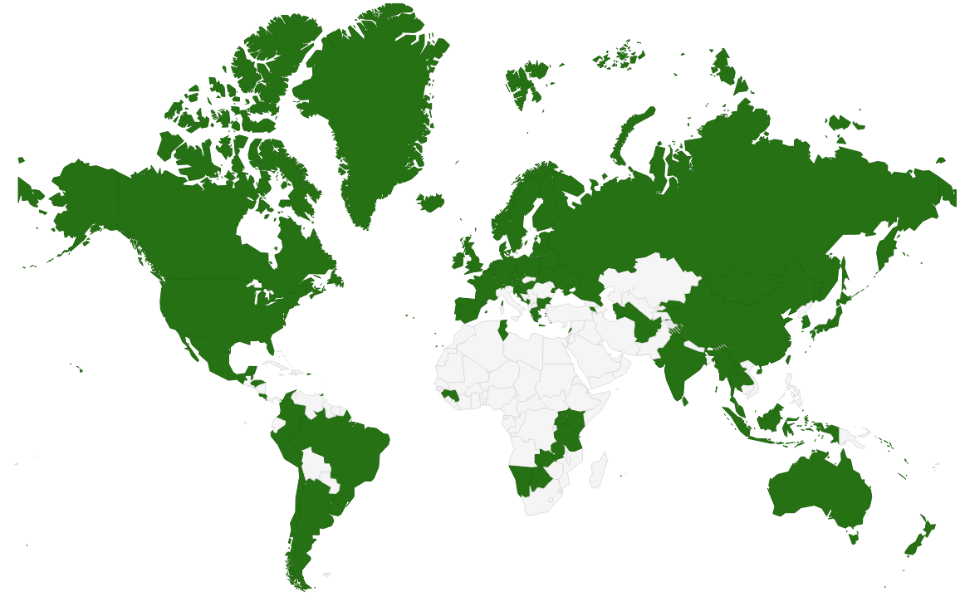
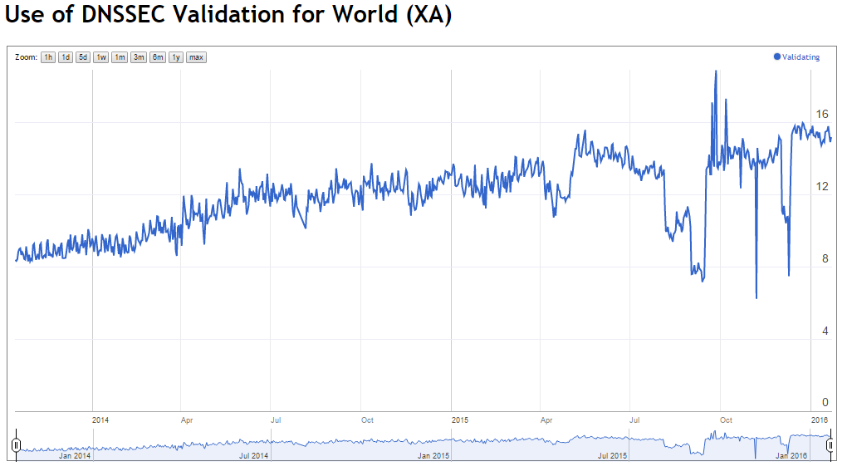
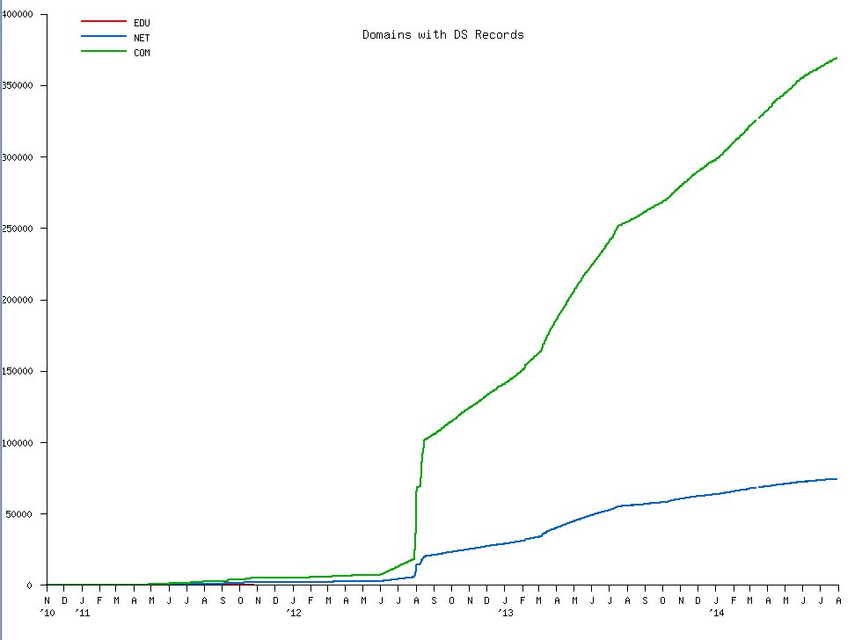
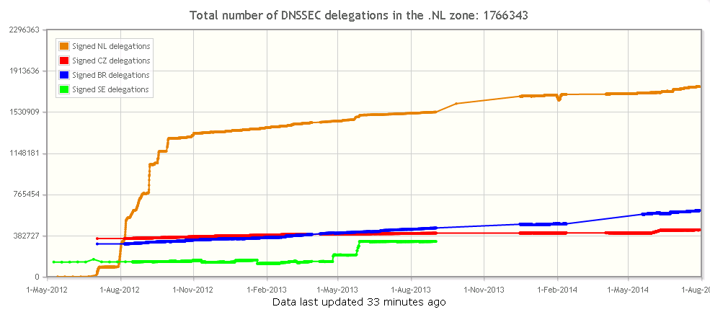
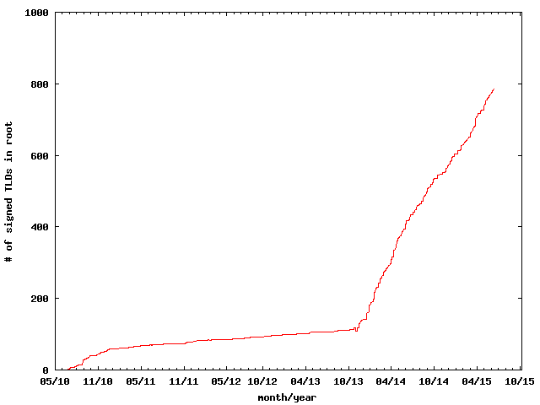
COM
Thank you Geoff Huston
DNSSEC TLDs
NL

Slide 17
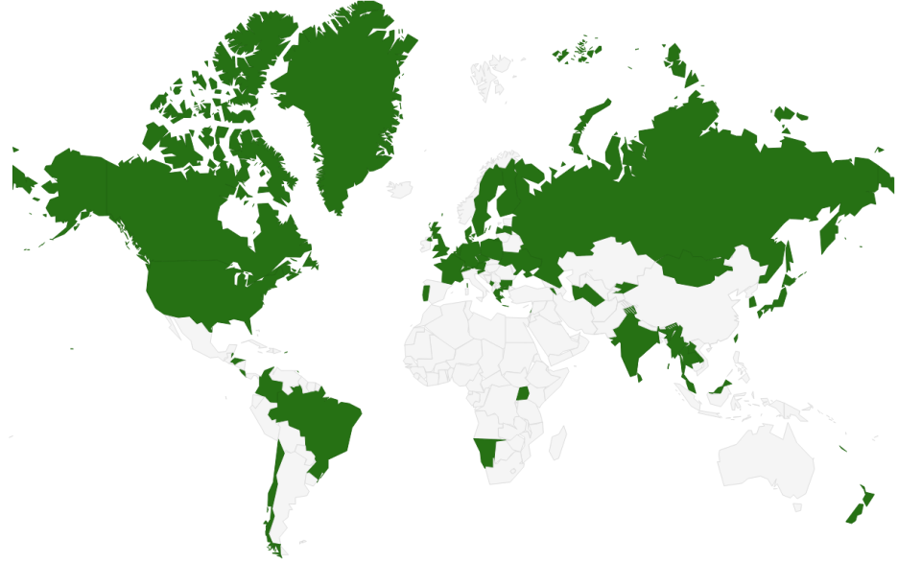
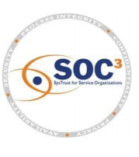

DNSSEC - Where we are
Deployed on 1034/1205 TLDs (23 Jan 2016 .az .in .af .tm .kg .cn .th .id .lk .se .de .ru .рф .com .uk .nl .fr .in .jp .us .my مليسيا .asia .tw 台灣, .kr 한국 .net, .org, .post, +ntlds, .ibm .berlin)
Root signed** and audited
> 85% of domain names could have DNSSEC
Required in new gTLDs. Basic support by ICANN registrars
Growing ISP support* - ~16% end users “validate”.
3rd party signing solutions***
Growing S/W H/W support: NLNetLabs, ISC, Microsoft, PowerDNS, Secure64…? openssl, postfix, XMPP, mozilla: early DANE support
IETF standard on DNSSEC TLS certificates (RFC6698) and others
Growing support from major players…(Apple iPhone/iPad, Google 8.8.8.8, hosting co Cloudflare DNSSEC by default, German email providers…)
Stats: https://rick.eng.br/dnssecstat/
* COMCAST /w 20M and others; most ISPs in SE ,CZ.
**Int’l bottom-up trust model /w 21 TCRs from: TT, BF, RU, CN, US, SE, NL, UG, BR, Benin, PT, NP, Mauritius, CZ, CA, JP, UK, NZ…
*** Partial list of registrars: https://www.icann.org/en/news/in-focus/dnssec/deployment
Notes:
http://rick.eng.br/dnssecstat/
Major layers: 8.8.8.8/Google, IOS6/Apple
Root: 21 TCRs from TT, BF, RU, CN, US, SE, NL, UG, BR, Togo, PT, NP, Mauritius, CZ, CA, JP, UK, NZ.
DNS over HTTP Chrome-ish, proprietary solutions: MSFT active directory, OpenDNS
All 18M COMCAST Internet customers. Also TeliaSonera SE, Vodafone, Telefonica, CZ, T-mobile NL
US ISP Comcast DNSSEC deployment plan for 18M customers and >5000 domain names http://blog.comcast.com/2011/12/dnssec-deployment-update.html
http://www.icann.org/en/news/in-focus/dnssec/deployment

Slide 18
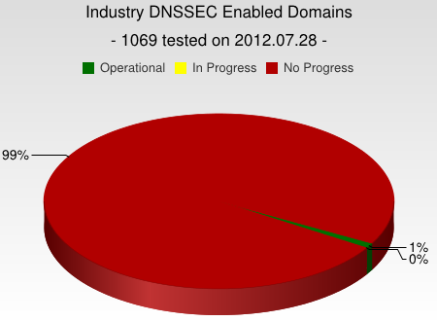
But…
But deployed on only ~2% of 2nd level domains. Many have plans. Few have taken the step (e.g., yandex.com, paypal.com*, comcast.com).
DNSChanger and other attacks highlight today’s need. (e.g end-2-end DNSSEC validation would have avoided the problems)
Innovative security solutions (e.g., DANE) highlight tomorrow’s value.
* http://fedv6-deployment.antd.nist.gov/cgi-bin/generate-com http://www.thesecuritypractice.com/the_security_practice/2011/12/all-paypal-domains-are-now-using-dnssec.html
http://www.nacion.com/2012-03-15/Tecnologia/Sitios-web-de-bancos-ticos-podran-ser-mas-seguros.aspx
Notes:
I was beaten into submission by APNIC’s to-notch PC to clarify this.
The future value of end2end dnssec as a foothold for securing applications.
OS or browser needs to validate. Not too hard a nut to crack but will take patience.
Note that “hotel/airport/hotspot” and other DNS interception networks would have saved you from DNSChanger as well since many force DNS requests to their own DNS resolvers regardless.
“people still get their domains social engineered out from under them at the registry/registar level, but would agree that it is a useful component to a larger solution”
Paypal deploys DNSSEC http://www.thesecuritypractice.com/the_security_practice/2011/12/all-paypal-domains-are-now-using-dnssec.html

Slide 19
DNSSEC: So what’s the problem?
Not enough IT departments know about it or are too busy putting out other security fires.
When they do look into it they hear old stories of FUD and lack of turnkey solutions and CDN support.
Registrars*/CDNs/DNS providers see no demand leading to “chicken-and-egg” problems.
*but required by new ICANN registrar agreement
Notes:
Ask 1) how many have dnssec deployed on corporate domains
and 2) if any of their resolvers have validation turned on.
“ISP support for DNSSEC is necessary even in a future in which end points perform all validation. They must be able to, at a minimum, recognize DNSSEC-related traffic and allow it to pass for the smooth functioning of an end-to-end, DNSSEC-secured system.”
Tools like DNS-Trigger, the CZ plug-in, etc help test this.
~6000 .COM 12 Dec 2011
For a virtuous cycle of secure DNSSEC implementations towards full deployment.
…and brings to bear improvements in overall IT security processes and practices that will address growing number of exploits such as hijacking.

Slide 20
Who Can Implement DNSSEC
Enterprises – Sign their zones and validate lookups
TLD Operators – Sign the TLD
Domain Name holders – Sign their zones
Internet Service Providers – validate DNS lookups
Hosting Provider – offer signing services to customers
Registrars – accept DNSSEC records (e.g., DS)

Slide 21
What you can do
For Companies:
  Sign your corporate domain names
  Just turn on validation on corporate DNS resolvers
For Users:
  Ask ISP to turn on validation on their DNS resolvers
For All:
  Take advantage of ICANN, ISOC and other organizations offering DNSSEC education and training
Notes:
Many options:
Build your own DNSSEC signer and submit keys to Registrar.
Or use GoDaddy service.
Could cost as little as $2/year (VRSN). Free (and training provided) if ccTLD with pch.net and some others.
Popular resolvers all support DNSSEC validation.

Slide 22
DNSSEC: A Global Platform for Innovation or..
I* $mell opportunity !
Notes:
*and a few others. See all the patent filings relying on DNSEC !!

Slide 23
Game changing Internet Core Infrastructure Upgrade
“More has happened here today than meets the eye. An infrastructure has been created for a hierarchical security system, which can be purposed and re‐purposed in a number of different ways. ..” – Vint Cerf (June 2010)

Slide 24
For Techies and other Dreamers

Slide 25
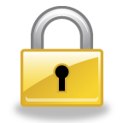
Too many CAs. Which one can we trust? DNSSEC to the rescue….
CA Certificate roots ~1482
Symantec, Thawte, Godaddy
DNSSEC root - 1
Internet of Things
IoT
Content security “Free SSL” certificates for Web and e-mail and “trust agility” DANE
Cross-organizational and trans-national authentication and security
Content security Commercial SSL Certificates for Web and e-mail
Crypto currencies and e-commerce?
DANE and other yet to be discovered security innovations, enhancements, and synergies
E-mail security SMIME,
DKIM RFC4871
Securing VoIP
Login security SSHFP RFC4255
Domain Names
https://www.eff.org/observatory
http://royal.pingdom.com/2011/01/12/internet-2010-in-numbers/
Notes:
SSL cert for tata.in can be provided by 1482 CAs including govts!! How do you know who to trust?
The Internet community started by with just trying to secure the DNS but we ended up with something much more. (see Vint Cerf’s quote)
With so many, trust is diluted. Used to be good when there were fewer.
Any one can encrypt. Few can Identify : Encryption != Identity
Examples of this problem: Comodo, MD5 crack, DigiNotar etc.. Failures.
Fact is that DNS has been unfortunately used as an independent authentication tool for some time: e.g. email authentication
Looking forward:
Build and improve on established trust models, e.g., CAs
Greatly expanded SSL usage (currently ~4M/200M)
Make SMIME (secured email - SMIMEA) a reality. All email packages already have support for this. They just don’t have a way to distribute keys. /w DNSSEC – now they do.
May work in concert with in enhancing or extending other cyber security efforts like digital Identities, WebID, BrowserID, CAs, ..
Securing VoIP
Simplify WiFi roaming security
Secure distribution of configurations (e.g., blacklists, anti-virus sigs)
Cryptocurrency??

Slide 26
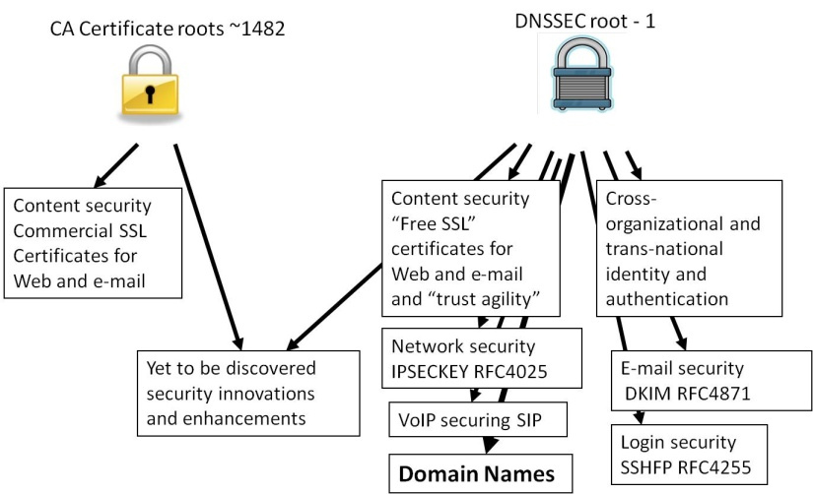
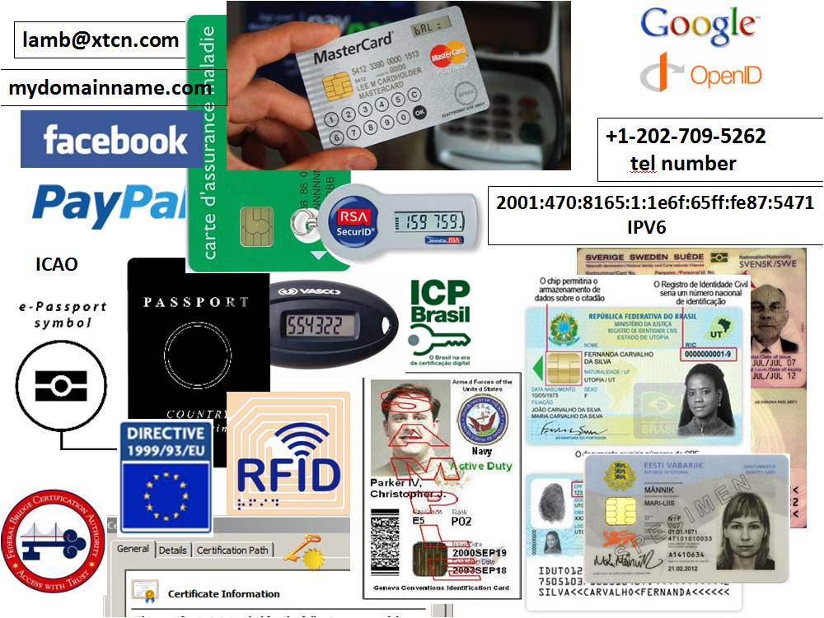
Opportunity: New Security Solutions
Improved Web SSL and certificates for all*
Secured e-mail (SMTP+S/MIME) for all*
Validated remote login SSH, IPSEC*
Securing VoIP
Cross organizational authentication, security
Secured content delivery (e.g. configurations, updates, keys) – Internet of Things
Securing Smart Grid efforts
Increasing trust in e-commerce
Securing cryptocurrencies and other new models
First global FREE PKI
A good ref http://www.internetsociety.org/deploy360/dnssec/
*IETF standards complete and more currently being developed
Notes:
Configuration data examples: anti-virus signatures, blacklists, etc…
Imagine if you could trust “the ‘Net” – again?
Inter email server exchange (SMTP) security using DNSSEC+DANE+TLS is becoming very popular in Germany and elsewhere post-Snowden.
At the 2015 Prague IETF meeting Snowden (via video conference) publicly singled out DNSSEC as a key technology for enhancing privacy.

Slide 27
A thought: Scalable Security for IoT
root
DNS is already there
DNSSEC adds security
com
and crosses organizational boundaries.
google.com
za
co.za
security.co.za
electric.co.za
iotdevices.co.za
water.rickshome.security.co.za
car.rickshome.iotdevices.co.za
aircond.rickshome.electric.co.za
window.rickshome.security.co.za
thermostat.rickshome.iotdevices.co.za
meter.rickshome.electric.co.za
door.rickshome.security.co.za
refrigerator.rickshome.iotdevices.co.za
Animated slide

Slide 28
DNSSEC: Internet infrastructure upgrade to help address today’s needs and create tomorrow’s opportunity.

Slide 29
More Techie stuff..
Hmm…how do I trust it?
(transparency transparency transparency!)

Slide 30
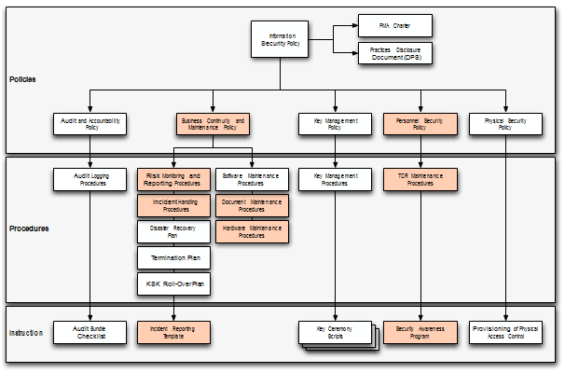
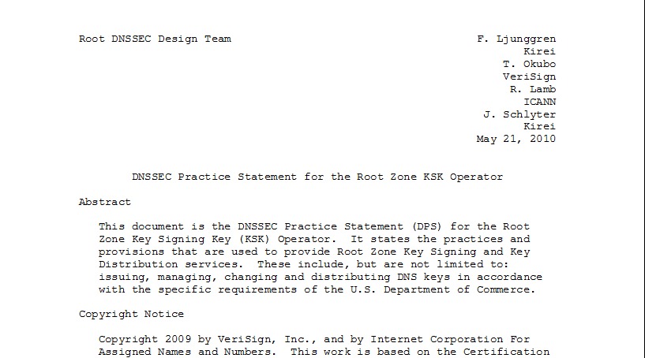
ICANN DNSSEC Deployment @Root
Multi-stakeholder, bottom-up trust model* /w 21 crypto officers from around the world
Broadcast Key Ceremonies and public docs
SysTrust audited
FIPS 140-2 level 4 HSMs
*Managed by technical community+ICANN
Root DPS
DNSSEC Practice Statement
Notes:
*Like how the Internet itself is operated and managed

Slide 31

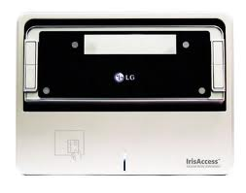
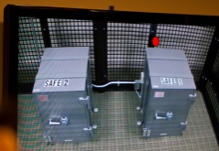
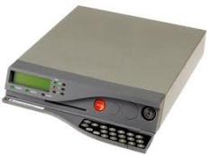
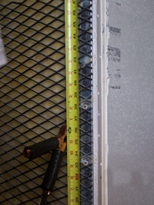
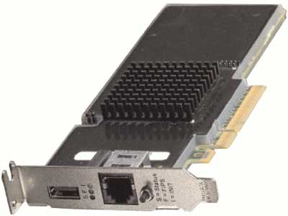
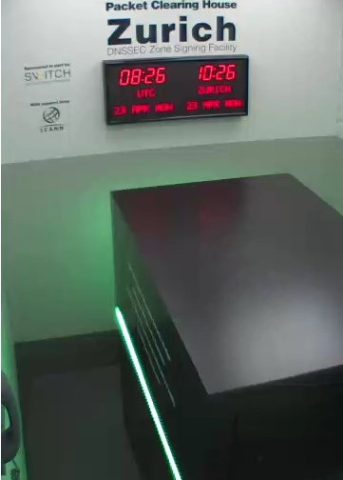
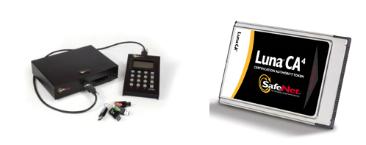
ICANN DNSSEC Deployment @Root (and elsewhere)
FIPS 140-2 level 4
Next .. ISO 19790
DCID 6/9 “SCIF” spec
Notes:
FR, NZ, root, com, UK, DCID 6/9
http://www.pch.net/dnssec/zrh

Slide 32
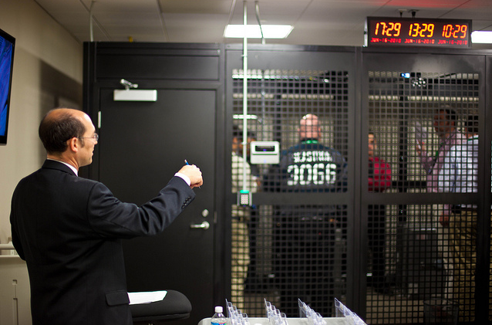
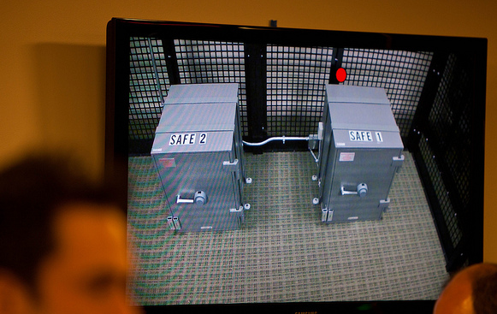
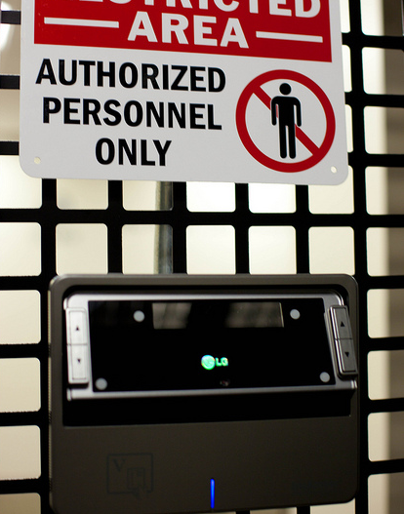
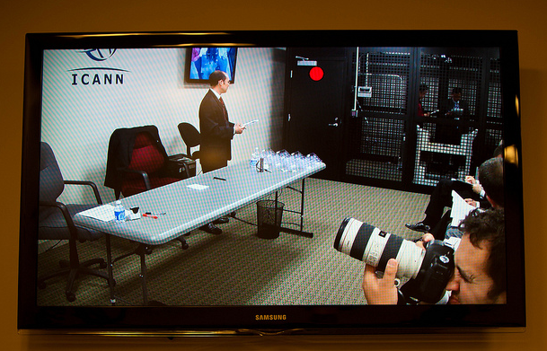
http://www.flickr.com/photos/kjd/sets/72157624302045698/
Photos: Kim Davies

Slide 33
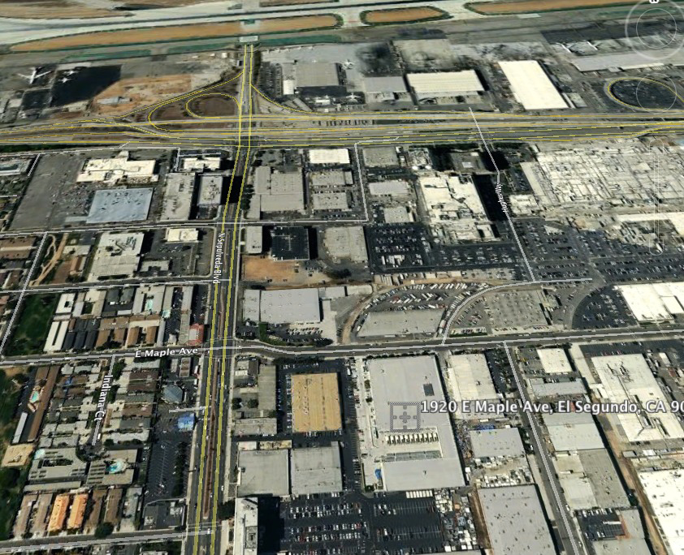

Slide 34
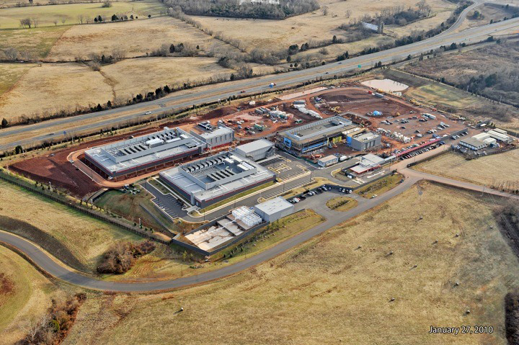

Slide 35

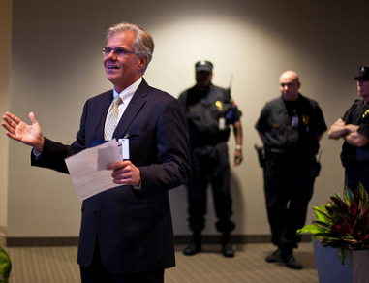
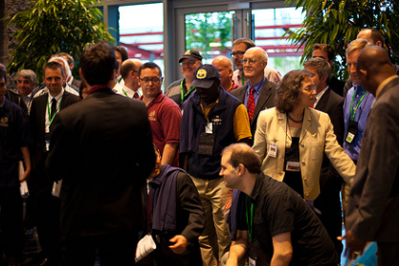
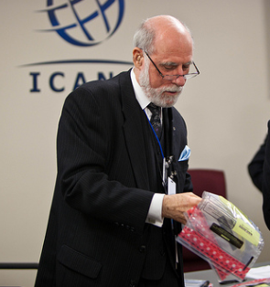
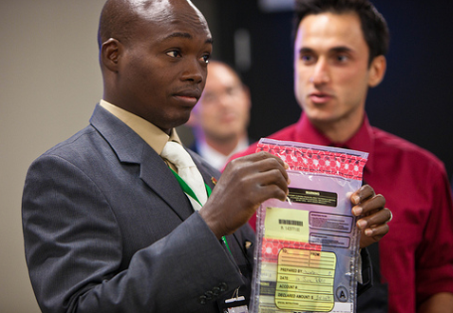
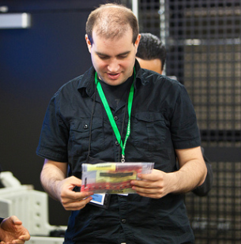

Slide 36
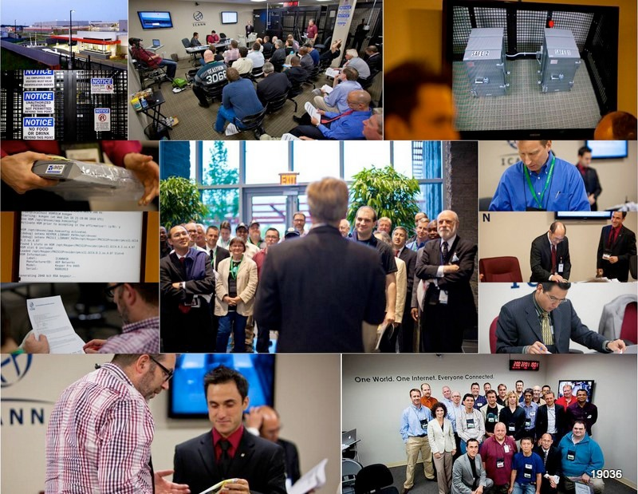
Photos: Kim Davies
Notes:
Fips 140-2 level 4
Gsa class 5
Biometrics
Multi-person control
Publicly documented
Draw from CA
Dcid 6/9 9 gauge mesh drywall

Slide 37
DNSSEC: Internet infrastructure upgrade to help address today’s needs and create tomorrow’s opportunity.

Slide 38
Tech Details of a DNSSEC Lookup

Slide 39
The Internet’s Phone Book - Domain Name System (DNS+DNSSEC)
bank.se DNSKEY+
RRSIG=?
www.bank.se=?
DNS Resolver
www.bank.se=?
DNS
Server
1.2.3.4
bank.se DNSKEY+
RRSIG=455536
www.bank.se=1.2.3.4
RRSIG=636345
Get page
webserverwww @ 1.2.3.4
Login page
www.bank.se=?
Username / Password
se DNSKEY+RRSIG=654376466
bank.se DS+RRSIG=11324
Account Data
ISP/ HotSpot / Enterprise/ End Node
bank.se (Registrant)
bank.se DS+RRSIG=?
se DNSKEY+RRSIG=?
Ask bank.se
. DNSKEY+RRSIG=77567577
se DS+RRSIG=7633423
DNS
Server
Ask .se
. DNSKEY+RRSIG=?
www.bank.se=?
se DS+RRSIG=?
.se (Registry)
DNS
Server
Details – yuk!
Animated slide
. (Root)
Notes:
Actually MANY phone books

