Slide 1
DNSSEC Implementation Considerations and Risk Analysis
Midrand, South Africa
8-10 July 2015
richard.lamb@icann.org

Slide 2
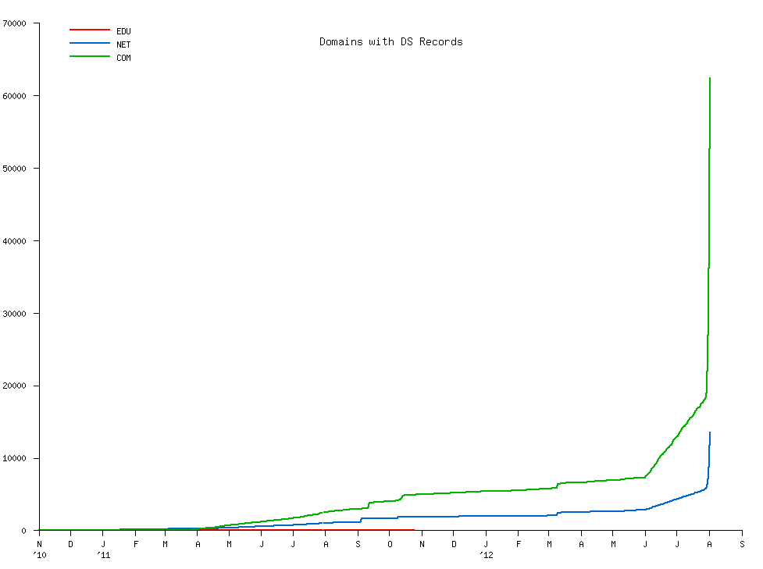
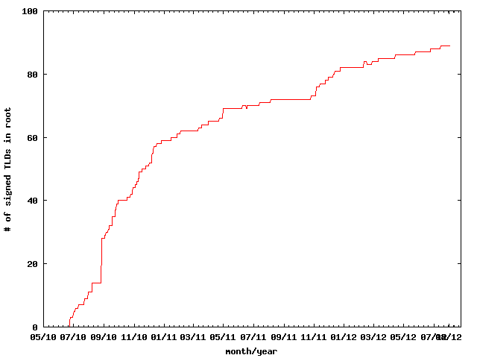
DNSSEC: We have passed the point of no return
Fast pace of deployment at the TLD level
Deployed at root
Supported by software
Growing support by ISPs
Required by new gTLDs
→ Inevitable widespread deployment across core Internet infrastructure
Notes:
The genie is out of the bottle.

Slide 3
Design Considerations

Slide 4
How do I sign a zone?

Slide 5
That’s it
dnssec-signzone mydomain.zone mydomain.zone.signed
www.abc.com. IN A 192.101.186.125
www.abc.com. IN A 192.101.186.125
IN RRSIG A 8 3 3600 20130926030000 20130909030000 32799 www.abc.com. N7upFHNplnIiXAEMOTefeuJrwymNxF 8D6/poAoRVDThHVOnXniaIj2WuGVbCGvUMjayDhVNk9vAQtVHUIAnxZXsIlP4ZbtIgtZ/hbTKByySx1Y0u9aRD1ik=

Slide 6
One way to do this
keys
nameserver
signer
mydomain.zone
mydomain.zone.signed

Slide 7
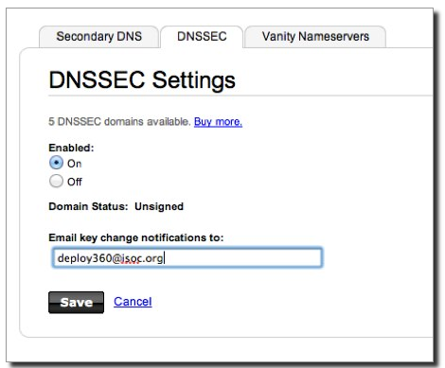
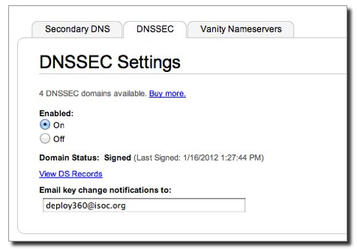
or…another
http://www.internetsociety.org/deploy360/resources/how-to-sign-your-domain-with-dnssec-using-godaddy-com/

Slide 8
It’s a question of risk / trust, but is does not have to be expensive

Slide 9
Goals
Reliable
Trusted
Cost Effective (for you)
Notes:
Trust – learn from existing formal IT security practices like SysTrust Principles: “Security, Availability,
Processing Integrity, Confidentiality, and Privacy”

Slide 10
Reliable
Keep design simple
Monitoring – DNSSEC is time sensitive!
People – develop checklists and documentation

Slide 11
Cost Effectiveness

Slide 12
Cost Effectiveness
Risk Assessment
Cost Benefit Analysis

Slide 13
Business Benefits and Motivation (from “The Costs of DNSSEC Deployment” ENISA report)
Become a reliable source of trust and boost market share and/or reputation of zones;
Lead by example and stimulate parties further down in the chain to adopt DNSSEC;
Earn recognition in the DNS community and share knowledge with TLD’s and others;
Provide assurance to end-user that domain name services are reliable and trustworthy;
Look forward to increasing adoption rate when revenue is an important driver. Deploying DNSSEC can be profitable;

Slide 14
Risk Assessment
Identify your risks
Reputational
Competition
Loss of contract
Legal / Financial
Who is the relying party?
SLA
Law suits
Build your risk profile
Determine your acceptable level of risk
Notes:
Acceptable level of risk - e.g. reputtation: no-compromise; An attack can only take place if key compromise goes unnoticed. Can recover otherwise.; Be real: will not protect against terrorist attack; internal collusion – pick a number: 1 in a million?; irrelevancy/non-use: stakeholder involvement.

Slide 15
Vulnerabilities
False expectations
Key compromise
Signer compromise
Zone file compromise
Notes:
False expectations – e.g. lack of “SLA” and or “DPS” to set expectations on compromise recovery for child key (how long) as well as for parent keying material (backup keys, how long). No one can offer perfect security. But
Involve stakeholders to minimize reputational / legal risks.
Insecure DS handling – broken chain of trust
Private key compromise: bad rng, too short; background checks?, threats, bribed -> collusion
bad Signer: unvalidated s/w; vulnerable code.
Undetermined: loss of chain of custody (careless handling, sabotage, environment, access control failure, structure weakness, collusion)

Slide 16
Cost Benefit Analysis
Setting reasonable expectations means it doesn’t have to be expensive

Slide 17
From ENISA Report
“….organizations considering implementing DNSSEC can greatly benefit from the work performed by the pioneers and early adopters.”
Few above 266240 Euros: Big Spenders: DNSSEC as an excuse to upgrade all infrastructure; embrace increased responsibility and trust through better governance.
Most below 36059 Euros: Big Savers: reuse existing infrastructure. Do minimum.

Slide 18
Anticipated Capital and Operating Expense
Being a trust anchor requires mature business processes, especially in key management;
Investment cost also depends on strategic positioning towards DNSSEC: leaders pay the bill, followers can limit their investment;
Financial cost might not outweigh the financial benefits. Prepare to write off the financial investment over 3 to 5 years, needed to gear up end-user equipment with DNSSEC.

Slide 19
Other Cost Analysis
People
Swedebank – half a FTE
Occasional shared duties for others
Facilities
Datacenter space
Safe ~ $100 - $14000
Crypto Equip ~ $5-$40000
Bandwidth ~ 4 x
http://www.internetdagarna.se/arkiv/2008/www.internetdagarna.se/images/stories/doc/22_Kjell_Rydger_DNSSEC_from_a_bank_perspective_2008-10-20.pdf
Notes:
http://www.internetdagarna.se/arkiv/2008/www.internetdagarna.se/images/stories/doc/22_Kjell_Rydger_DNSSEC_from_a_bank_perspective_2008-10-20.pdf
Too much?
Outsource all
Opportunity for some

Slide 20
Trusted

Slide 21
Trust
Transparent
Secure

Slide 22
Transparency

Slide 23
Transparency
The power of truth
Transparency floats all boats here
Say what you do
Do what you say
Prove it

Slide 24
Say what you do
Setting expectations
Document what you do and how you do it
Maintain up to date documentation
Define Organization Roles and responsibilities
Describe Services, facilities, system, processes, parameters

Slide 25
Learn from CA successes (and mistakes)
The good:
The people
The mindset
The practices
The legal framework
The audit against international accounting and technical standards
The bad:
Diluted trust with a race to the bottom (>1400 CA’s)
DigiNotar
Weak and inconsistent polices and controls
Lack of compromise notification (non-transparent)
Audits don’t solve everything (ETSI audit)
Notes:
The people: e.g., Tomofumi Okubo, Fredrik Lundgren, Paul Hoffman, David Miller (AEP)
The people (those willing to share in this secret art)
The mindset (trust in process. not people)
The practices (physical, logical, cryptographic security)
The legal framework (setting expecations. liability limitations)
HEBC/USHER – US university system PKI example.
SysTrust similar to WebTrust – economies of similarity. Number of SSL: 4M/200+M sites Could have many more. Many countries use VRSN for govt dig sign. Why not own country?
ETSI failed for DigiNotar

Slide 26
Say What You Do - Learn from Existing Trust Services
Borrow many practices from SSL Certification Authorities (CA)
Published Certificate Practices Statements (CPS)
VeriSign, GoDaddy, etc..
Documented Policy and Practices (e.g., key management ceremony, audit materials, emergency procedures, contingency planning, lost facilities, etc…)
Notes:
Learn from existing formal IT security practices.
CPS and instructive CA key/backup document for HEBCA: http://usher.internet2.edu/practices/ca1/cps.pdf http://tinyurl.com/34zzmne
CA’s are a good start (they know the trust business) but most of internal Practices are kept private.
Line between current CA offerings and DNS will become blurred – but real CAs provide critical value on the ground, e.g., EV certs.
Note: Cant just copy CPS – usually copyrighted.

Slide 27
Say What You Do - DNSSEC Practices Statement
DNSSEC Policy/Practices Statement (DPS)
Drawn from SSL CA CPS
Provides a level of assurance and transparency to the stakeholders relying on the security of the operations.
Regular re-assessment
Management signoff
Formalize - Policy Management Authority (PMA)
Notes:
Policy may be used by TLD mgrs or regulatory authorities to express requirements to registry operator.
Or may simply be the registry’s own standards to follow.
May be one document or two.
RFC for DNS framework / check list in draft (Fredrik Lundgren)
Examples: SE DPS http://www.iis.se/docs/se-dnssec-dps-eng.pdf Root http://www.iana.org/dnssec
Describe PMA

Slide 28
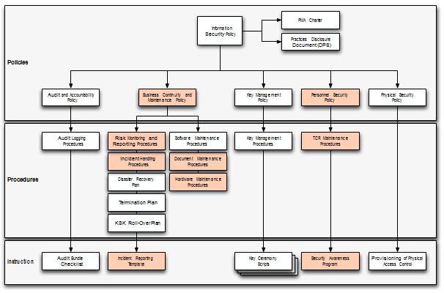
Documentation - Root
91 Pages and tree of other documents!
Root DPS
Notes:
Spells out multiparty controls (e.g., at least two)

Slide 29
Documentation - .SE
22 pages, Creative Commons License!
.SE DPS
Notes:
Just go through and replace “SE” with “your TLD” for a great starting point for your lawyers.
**BR just had checklists. Bottom line – transparency buys trust.

Slide 30
Do what you say
Follow documented procedures / checklists
Maintain logs, records and reports of each action, including incidents.
Critical operations at Key Ceremonies
Video
Logged
Witnessed

Slide 31
Key Ceremony
A filmed and audited process carefully scripted for maximum transparency at which cryptographic key material is generated or used.
Notes:
Point to root zone key ceremonies document

Slide 32
Prove it
Audits
3rd party auditor $$
ISO 27000 $$ etc..
Internal

Slide 33
Prove it - Audit Material
Key Ceremony Scripts
Access Control System logs
Facility, Room, Safe logs
Video
Annual Inventory
Logs from other Compensating Controls
Incident Reports
Notes:
Some elements above may need to be attested to or signed by management as determined by auditor.
Logs should have entry/exit, open/close, removal/return.
Compensating Controls are your friend – other logs, logging, video etc…

Slide 34
Prove it
Stakeholder Involvement
Publish updated material and reports
Participation, e.g. External Witnesses from
local Internet community
Government
Listen to Feedback

Slide 35
Prove it
Be Responsible
Executive Level Involvement
In policies via Policy Management Authority
Key Ceremony participation

Slide 36
Security

Slide 37
Building in security
Getting the machinery for DNSSEC is easy (BIND, NSD/Unbound, OpenDNSSEC, etc..).
Finding good security practices to run it is not.

Slide 38
Security
Physical
Logical
Crypto

Slide 39
Physical
Environmental
Tiers
Access Control
Intrusion Detection
Disaster Recovery

Slide 40
Physical - Environmental
Based on your risk profile
Suitable
Power
Air Conditioning
Protection from
Flooding
Fire
Earthquake
Notes:
California reference – risk profile balances operational, cost, and environmental

Slide 41
Physical - Tiers
Each tier should be successively harder to penetrate than the last
Facility
Cage/Room
Rack
Safe
System
Think of concentric boxes

Slide 42
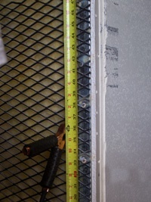
Physical - Tier Construction
Base on your risk profile and regulations
Facility design and physical security on
Other experience
DCID 6/9
NIST 800-53 and related documents
Safe / container standards
Notes:
Terrorist attack – not protected
Undetected access is worst case
Safe story
EMI – don’t care if HSM rated
Local regulations (e.g. fire)
DCID and various other hard to learn from sources: 9 gague stretched steel, real floor to real ceiling.
DNSSEC at root is rare in that we are sharing such info with public – call it a dividend to the public

Slide 43
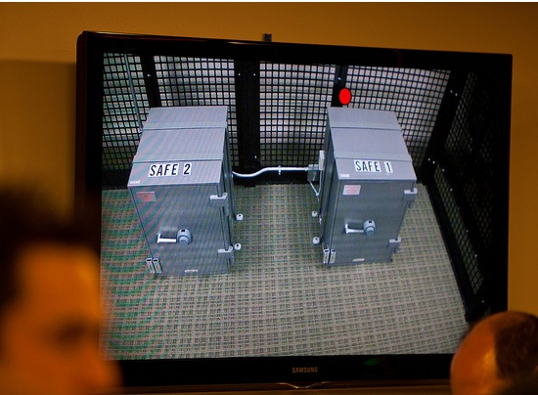
Physical – Safe Tier
Notes:
M of N was 3-of-7 plus SSSC1 SSC2 and multi-person access control to facility

Slide 44
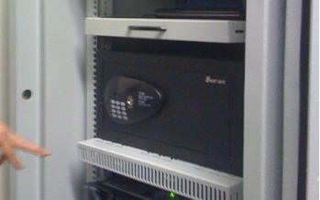
Physical – Safe Tier
Notes:
Looks like your hotel safe – huh. My suggestion – no batteries.

Slide 45
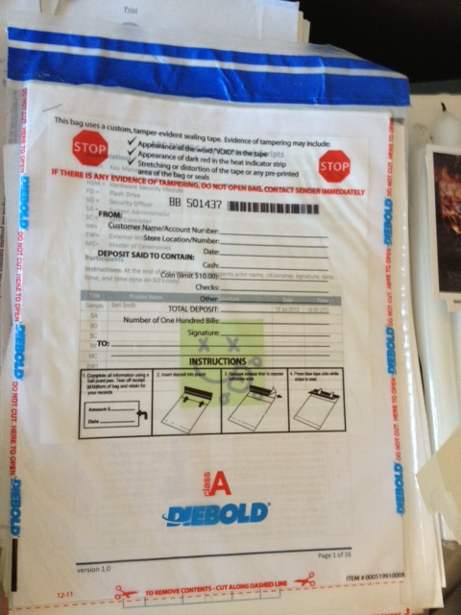
Physical – Tamper Evident Packaging

Slide 46
Physical - Access Control
Base on your risk profile
Access Control System
Logs of entry/exit
Dual occupancy / Anti-passback
Allow Emergency Access
High Security: Control physical access to system independent of physical access controls for the facility
Notes:
Facility is ID + guard – log book
Safe is combination – log sheet
Tiers are card+pin+biometric – ACS logging
All filmed by at least facility

Slide 47
Physical - Intrusion Detection
Intrusion Detection System
Sensors
Motion
Camera
Tamper Evident Safes and Packaging
Tamper Proof Equipment
Notes:
Facility: Manned, video monitor (and archived), monitor access to racks/cage/room
Sensors – door, seismic, water
Risk assessment – worst case: undetected/ unnoticed. So focus on detecting where total prevention is impossible. …and have mechanism to recover from compromise.

Slide 48
Physical - Disaster Recovery
Multiple sites
Mirror
Backup
Geographical and Vendor diversity
Notes:
Availability !!! So two sites AND backup of material.
Multiple sites from different facility providers.
Off site Backup could be a bank safe deposit box holding a smartcard in a tamper evident bag.

Slide 49
Logical
Authentication (passwords, PINs)
Multi-Party controls
Notes:
Risk:
lost/guessed password
Collusion

Slide 50
Logical - Authentication
Procedural:
REAL passwords
Forced regular updates
Out-of-band checks
Hardware:
Two-factor authentication
Smart cards (cryptographic)
Notes:
Risk: guessed password
Password best practices can be found in various commercial standards PCI
Most of this slide is critical for the “child” user interface (that does not benefit from any physical security) for submitting DS records.
Out of band may be an automated phone call or FAX like many services (e.g. GoDaddy, name.com – “courtesy” call) do.
Pass out various embodiments…
In the case of compromise, Out-of-band authentication mechanism is necessary (e.g. should attacker use compromised key to facilitate a legitimate dnskey/ds rollover) - true for parent or child relationship

Slide 51
Logical - Multi-Party Control
Split Control / Separation of Duties
E.g., Security Officer and System Admin and Safe Controller
M-of-N
Built in equipment (e.g. HSM)
Procedural: Split PIN
Bolt-On: Split key (Shamir, e.g. ssss.c)
Notes:
Risk: Collusion
Separation of Duties: Different departments in same org or different orgs
Explain split PIN and split-key
Can combine ACS+Safe+MofN to greatly reduce collusion probability

Slide 52
Crypto
Algorithms / Key Length
Crypto Hardware

Slide 53
Crypto - Algorithms / Key Length
Factors in selection
Cryptanalysis
Regulations
Network limitations

Slide 54
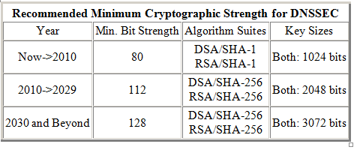
Crypto - Key Length
Cryptanalysis from NIST: 2048 bit RSA SHA256
http://csrc.nist.gov/publications/nistpubs/800-57/sp800-57_PART3_key-management_Dec2009.pdf
Notes:
NIST
http://csrc.nist.gov/publications/nistpubs/800-57/sp800-57_PART3_key-management_Dec2009.pdf
Root rollout did force resolver upgrade to sha256…

Slide 55
Crypto - Algorithms
Local regulations may determine algorithm
GOST
DSA
Network limitations
Fragmentation means shorter key length is better
ZSK may be shorter since it gets rolled often
Elliptical is ideal – but not commonplace
Notes:
Signature churn not a problem with RSA 1024 or higher
If problems with 1024 – we have a much bigger problem than DNSSEC.
FWIW: RSA 1024 ~ 6 mo – other anecdotal notes, 10 years estimated, 2048 is ok
Elliptical is encumbered by patent rights but cryptographers love it. It may become standard after a few (>5) years
BTW GOST is elliptical…

Slide 56
Crypto - Algorithms
NSEC3 if required
Protects against zone walking
Avoid if not needed – adds overhead for small zones
Non-disclosure agreement?
Regulatory requirement?
Useful if zone is large, not trivially guessable (only “www” and “mail”) or structured (ip6.arpa), and not expected to have many signed delegations (“opt-out” avoids recalculation).
Notes:
Use a dynamic / incremental signing solution for the large zones? BIND 9.7.x

Slide 57
Crypto - Hardware
Satisfy your stakeholders
Doesn’t need to be certified to be secure (e.g., off-line PC)
Can use transparent process and procedures to instill trust
But most Registries use or plan to use HSM. Maybe CYA?
AT LEAST USE A GOOD Random Number Generator (RNG)!
Use common standards avoid vendor lock-in.
Note: KSK rollover may be ~10 years.
Remember you must have a way to backup keys!
Notes:
Off-line PC: Your know secure64 is just a PC with a TPM chip that encrypts a bundle = FIPS 140-2 level 2
NO RNG = a vulnerability. "random numbers too important to be left for chance."
Backup keys – cant use on smartcard key gen. Bad policy if HSM vendor dies too. See CA HEBCA example.

Slide 58
Crypto - Hardware Security Module (HSM)
FIPS 140-2 Level 3
Sun SCA6000 (~30000 RSA 1024/sec) ~$10000 (was $1000!!)
Thales/Ncipher nshield (~500 RSA 1024/sec) ~$15000
Ultimaco
FIPS 140-2 Level 4
AEP Keyper (~1200 RSA 1024/sec) ~$15000
IBM 4765 (~1000 RSA 1024/sec) ~$9000
Recognized by your national certification authority
Kryptus (Brazil) ~ $2500
Study: http://www.opendnssec.org/wp-content/uploads/2011/01/A-Review-of-Hardware-Security-Modules-Fall-2010.pdf

Slide 59
Crypto - PKCS11
A common interface for HSM and smartcards
C_Sign()
C_GeneratePair()
Avoids vendor lock-in - somewhat
Vendor Supplied Drivers (mostly Linux, Windows) and some open source

Slide 60
Crypto - Smartcards / Tokens
Smartcards (PKI) (card reader ~$12)
AthenaSC IDProtect ~$30
Feitian ~$5-10
Aventra ~$11
TPM
Built into many PCs
Token
Aladdin/SafeNet USB e-Token ~$50
Open source PKCS11 Drivers available
OpenSC
Has RNG
Slow ~0.5-10 1024 RSA signatures per second

Slide 61
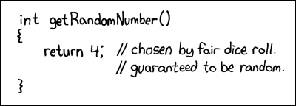
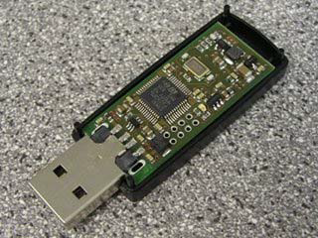
Crypto -Random Number Generator
rand()
Netscape: Date+PIDs
LavaRand
System Entropy (/dev/random-urandom)
H/W, Quantum Mechanical (laser) $$
Standards based (FIPS, NIST 800-90 DRBG)
Built into CPU chips

Slide 62
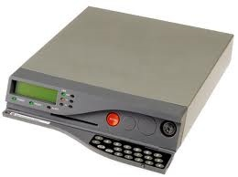
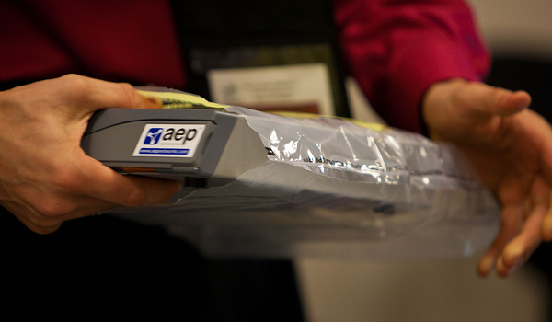
Crypto - FIPS 140-2 Level 4 HSM
Root, .FR, .CA …

Slide 63
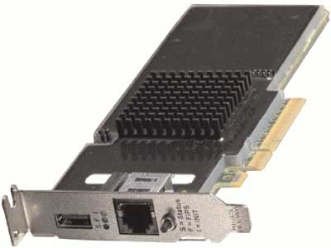
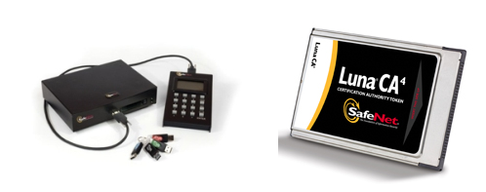
Crypto – FIPS Level 3 HSM
But FIPS 140-2 Level 3 is also common
Many TLDs using Level 3 .com , .se, .uk, .com, etc… $10K-$40K

Slide 64
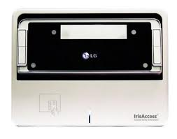
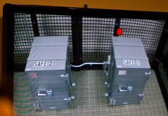
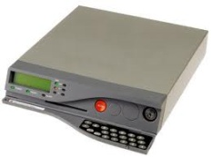
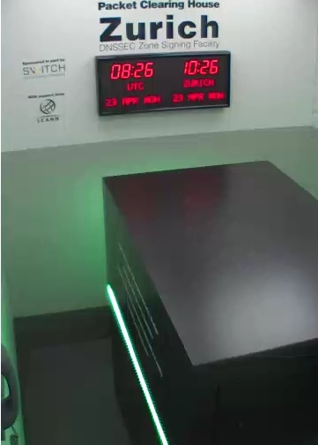
An implementation can be thi$
Notes:
FR, NZ, root, com, UK, DCID 6/9
http://www.pch.net/dnssec/zrh

Slide 65
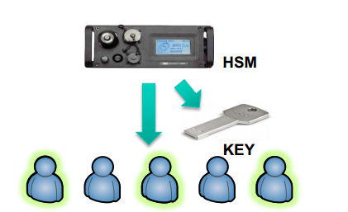
…or this
http://singapore49.icann.org/en/schedule/wed-dnssec/presentation-dnssec-deployment-cn-26mar14-en.pdf

Slide 66
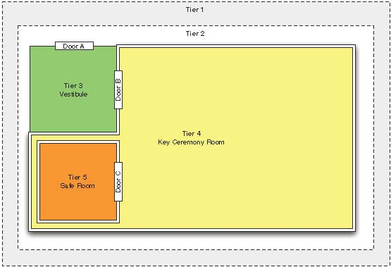
Physical Security

Slide 67
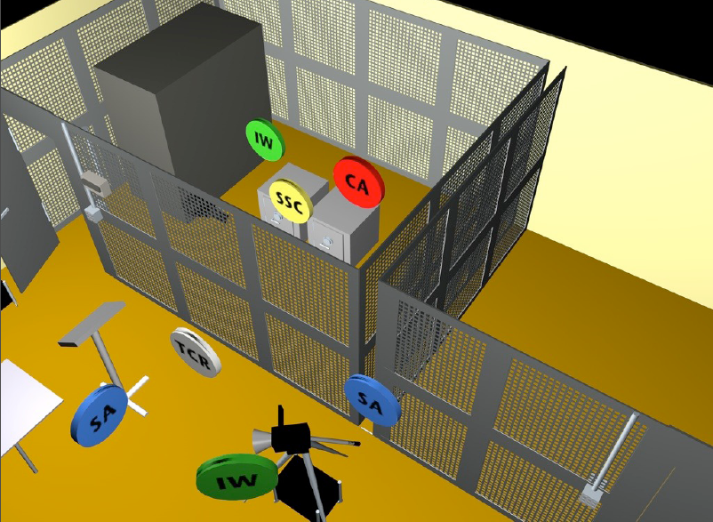

Slide 68
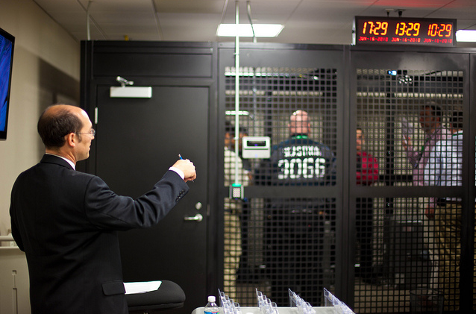
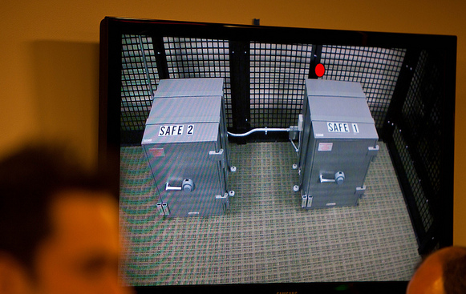
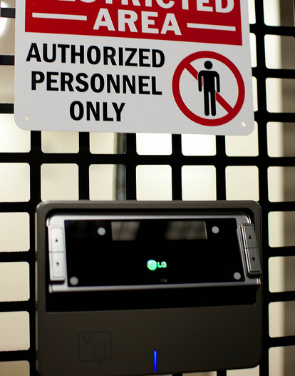
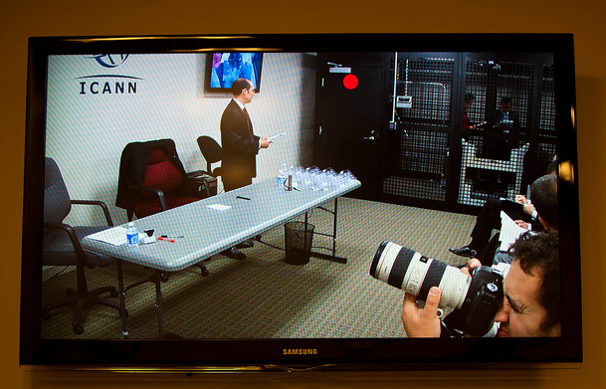
http://www.flickr.com/photos/kjd/sets/72157624302045698/

Slide 69
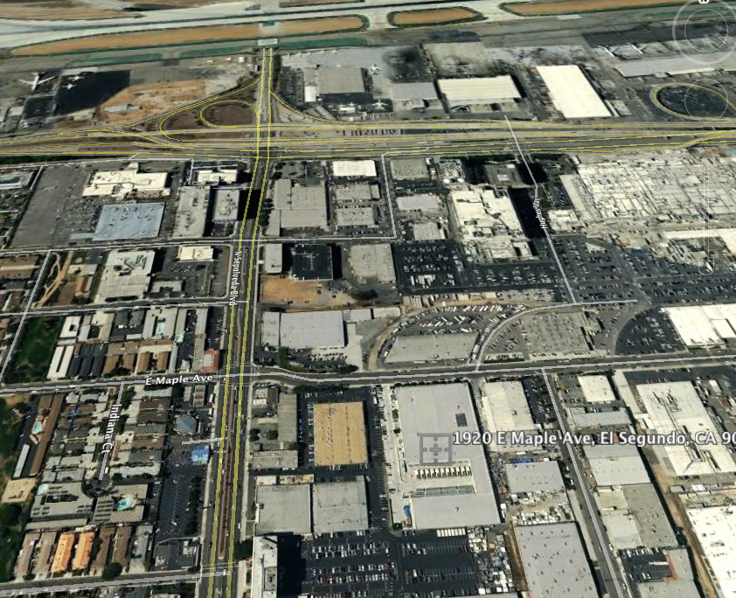

Slide 70
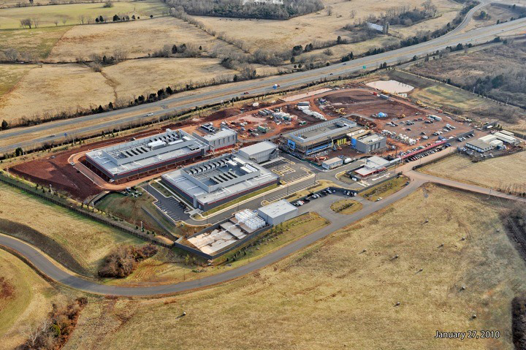

Slide 71
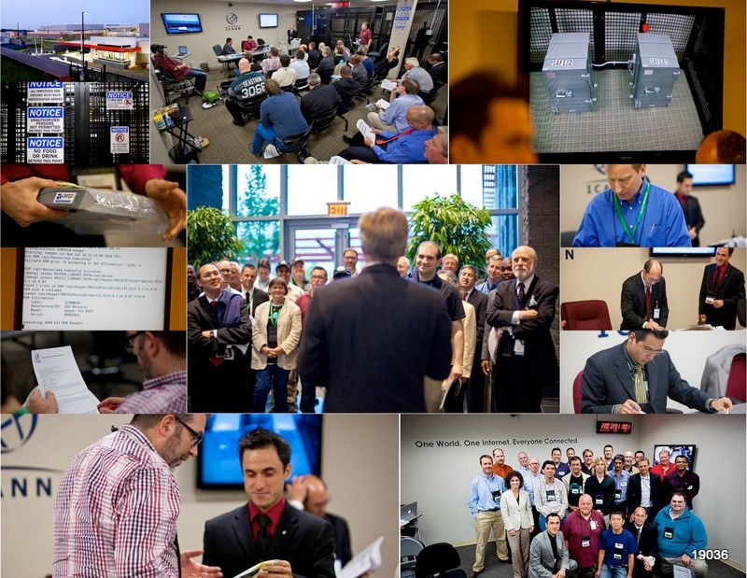
Notes:
Fips 140-2 level 4
Gsa class 5
Biometrics
Multi-person control
Publicly documented
Draw from CA
Dcid 6/9 9 gauge mesh drywall

Slide 72
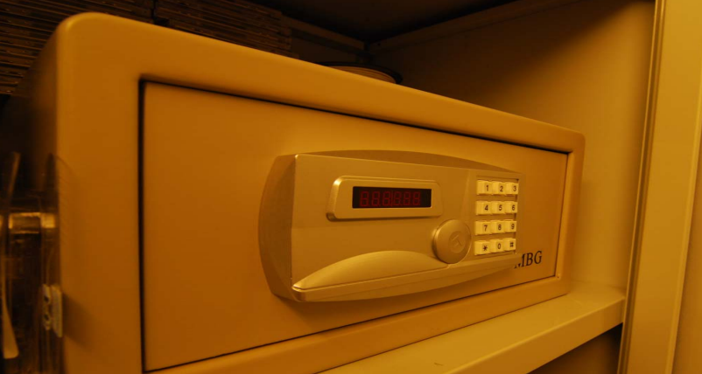
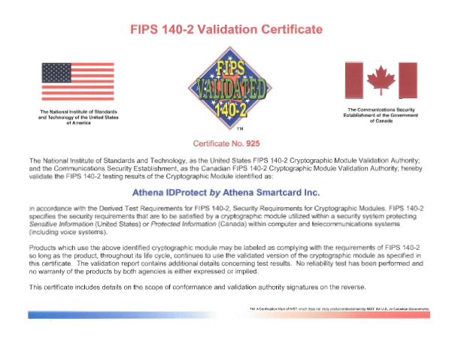
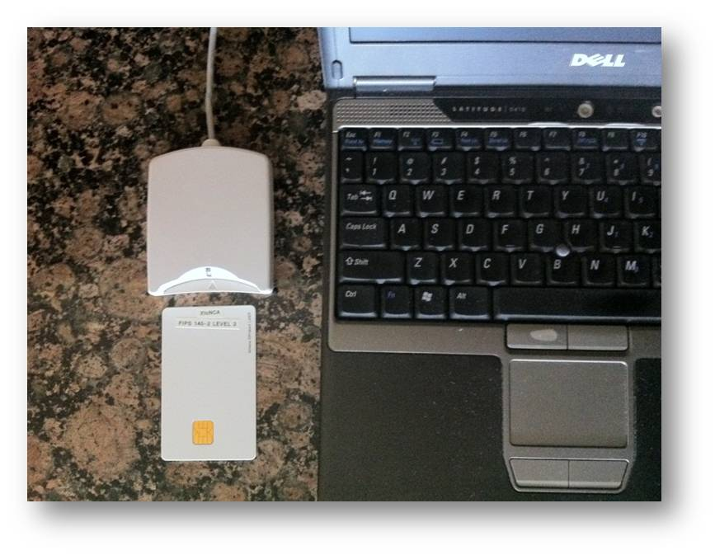
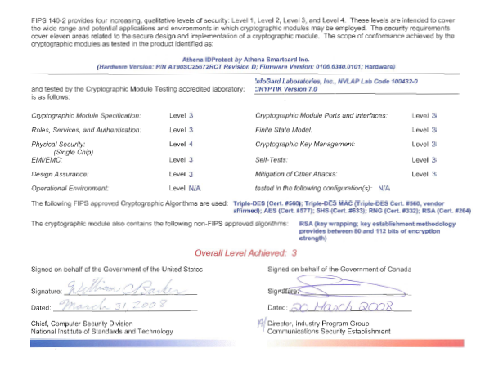
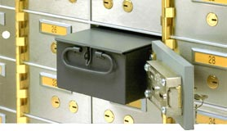
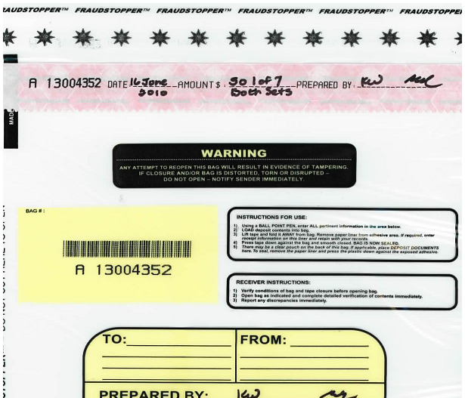
…or this
+
TPM
Notes:
JP, old SE, new CR

Slide 73
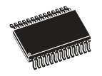
..or this (from .cr .ar)
Transport KSK signed DNSKEY RRsets
unsigned
zone
Sign ZSKs with KSK
Sign zones with ZSK
Offline Laptop with TPM
Online/off-net DNSSEC Signer with TPM
signed
zone
KSK
Transport public half of ZSKs
Generate KSK
ZSKs
Generate ZSKs
Secure Off-line Environment
Animated slide
Notes:
9 March 2012
…and bnonline.fi.cr
http://www.nacion.com/2012-03-15/Tecnologia/Sitios-web-de-bancos-ticos-podran-ser-mas-seguros.aspx

Slide 74
…or even this
Off-line
Off-net
DATA CENTER
CAGE
DATA CENTER
RACK
CAGE
SAFE
RACK
All in tamper evident bags
FD with public ZSKs
zonefile
ZSKs
KSK on FD
Live O/S DVD
signer
laptop
FD with KSK signed DNSKEY RRsets
firewall
hidden master
RNG
Notes:
From LACTLD training I gave in September. Notes from there on simple separation of duties and even ssss.c for M-of-N. Go thru risk analysis, threats and controls
Pull out TEBs.

Slide 75
Learn from others mistakes

Slide 76
ISP’s and other validating resolver operators
Learn from experience of others*. When someone else’s DNSSEC system fails, e.g., signatures expire, who gets the phone call? YOU DO.
It is happening less and less (a few times a year) but have an email response ready and
If necessary use the Negative Trust Anchor** option found in some resolvers to temporarily disable validating the problematic zone
*COMCAST US ISP ~20M customers
**Appendix A: https://tools.ietf.org/html/draft-livingood-dnsop-negative-trust-anchors-01

Slide 77
Signing Operations – DNSSEC and Vacations
Learn from the experience of others. Technology is easy. Managing people is hard. DNSSEC signatures are time limited. If the signature validity period is too long, you will not be able to recover from a compromise too quickly.
If the validity period is too short, you might not be able to replace failed equipment or get a hold of your engineers on vacation.
Therefore many DNSSEC signatures are good for 1 to 2 weeks (about how long someone in the US takes a vacation ☺ )

Slide 78
Signing Operations – Monitoring Signature Expiry
The biggest problem we have seen with DNSSEC deployments has been expired signatures. Do you really want signatures to renew on December 31 ? Who is going to be around if things fail?
Monitor the expiry time of your zone using a script or an outside service. Send out email/SMS if a DNSSEC signature is about to expire. Plenty of tools*
The Internet technical community is small but global. Have one of them run a script to monitor your systems and you do the same for them. Just like you might do with secondary name servers.
*http://dnsviz.net/
http://www.zonecheck.fr/
http://dnscheck.iis.se/ (note:has undelegated option for testing new zones)

Slide 79
Signing Operations – Openness = Trust
At these early stages of DNSSEC mistakes will happen. Being public about such mistakes and how you fix them builds trust and sets expectations*.
Sharing those experiences helps others and makes you the expert.
Being “found out” later can destroy an operation
*http://en.wikipedia.org/wiki/Chicago_Tylenol_murders#Aftermath
UK http://blog.nominet.org.uk/tech/wp-content/uploads/2010/09/dnssec-incident-report.pdf
FR http://singapore41.icann.org/meetings/singapore2011/presentation-key-deletion-issues-22jun11-en.pdf

Slide 80
Some Recent Recommendations..
“One obstacle for the implementation of DNSSEC is the lack of guidance for individual domain holders regarding which requirements should be defined - in particular for small and medium-sized businesses. In order to remedy that obstacle, .SE has written a guide as an aid and tool for municipalities that have the intention to implement DNSSEC, but this guide also applies to other types of organizations in both the public and private sectors.”
https://www.iis.se/english/domains/tech/recommendations-for-dnssec-deployment/
Anne-Marie Eklund Löwinder
Chief Information Security Officer
.SE (The Internet Infrastructure Foundation)

Slide 81
Setting reasonable expectations means it doesn’t have to be expensive
You do not need a fortress, just detect if something is touched

Slide 82
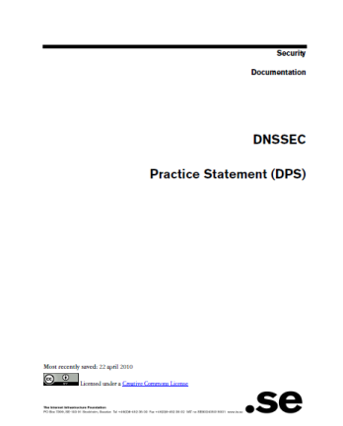
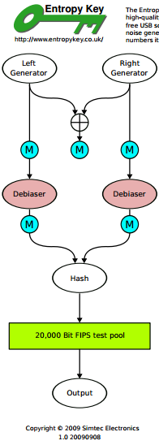
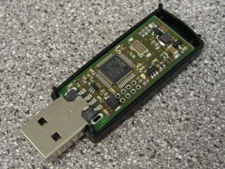
But all must have:
Published practice statement
Overview of operations
Setting expectations
Normal
Emergency
Limiting liability
Documented procedures
Multi person access requirements
Audit logs
Monitoring (e.g., for signature expiry)
Good Random Number Generators
Intel RdRand
DRBGs
FIPS 140
Useful IETF RFCs:
DNSSEC Operational Practices http://tools.ietf.org/html/draft-ietf-dnsop-rfc4641bis
A Framework for DNSSEC Policies and DNSSEC Practice Statements http://tools.ietf.org/html/draft-ietf-dnsop-dnssec-dps-framework
Notes:
CA, NZ, PCH, and others based on pioneering work by SE / Fredrik and RFC draft for DPS. I use one for my training sessions and have one translated into Spanish. I understand JPNIC has one translated into English.
http://cira.ca/knowledge-centre/technology/dnssec/practice-statement/
Recent news of bad random numbers for 10s of 1000’s of SSL certificates (15 Feb). 2 out of 1000 offer no security.
http://www.nytimes.com/2012/02/15/technology/researchers-find-flaw-in-an-online-encryption-method.html?_r=2&hp
DRBG http://csrc.nist.gov/publications/nistpubs/800-90A/SP800-90A.pdf
SysTrust similar to WebTrust – economies of similarity.
Number of SSL: 4M/200+M sites Could have many more.
Many countries use VRSN for govt dig sign. Why not own country?
DNSSEC deployment as an excuse to improve all process (ENISA)
Leverage govt interests in cyber security (+secure smart grid and other infrastructures that rely on DNSSEC) and digital identity efforts.
Opportunity to use DNSSEC requirements and current interest in digital identity systems as an excuse to improve overall DNS and identity ecosystems
DNS/DNSSEC part of all Internet ecosystems.
In order to realize the full benefits of DNSSEC, DNS operators and other entities that make up the chain of trust must embrace transparent IT security processes and practices.
Greater end user and Registrant awareness of the benefits of DNSSEC is needed to drive a virtuous cycle of effective deployment.

Slide 83
Demo Implementation
Key lengths – KSK:2048 RSA ZSK:1024 RSA
Rollover – KSK:as needed ZSK:90 days
RSASHA256 NSEC3
Physical – HSM/smartcards inside Safe inside Rack inside Cage inside Commercial Data Center
Logical – Separation of roles: cage access, safe combination, HSM/smartcard activation across three roles
Crypto – use FIPS certified smartcards as HSM and RNG
Generate KSK and ZSK offline using RNG
KSK use off-line
ZSK use off-net

Slide 84
Off-Line Key generator and KSK Signer
DATA CENTER
CAGE
RACK
smartcards
SAFE
Flash Drive
KSK+RNG
Live O/S DVD
KSK signed DNSKEYs
Encrypted ZSKs
KSK+RNG
reader
laptop
KSK+RNG

Slide 85
Off-Net Signer
DATA CENTER
CAGE
RACK
zonefile
hidden master
Flash Drive
nameserver
KSK signed DNSKEYs
Encrypted ZSKs
nameserver
signer
firewall
hidden master
nameserver

Slide 86
Key Management
Transport KSK signed DNSKEY RRsets
Sign ZSKs with KSK
unsigned
zone
Sign zones with ZSK
Offline Laptop
and Encrypted ZSKs
Online/off-net DNSSEC Signer
signed
zone
Generate ZSKs
KSK
Generate KSK
Secure Key Generation and Signing Environment
Animated slide

Slide 87
DNS+DNSSEC
www.majorbank.se = 1.2.3.4
www.majorbank.se=?
DNS Resolver
DNS
Server
1.2.3.4
Get page
webserverwww @ 1.2.3.4
Login page
Username / Password
Account Data
ISP/ HotSpot / Enterprise/ End Node
Majorbank.se (Registrant)
DNS
Server
.se (Registry)
DNS
Server
Animated slide
. (Root)
Notes:
Actually MANY phone books

Slide 88
Simple Key Management Scripts

Slide 89
Keeping things signed
If the signatures are going to expire soon, sign the zone
Define “soon”
Also sign if a record has changed
That’s it!

Slide 90
while(1) {
t = time
if(exp - t) < 5 days {
inc = t
exp = t + 10 days
touch infile
}
if new infile {
cat infile keys > zonefile
increment zonefile SOA serial
signzone -s inc -e exp zonefile
zsk-current ksk
rndc reload
}
sleep 1 second
}

Slide 91
Rolling keys
Mind the cache – DNS resolvers have memory
Publish the new ZSK before signing with it
Put the new ZSK in the DNSKEY RRset along with old ZSK and wait until everyone see its
Sign the zone with the new ZSK until you want to change it
But do not un-Publish the old ZSK until no one may need it

Slide 92
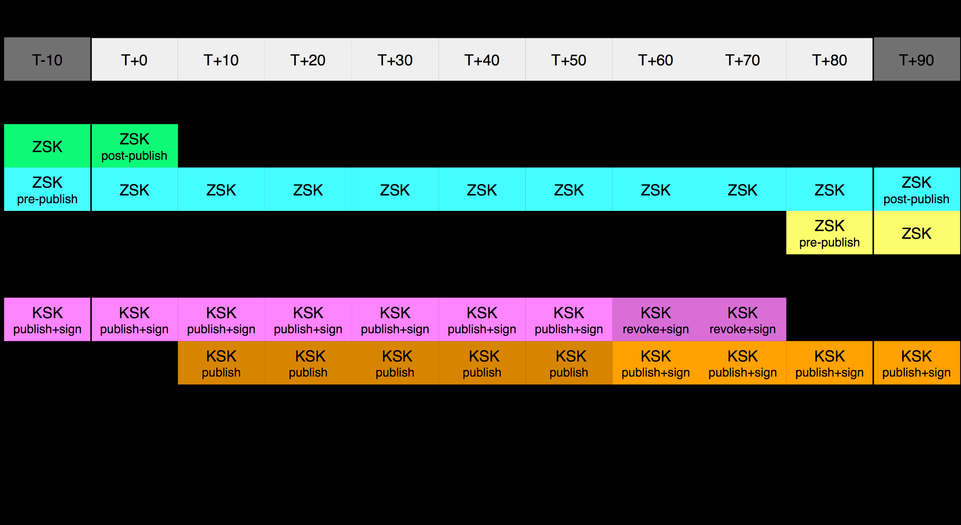
Key Rollover Schedule - Root
https://www.iana.org/dnssec

Slide 93
generate zsk-new
cat zsk-new zsk-current ksk > keys
touch infile
sleep >2xTTL
copy zsk-new zsk-current
touch infile
sleep >2xTTL
cat zsk-current ksk > keys
touch infile
sleep >2xTTL

