Slide 1
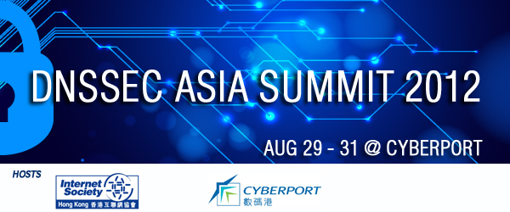

DNSSEC: Where We Are (and how we get to where we want to be)
DNSSEC ASIA SUMMIT 2012
29-31 August 2012
richard.lamb@icann.org

Slide 2
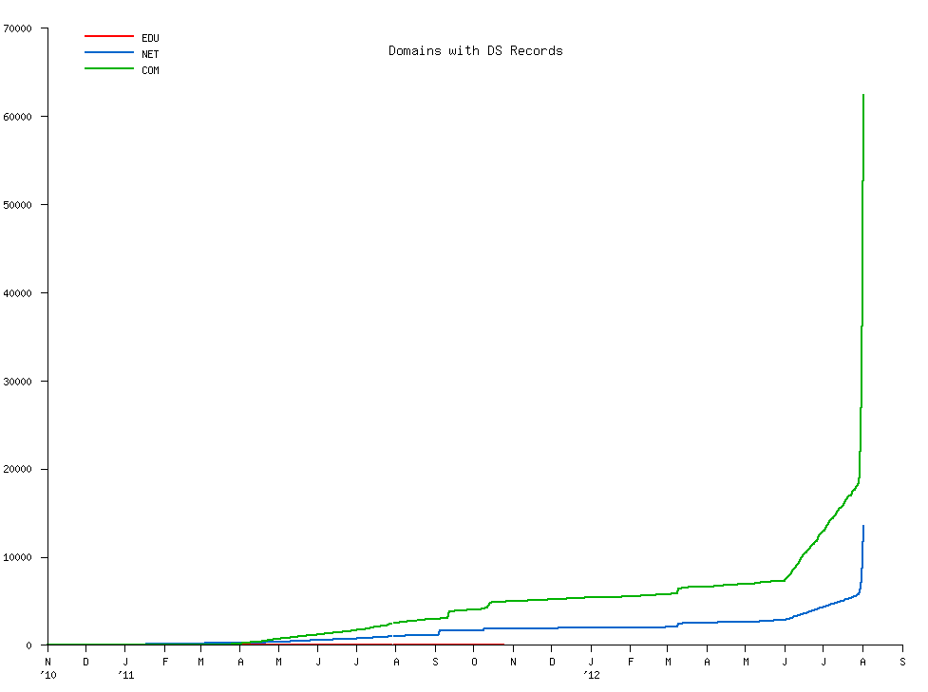
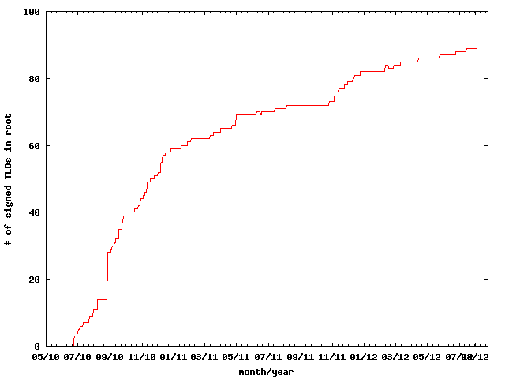
DNSSEC: We have passed the point of no return
Fast pace of deployment at the TLD level
Deployed at root
Supported by software
Growing support by ISPs
Required by new gTLDs
→ Inevitable widespread deployment across core Internet infrastructure
Notes:
The genie is out of the bottle.

Slide 3
The Problem:
DNS Cache Poisoning Attack
ISP / ENTERPRISE /
END NODE
ENTERPRISE
www.majorbank.se = 1.2.3.4
www.majorbank.se=?
DNS Resolver
DNS
Server
5.6.7.8
Attacker
www.majorbank.se = 5.6.7.8
Get page
Attacker
webserverwww @ 5.6.7.8
Login page
Username / Password
Error
Password database
Animated slide

Slide 4
Argghh! Now all ISP customers get sent to attacker.
www.majorbank.se = 1.2.3.4
www.majorbank.se=?
DNS Resolver
DNS
Server
5.6.7.8
Get page
Attacker
webserverwww @ 5.6.7.8
Login page
Username / Password
Error
Password database
Animated slide

Slide 5
Securing The Phone Book - DNS Security Extensions (DNSSEC)
Attacker’s record does not validate – drop it
www.majorbank.se = 1.2.3.4
www.majorbank.se=?
DNS Resolver
with DNSSEC
DNS
Server with DNSSEC
1.2.3.4
Attacker
www.majorbank.se = 5.6.7.8
Get page
webserverwww @ 1.2.3.4
Login page
Username / Password
Account Data
Animated slide
Notes:
So DNSSEC is a good thing.

Slide 6
Resolver only caches validated records
ISP / ENTERPRISE /
END NODE
www.majorbank.se = 1.2.3.4
ENTERPRISE
www.majorbank.se=?
DNS Resolver
with DNSSEC
DNS
Server with DNSSEC
1.2.3.4
Get page
webserverwww @ 1.2.3.4
Login page
Username / Password
Account Data
Animated slide
Notes:
So DNSSEC is a good thing.

Slide 7
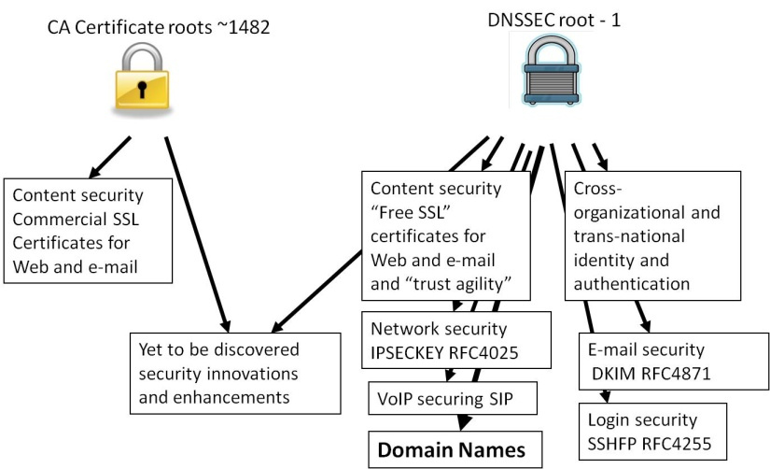
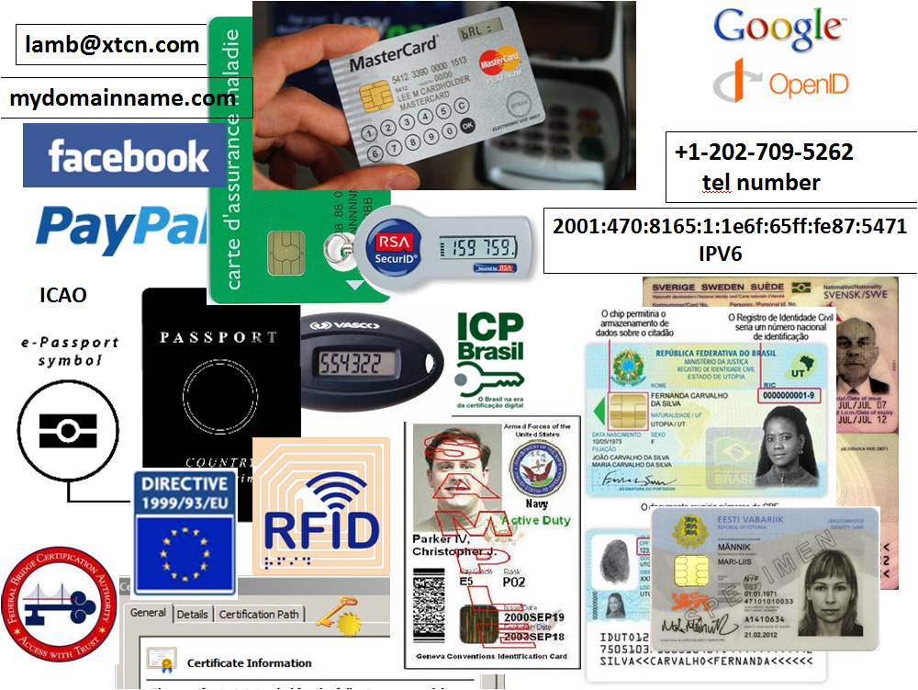
DNSSEC: Plenty of Motivation
DNSChanger (Nov 2011), calls for deployment by government, etc…
DANE
  Improved Web TLS and certs for all
  Email S/MIME for all
…and
  SSH, IPSEC, VoIP
  Digital identity
  Other content (e.g. configurations, XML, app updates)
  Smart Grid
  A global PKI
A good ref http://www.internetsociety.org/deploy360/dnssec/
Notes:
DNS Changer/Ghost Click: 4M PCs across 100 countries - http://www.theregister.co.uk/2011/11/10/botnet_take_down_clean_up/
http://threatpost.com/en_us/blogs/major-dns-cache-poisoning-attack-hits-brazilian-isps-110711
Potentially millions of users effected.
TLD+SSL opportunity and economy - .NG and others.
http://www.fcc.gov/document/chairmans-remarks-cybersecurity-bipartisan-policy-center
http://www.pcworld.com/businesscenter/article/250480/fcc_chairman_calls_on_isps_to_adopt_new_security_measures.html
“A report by Gartner found 3.6 million Americans getting redirected to bogus websites in
a single year, costing them $3.2 billion.,” said Genachowski. and “urge[d] all broadband providers to begin implementing DNSSEC as soon as possible.”

Slide 8
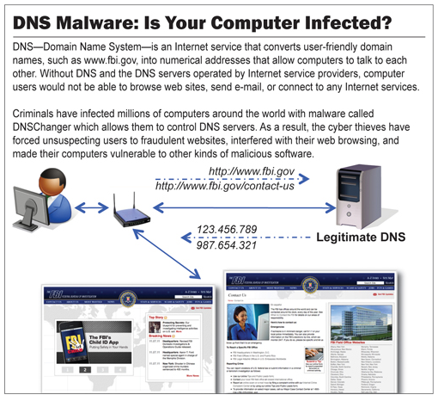
The BAD: DNSChanger - ‘Biggest Cybercriminal Takedown in History’ – 4M machines, 100 countries, $14M
Nov 2011 http://krebsonsecurity.com/2011/11/malware-click-fraud-kingpins-arrested-in-estonia/
End-2-end DNSSEC validation would have avoided the problems
Notes:
end-2-end DNSSEC validation would have avoided the problems.

Slide 9
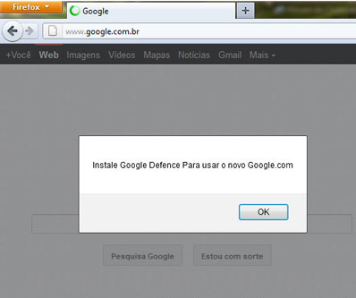
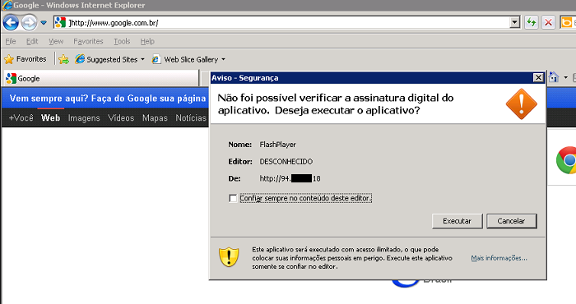
The BAD: Brazilian ISP fall victim to a series of DNS attacks
7 Nov 2011 http://www.securelist.com/en/blog/208193214/Massive_DNS_poisoning_attacks_in_Brazil
End-2-end DNSSEC validation would have avoided the problems
Notes:
1) Rogue insider who added bogus entries to ISP resolvers. ( alguma demanda priveligiada de dentro dos ISP que adicionou a entrada falsa.
2) Hacking of customer premise gateways (mainly home/SOHO routers) with default or easily guessed passwords to add bogus entries. There was possibly some vulnerability hacking in this area as well, but no clear answer on that.

Slide 10
The BAD: Other DNS hijacks*
25 Dec 2010 - Russian e-Payment Giant ChronoPay Hacked
18 Dec 2009 – Twitter – “Iranian cyber army”
13 Aug 2010 - Chinese gmail phishing attack
25 Dec 2010 Tunisia DNS Hijack
2009-2012 google.*
  April 28 2009 Google Puerto Rico sites redirected in DNS attack
  May 9 2009 Morocco temporarily seize Google domain name
9 Sep 2011 - Diginotar certificate compromise for Iranian users
SSL / TLS doesn't tell you if you've been sent to the correct site, it only tells you if the DNS matches the name in the certificate. Unfortunately, majority of Web site certificates rely on DNS to validate identity.
DNS is relied on for unexpected things though insecure.
*A Brief History of DNS Hijacking - Google
http://costarica43.icann.org/meetings/sanjose2012/presentation-dns-hijackings-marquis-boire-12mar12-en.pdf

Slide 11
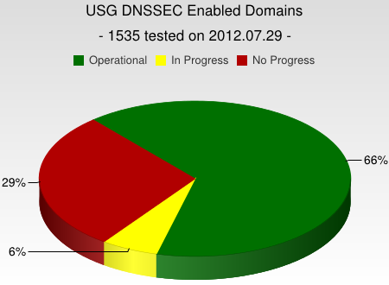
DNSSEC support from government
Sweden, Brazil, Netherlands and others encourage DNSSEC deployment to varying degrees
Mar 2012 - AT&T, CenturyLink (Qwest), Comcast, Cox, Sprint, TimeWarner Cable, and Verizon have pledged to comply and abide by US FCC [1] recommendations that include DNSSEC.. “A report by Gartner found 3.6 million Americans getting redirected to bogus websites in a single year, costing them $3.2 billion.,”[2].
2008 US .gov mandate. >60% operational. [3]
[1] FCC=Federal Communications Commission=US communications Ministry
[2] http://securitywatch.pcmag.com/security/295722-isps-agree-to-fcc-rules-on-anti-botnet-dnssec-internet-routing
[3] http://www.whitehouse.gov/sites/default/files/omb/memoranda/fy2008/m08-23.pdf

Slide 12

DNSSEC = Global PKI
CA Certificate roots ~1482
DNSSEC root - 1
Content security “Free SSL” certificates for Web and e-mail and “trust agility” (DANE)
Cross-organizational and trans-national identity and authentication
Content security Commercial SSL Certificates for Web and e-mail
Network security IPSECKEY RFC4025
Yet to be discovered security innovations, enhancements, and synergies
E-mail security
DKIM RFC4871
Securing VoIP
Login security SSHFP RFC4255
Domain Names
https://www.eff.org/observatory
http://royal.pingdom.com/2011/01/12/internet-2010-in-numbers/
Notes:
The Internet community started by with just trying to secure the DNS but we ended up with something much more. The root is managed by 21 distinguished representatives from the DNS technical community – 18 of which are non-US.
With so many, trust is diluted. Used to be good when there were fewer.
Any one can encrypt. Few can Identify : Encryption != Identity
Comodo, MD5 crack, etc..
Fact is that DNS has been unfortunately used as an independent authentication tool for some time: e.g. email authentication
Build and improve on established trust models, e.g., CAs
Greatly expanded SSL usage (currently ~4M/200M)
Make SMIME (secured email) a reality. All email packages already have support for this. They just don’t have a way to distribute keys. /w DNSSEC – now they do.
May work in concert with in enhancing or extending other cyber security efforts like digital Identities, WebID, BrowserID, CAs, ..
Securing VoIP
Simplify WiFi roaming security
Secure distribution of configurations (e.g., blacklists, anti-virus sigs)

Slide 13
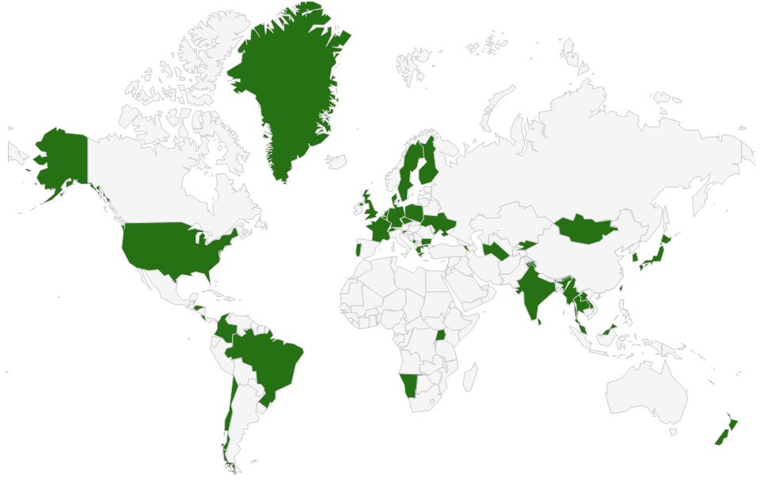
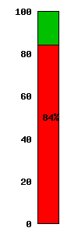

DNSSEC: Where we are
Deployed on 92/315 TLDs (.asia, .tw 台灣 台湾, .kr 한국, .jp, .in, .lk, .kg, .tm, .am, .mm, .ua, .cr, .cz, .br, .se, .uk, .fr, .com, .tt, …post)
Root signed** and audited
>84% of domain names could have DNSSEC
Growing ISP support*
3rd party signing solutions are appearing (e.g., GoDaddy, VeriSign, Binero,…)
Unbound, BIND, DNSSEC-trigger, vsResolver and other s/w support and secure last-mile
IETF DANE Certificate support RFC almost out
*COMCAST Internet (18M), TeliaSonera SE, Sprint,Vodafone CZ,Telefonica CZ, T-mobile NL, SurfNet NL, SANYO Information Technology Solutions JP, others..
**21 TCRs from: TT, BF, RU, CN, US, SE, NL, UG, BR, Benin, PT, NP, Mauritius, CZ, CA, JP, UK, NZ
Notes:
Root: 21 TCRs from TT, BF, RU, CN, US, SE, NL, UG, BR, Togo, PT, NP, Mauritius, CZ, CA, JP, UK, NZ.
DNS over HTTP Chrome-ish, proprietary solutions: MSFT active directory, OpenDNS
All 18M COMCAST Internet customers. Also TeliaSonera SE, Vodafone, Telefonica, CZ, T-mobile NL
US ISP Comcast DNSSEC deployment plan for 18M customers and >5000 domain names http://blog.comcast.com/2011/12/dnssec-deployment-update.html .
http://www.icann.org/en/news/in-focus/dnssec/deployment

Slide 14
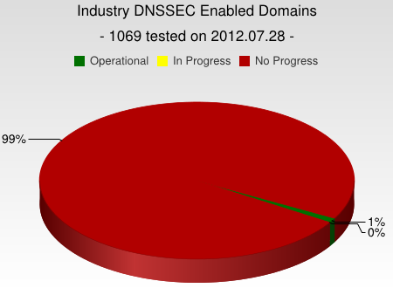
But…
But deployed on < 1% of 2nd level domains. Many have plans. Few have taken the step (e.g., yandex.com, paypal.com*, comcast.com).
DNSChanger and other attacks highlight today’s need. (e.g end-2-end DNSSEC validation would have avoided the problems)
Innovative security solutions (e.g., DANE) highlight tomorrow’s value.
* http://fedv6-deployment.antd.nist.gov/cgi-bin/generate-com http://www.thesecuritypractice.com/the_security_practice/2011/12/all-paypal-domains-are-now-using-dnssec.html
http://www.nacion.com/2012-03-15/Tecnologia/Sitios-web-de-bancos-ticos-podran-ser-mas-seguros.aspx
Notes:
I was beaten into submission by APNIC’s to-notch PC to clarify this.
The future value of end2end dnssec as a foothold for securing applications.
OS or browser needs to validate. Not too hard a nut to crack but will take patience.
Note that “hotel/airport/hotspot” and other DNS interception networks would have saved you from DNSChanger as well since many force DNS requests to their own DNS resolvers regardless.
“people still get their domains social engineered out from under them at the registry/registar level, but would agree that it is a useful component to a larger solution”
Paypal deploys DNSSEC http://www.thesecuritypractice.com/the_security_practice/2011/12/all-paypal-domains-are-now-using-dnssec.html

Slide 15
DNSSEC: So what’s the problem?
Not enough enterprise IT departments know about it or are busy putting out other fires.
When they do look into it they hear FUD and lack of turnkey solutions.
Registrars/DNS providers see no demand
Notes:
Ask 1) how many have dnssec deployed on corporate domains
and 2) if any of their resolvers have validation turned on.
“ISP support for DNSSEC is necessary even in a future in which end points perform all validation. They must be able to, at a minimum, recognize DNSSEC-related traffic and allow it to pass for the smooth functioning of an end-to-end, DNSSEC-secured system.”
Tools like DNS-Trigger, the CZ plug-in, etc help test this.
~6000 .COM 12 Dec 2011
For a virtuous cycle of secure DNSSEC implementations towards full deployment.
…and brings to bear improvements in overall IT security processes and practices that will address growing number of exploits such as hijacking.

Slide 16
Barriers to success
Lack of Awareness at enterprise and customer level (e.g., security implications)
Lack of Registrar support* and/or expertise or turn-key solutions
  Chicken and egg
  Justifying cost
Implementation F.U.D.
  Security/crypto/key management/complexity
  Effect on existing enterprise operations: e.g. expiry, LB, CDN, etc..
Un-trustworthy deployment
  Yet another security thing to manage: “email the keys to everyone”
  Insecure practices and processes
  Garbage in, garbage out - what does signing my zone buy me?
*Partial list of Registrars supporting DNSSEC
http://www.icann.org/en/news/in-focus/dnssec/deployment
Notes:
Joe Klein/Qinetiq/CES – “hard to justify trust as a feature at many apps at the second level domain”
…but with secure IT practices unlike DigiNotar/black tulip etc. Things can spiral into failure if we end up like SSL.
Domain hijacking redux - https://isc.sans.edu/diary.html?storyid=11770
SSAC 044
SSAC 007
DNS-EASY presentation on DNSSEC: how to avoid certain failure

Slide 17
"What You Can Do"
Raise Awareness of DNSSEC and its security value in your enterprises. Deploy on your domain names – it is “a feature”.
Start DNSSEC implementation early, combine with other upgrades. Later, offer hosting as a service.
At minimum ensure network and resolvers pass DNSSEC responses to end users unscathed to allow validation to occur there.
Notes:
COMCAST lessons learned…start early, combine with ipv6 or other upgrades, customers now don’t just want speed.
Refer to NZ press on making NZ secure. Marketing opportunity.

Slide 18
Solutions
Raise awareness of domain holders, end users, h/w+s/w vendors [1]
  Point to improved security as differentiator and the disadvantage of not adopting
  New opportunities for O/S (mobile and desktop) and browser vendors
  Added security for hardware products (e.g., validator in CPE)
  Meet with Registrars and DNS providers
Ease Implementation:
  Take advantage of DNSSEC training[2] and learn from existing implementations
  Automate key management and monitoring
  Crypto: HSM? Smartcard? TPM chip? Soft keys? - all good
  Seek “click and sign” interface simplicity
  Start implementation early since to get ahead in learning curve
  For ISPs, at minimum ensure validation can occur downstream to support end2end security
Make it trustworthy:
  Transparent and secure processes and practices
  Writing a DPS creates the right mindset for:
    Separation of duties
    Documented procedures
    Audit logging
  Opportunity to improve overall operations using DNSSEC as an excuse [3]
[1] DNSSEC.jp and other groups are excellent examples
[2] APNIC, NSRC, ISOC, ICANN offer training
[3] ENISA report on DNSSEC deployment
Notes:
Awareness: DNSSEC.jp has made great progress in educating entities in this ecosystem
COMCAST: Was speed. Now security. Takes a while to ramp up so do now /w ipv6. Start early. Not adopting has greater disadvantages.)
Tools to test with https://labs.nic.cz/dnssec-validator/
ISPs do not have to validate, just allow for validation to occur downstream. End2end security model
CIRA just published a DPS - all based on SE. I have Spanish one as well.

Slide 19
Trustworthy Implementation

Slide 20
Building in security
Getting the machinery for DNSSEC is easy (BIND, NSD/Unbound, OpenDNSSEC, etc..).
Finding good security practices to run it is not.

Slide 21


Learn from CA successes
(and mistakes)
The good:
  The people
  The mindset
  The practices
  The legal framework
  The audit against international accounting and technical standards
The bad:
  Diluted trust with a race to the bottom (>1400 CA’s)
  DigiNotar
    Weak and inconsistent polices and controls
    Lack of compromise notification (non-transparent)
    Audits don’t solve everything (ETSI audit)
Notes:
The people: e.g., Tomofumi Okubo, Fredrik Lundgren, Paul Hoffman, David Miller (AEP)
The people (those willing to share in this secret art)
The mindset (trust in process. not people)
The practices (physical, logical, cryptographic security)
The legal framework (setting expecations. liability limitations)
HEBC/USHER – US university system PKI example.
SysTrust similar to WebTrust – economies of similarity. Number of SSL: 4M/200+M sites Could have many more. Many countries use VRSN for govt dig sign. Why not own country?
ETSI failed for DigiNotar

Slide 22

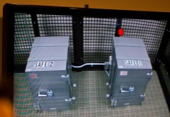
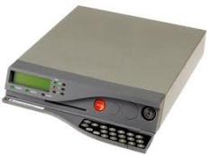
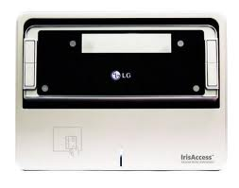
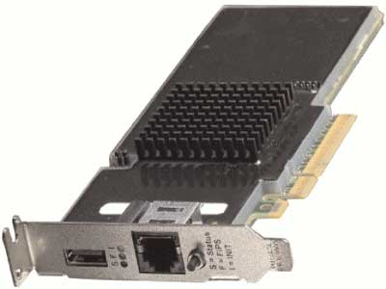
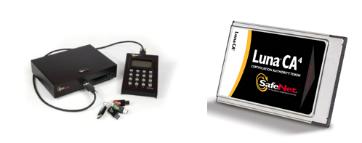
An implementation can be thi$
Notes:
FR, NZ, root, com, UK

Slide 23
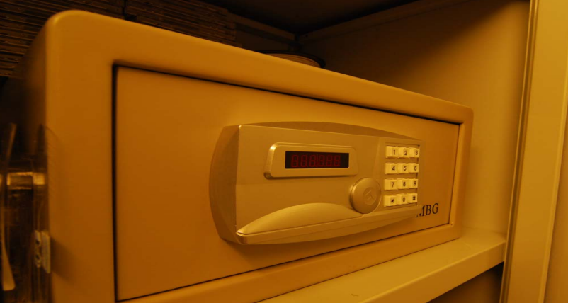

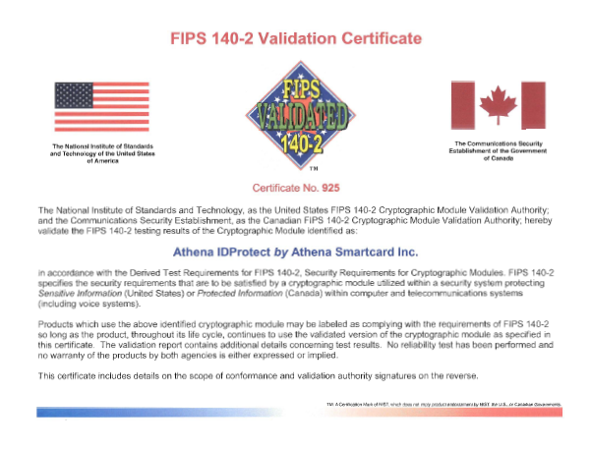
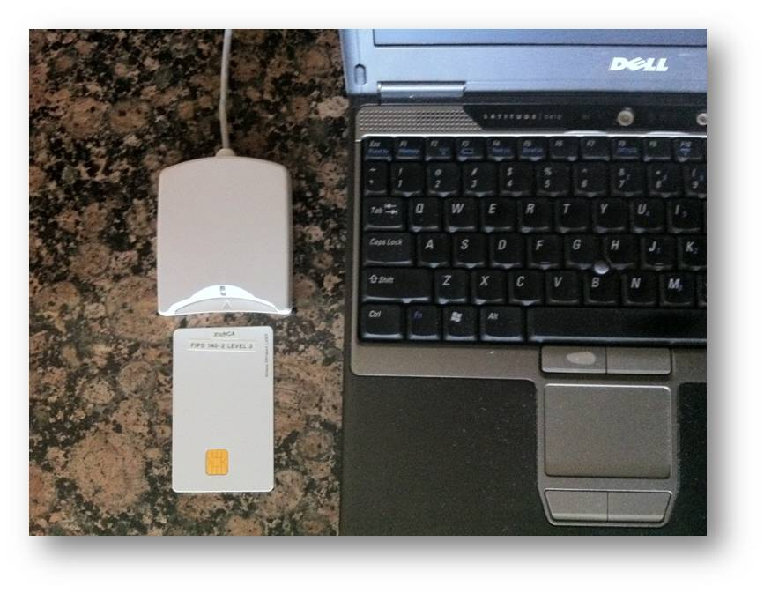
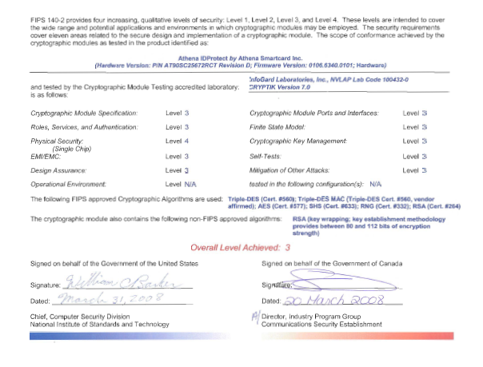
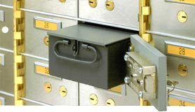
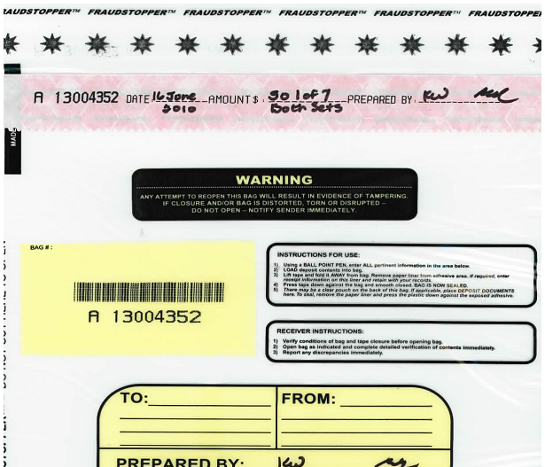
…or this
+
TPM
Notes:
JP, old SE, new CR

Slide 24
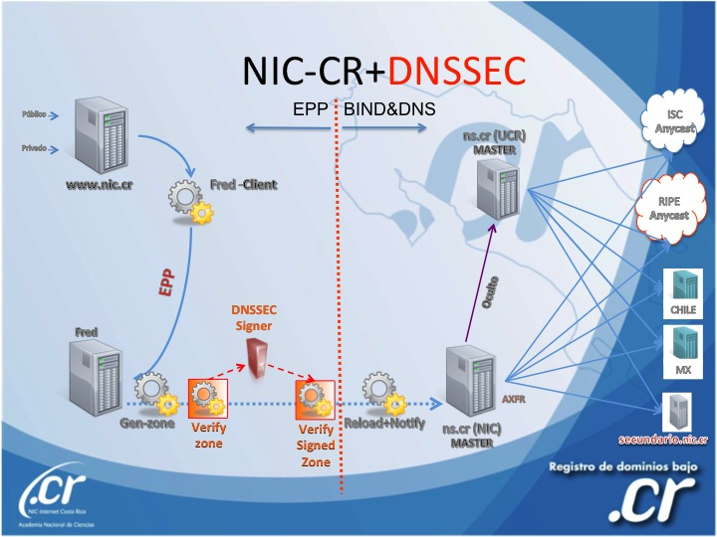
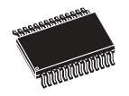
..or this (CR NIC)
Transport KSK signed DNSKEY RRsets
unsigned
zone
Sign ZSKs with KSK
Sign zones with ZSK
Offline Laptop with TPM
Online/off-net DNSSEC Signer with TPM
signed
zone
KSK
Transport public half of ZSKs
Generate KSK
ZSKs
Generate ZSKs
Secure Off-line Environment
Animated slide
Notes:
9 March 2012
…and bnonline.fi.cr
http://www.nacion.com/2012-03-15/Tecnologia/Sitios-web-de-bancos-ticos-podran-ser-mas-seguros.aspx

Slide 25
…or even this
Off-line
Off-net
DATA CENTER
CAGE
DATA CENTER
RACK
CAGE
SAFE
RACK
All in tamper evident bags
FD with public ZSKs
zonefile
ZSKs
KSK on FD
Live O/S DVD
signer
laptop
FD with KSK signed DNSKEY RRsets
firewall
hidden master
RNG
Notes:
From LACTLD training I gave in September. Notes from there on simple separation of duties and even ssss.c for M-of-N. Go thru risk analysis, threats and controls
Pull out TEBs.

Slide 26
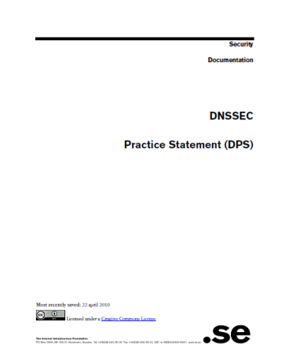

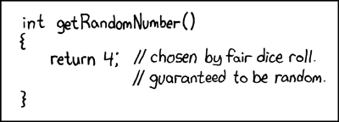
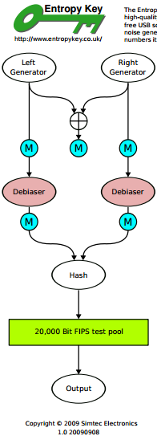
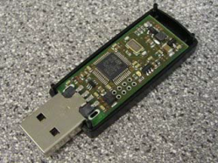
But all must have:
Published practice statement
  Overview of operations
  Setting expectations
    Normal
    Emergency
  Limiting liability
Documented procedures
Multi person access requirements
Audit logs
Monitoring (e.g., for signature expiry)
Good Random Number Generators
Intel RdRand
DRBGs
FIPS 140
Useful IETF RFCs:
DNSSEC Operational Practices http://tools.ietf.org/html/draft-ietf-dnsop-rfc4641bis
A Framework for DNSSEC Policies and DNSSEC Practice Statements http://tools.ietf.org/html/draft-ietf-dnsop-dnssec-dps-framework
Notes:
CA, NZ, PCH, and others based on pioneering work by SE / Fredrik and RFC draft for DPS. I use one for my training sessions and have one translated into Spanish. I understand JPNIC has one translated into English.
http://cira.ca/knowledge-centre/technology/dnssec/practice-statement/
Recent news of bad random numbers for 10s of 1000’s of SSL certificates (15 Feb). 2 out of 1000 offer no security.
http://www.nytimes.com/2012/02/15/technology/researchers-find-flaw-in-an-online-encryption-method.html?_r=2&hp
DRBG http://csrc.nist.gov/publications/nistpubs/800-90A/SP800-90A.pdf
SysTrust similar to WebTrust – economies of similarity.
Number of SSL: 4M/200+M sites Could have many more.
Many countries use VRSN for govt dig sign. Why not own country?
DNSSEC deployment as an excuse to improve all process (ENISA)
Leverage govt interests in cyber security (+secure smart grid and other infrastructures that rely on DNSSEC) and digital identity efforts.
Opportunity to use DNSSEC requirements and current interest in digital identity systems as an excuse to improve overall DNS and identity ecosystems
DNS/DNSSEC part of all Internet ecosystems.
In order to realize the full benefits of DNSSEC, DNS operators and other entities that make up the chain of trust must embrace transparent IT security processes and practices.
Greater end user and Registrant awareness of the benefits of DNSSEC is needed to drive a virtuous cycle of effective deployment.

Slide 27
Summary
DNSSEC has left the starting gate but without greater support by Registrars, demand from domain name holders and trustworthy deployment by operators, it will die on the vine
Building awareness amongst a larger audience based on recent attacks and increased interest in cyber security may be one solution
Drawing on lessons learned from certificate authorities and other existing sources of trust on the Internet can make DNSSEC a source of innovation and opportunity for all
Notes:
APNIC, NSRC, ISOC, ICANN Training courses.
Nothing is perfect but forcing thought about secure processes and practices helps solve many exisiting problems. Doing the DPS is the mesuarble exercize that provides this.
Just Ask. I have seen them all. I am happy to do a training session here. Its my job.
Ask 1) how many have dnssec deployed on corporate domains
and 2) if any of their resolvers have validation turned on.

Slide 28
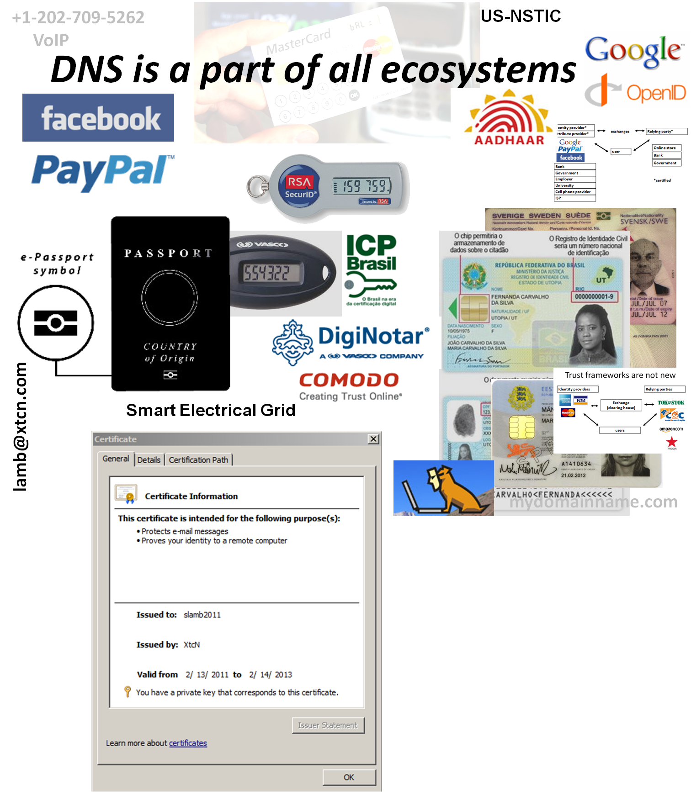



OECS ID effort
Notes:
Smart Electrical Grid effort - Not just reading meters

Slide 29
The Internet’s Phone Book - Domain Name System (DNS+DNSSEC)
www.majorbank.se = 1.2.3.4
www.majorbank.se=?
DNS Resolver
DNS
Server
1.2.3.4
Get page
webserverwww @ 1.2.3.4
Login page
Username / Password
Account Data
ISP/ HotSpot / Enterprise/ End Node
Majorbank.se (Registrant)
DNS
Server
.se (Registry)
DNS
Server
Animated slide
. (Root)
Notes:
Actually MANY phone books

