Slide 1
Deploying DNSSEC: From Content to End-customer
LACNIC 18
28 October 2012
richard.lamb@icann.org

Slide 2
Terminology
Registrant (Content)←→Registrar←
→Registry←→Root←
→ISP←→End User (Eyes)
Example:
largebank.com (Large Bank)←→(GoDaddy)←
→.com (VeriSign)←→icann.org (ICANN)←
→ISP (Vodafone, etc)←→ISP Customer
Notes:
ISPAI association

Slide 3
Creating a Chain of Trust
Registrant generates, signs their records with and publishes key to Registrar.
Registrar manages key at the Registry on behalf of the Registrant.
Registry generates, signs Registrant key with and publishes its own key in root.
The root generates, signs Registry key with and publishes its own key to public.
ISP/End User validates Registrant DNS record with Registrant key then Registrant key with Registry key and finally Registry key with root key.
This creates the chain of trust from content provider (Registrant) to end user.
Registrant→Registrar→Registry→Root→ISP→End User
Notes:
Must understand public/private key crypto

Slide 4
DNS+DNSSEC
www.majorbank.se = 1.2.3.4
www.majorbank.se=?
DNS Resolver
DNS
Server
1.2.3.4
Get page
webserverwww @ 1.2.3.4
Login page
Username / Password
Account Data
ISP/ HotSpot / Enterprise/ End Node
Majorbank.se (Registrant)
DNS
Server
.se (Registry)
DNS
Server
Animated slide
. (Root)
Notes:
Actually MANY phone books

Slide 5
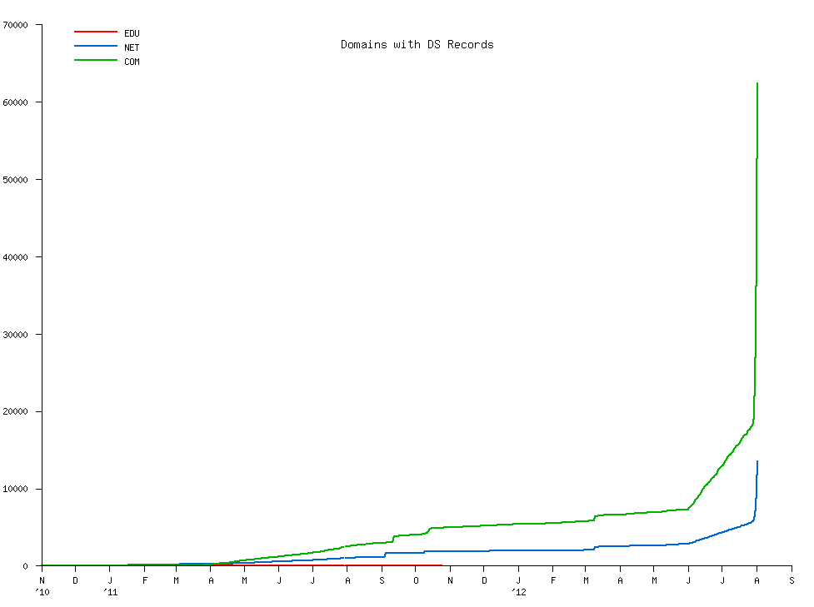
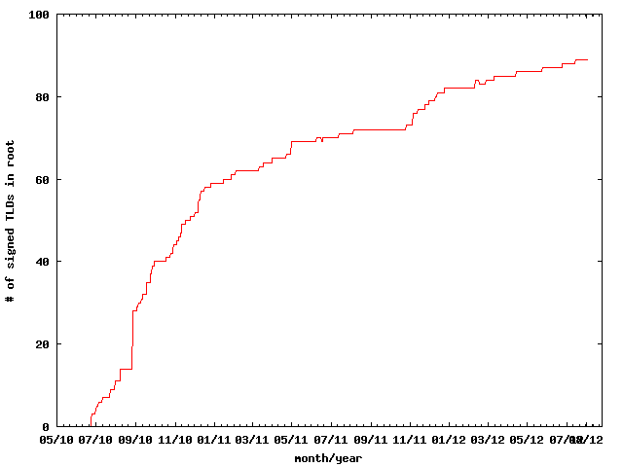
DNSSEC: We have passed the point of no return
Fast pace of deployment at the TLD level
Deployed at root
Supported by software
Growing support by ISPs
Required by new gTLDs
→ Inevitable widespread deployment across core Internet infrastructure
Notes:
The genie is out of the bottle.

Slide 6
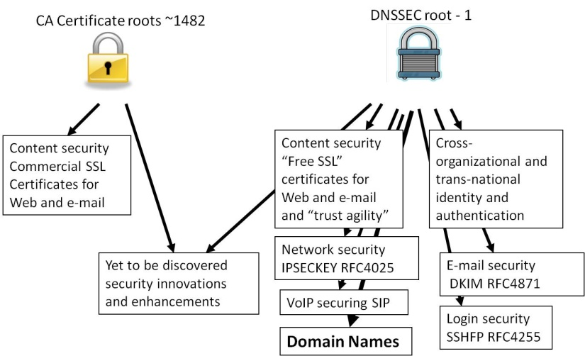
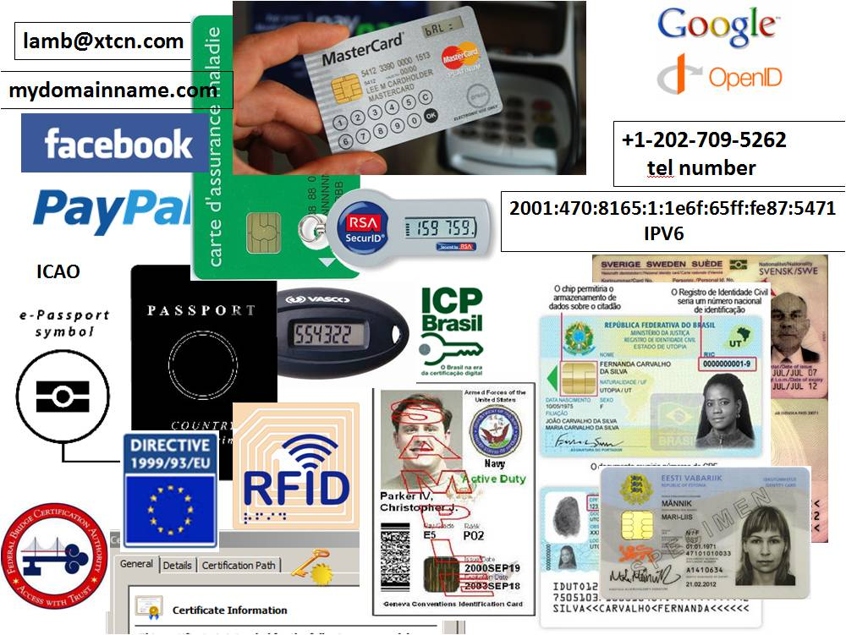
DNSSEC: Plenty of Motivation
DNSChanger attack, calls for deployment by governments, etc…
Technology and standards built on DNSSEC*
Improved Web TLS and certs for all
Secured e-mail (S/MIME) for all
SSH, IPSEC, …
…and new applications
VoIP
Digital identity
Secured content delivery (e.g. configurations, updates)
Smart Grid
A global PKI
Increasing trust in e-commerce
A good ref http://www.internetsociety.org/deploy360/dnssec/
*IETF standards complete or currently being developed
Notes:
DNS Changer/Ghost Click: 4M PCs across 100 countries - http://www.theregister.co.uk/2011/11/10/botnet_take_down_clean_up/
http://threatpost.com/en_us/blogs/major-dns-cache-poisoning-attack-hits-brazilian-isps-110711
Potentially millions of users effected.
TLD+SSL opportunity and economy - .NG and others.
http://www.fcc.gov/document/chairmans-remarks-cybersecurity-bipartisan-policy-center
http://www.pcworld.com/businesscenter/article/250480/fcc_chairman_calls_on_isps_to_adopt_new_security_measures.html
“A report by Gartner found 3.6 million Americans getting redirected to bogus websites in
a single year, costing them $3.2 billion.,” said Genachowski. and “urge[d] all broadband providers to begin implementing DNSSEC as soon as possible.”

Slide 7
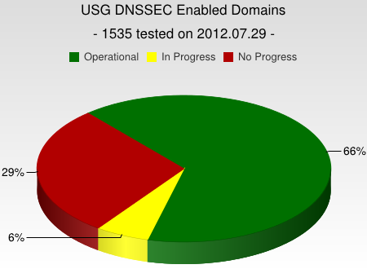
DNSSEC interest from governments
Sweden, Brazil, Netherlands and others encourage DNSSEC deployment to varying degrees
Mar 2012 - AT&T, CenturyLink (Qwest), Comcast, Cox, Sprint, TimeWarner Cable, and Verizon have pledged to comply and abide by US FCC [1] recommendations that include DNSSEC.. “A report by Gartner found 3.6 million Americans getting redirected to bogus websites in a single year, costing them $3.2 billion.,”[2].
2008 US .gov mandate. >60% operational. [3]
[1] FCC=Federal Communications Commission=US communications Ministry
[2] http://securitywatch.pcmag.com/security/295722-isps-agree-to-fcc-rules-on-anti-botnet-dnssec-internet-routing
[3] http://www.whitehouse.gov/sites/default/files/omb/memoranda/fy2008/m08-23.pdf

Slide 8
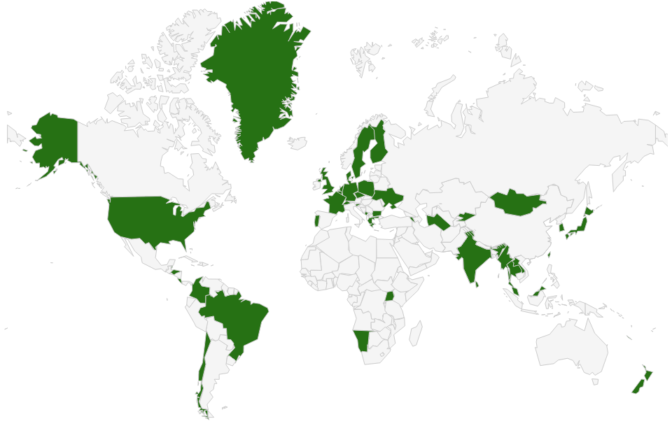
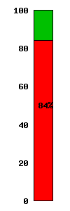
DNSSEC: Where we are
Deployed on 95/316 TLDs (.br, .cl, .cr, .nl, .cz, .co, .com, .de, .pt, .in, .lk, .my مليسيا , .asia, .tw 台灣, .kr 한국, .jp, .ua, .uk, .fr, .tt, .net, .post, …)
Root signed** and audited
>84% of domain names could have DNSSEC
Growing ISP support*
3rd party signing solutions: GoDaddy, Binero, VeriSign…***
S/W H/W support: NLNetLabs/NSD+Unbound, ISC/BIND, Microsoft, PowerDNS, Secure64,…
IETF standard on DNSSEC SSL certificates (RFC6698)
Growing interest from others…
*COMCAST Internet (18M), TeliaSonera SE, Sprint,Vodafone CZ,Telefonica CZ, T-mobile NL, SurfNet NL, SANYO Information Technology Solutions JP, others..
**21 TCRs from: TT, BF, RU, CN, US, SE, NL, UG, BR, Benin, PT, NP, Mauritius, CZ, CA, JP, UK, NZ
*** Partial list of registrars: https://www.icann.org/en/news/in-focus/dnssec/deployment
Notes:
Root: 21 TCRs from TT, BF, RU, CN, US, SE, NL, UG, BR, Togo, PT, NP, Mauritius, CZ, CA, JP, UK, NZ.
DNS over HTTP Chrome-ish, proprietary solutions: MSFT active directory, OpenDNS
All 18M COMCAST Internet customers. Also TeliaSonera SE, Vodafone, Telefonica, CZ, T-mobile NL
US ISP Comcast DNSSEC deployment plan for 18M customers and >5000 domain names http://blog.comcast.com/2011/12/dnssec-deployment-update.html
http://www.icann.org/en/news/in-focus/dnssec/deployment

Slide 9
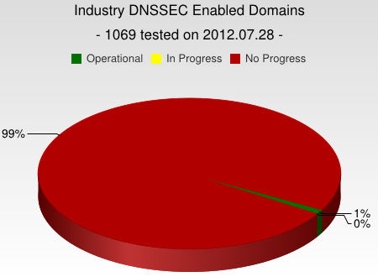
But…
But deployed on < 1% (~2M) of 2nd level domains. Many have plans. Few have taken the step (e.g., yandex.com, paypal.com*, comcast.com).
DNSChanger and other attacks highlight today’s need. (e.g end-2-end DNSSEC validation would have avoided the problems)
Innovative security solutions (e.g., DANE) highlight tomorrow’s value.
* http://fedv6-deployment.antd.nist.gov/cgi-bin/generate-com http://www.thesecuritypractice.com/the_security_practice/2011/12/all-paypal-domains-are-now-using-dnssec.html
http://www.nacion.com/2012-03-15/Tecnologia/Sitios-web-de-bancos-ticos-podran-ser-mas-seguros.aspx
Notes:
I was beaten into submission by APNIC’s to-notch PC to clarify this.
The future value of end2end dnssec as a foothold for securing applications.
OS or browser needs to validate. Not too hard a nut to crack but will take patience.
Note that “hotel/airport/hotspot” and other DNS interception networks would have saved you from DNSChanger as well since many force DNS requests to their own DNS resolvers regardless.
“people still get their domains social engineered out from under them at the registry/registar level, but would agree that it is a useful component to a larger solution”
Paypal deploys DNSSEC http://www.thesecuritypractice.com/the_security_practice/2011/12/all-paypal-domains-are-now-using-dnssec.html

Slide 10
DNSSEC: So what’s the problem?
Not enough enterprise. IT departments know about it or are busy putting out other fires.
When they do look into it they hear FUD and lack of turnkey solutions.
Registrars/DNS providers see no demand
Notes:
Ask 1) how many have dnssec deployed on corporate domains
and 2) if any of their resolvers have validation turned on.
“ISP support for DNSSEC is necessary even in a future in which end points perform all validation. They must be able to, at a minimum, recognize DNSSEC-related traffic and allow it to pass for the smooth functioning of an end-to-end, DNSSEC-secured system.”
Tools like DNS-Trigger, the CZ plug-in, etc help test this.
~6000 .COM 12 Dec 2011
For a virtuous cycle of secure DNSSEC implementations towards full deployment.
…and brings to bear improvements in overall IT security processes and practices that will address growing number of exploits such as hijacking.

Slide 11
How to implement DNSSEC?
For Companies:
Sign your corporate domain names (ask Registrars to support DNSSEC)
Just turn on validation on corporate DNS resolvers
For Users:
Ask ISP to turn on validation on their DNS resolvers
Take advantage of ICANN, ISOC and other organizations offering education and training.
Notes:
Many options:
Build your own DNSSEC signer and submit keys to Registrar.
Or use GoDaddy service.
Could cost as little as $2/year (VRSN). Free (and training provided) if ccTLD with pch.net and some others.
Popular resolvers all support DNSSEC validation.

Slide 12
"What You Can Do"
Raise awareness of DNSSEC and its security value in your enterprises. Deploy on your domain names – it is “a feature”.
Start DNSSEC implementation early, combine with other upgrades. Later, offer hosting as a service.
At minimum ensure network and resolvers pass DNSSEC responses to end users unscathed to allow validation to occur there.
Notes:
COMCAST lessons learned…start early, combine with ipv6 or other upgrades, customers now don’t just want speed.
Refer to NZ press on making NZ secure. Marketing opportunity.

Slide 13
Trustworthy Implementation

Slide 14
Building in security
Getting the machinery for DNSSEC is easy (BIND, NSD/Unbound, OpenDNSSEC, etc..).
Finding good security practices to run it is not.

Slide 15
Learn from CA successes (and mistakes)
The good:
The people
The mindset
The practices
The legal framework
The audit against international accounting and technical standards
The bad:
Diluted trust with a race to the bottom (>1400 CA’s)
DigiNotar
Weak and inconsistent polices and controls
Lack of compromise notification (non-transparent)
Audits don’t solve everything (ETSI audit)
Notes:
The people: e.g., Tomofumi Okubo, Fredrik Lundgren, Paul Hoffman, David Miller (AEP)
The people (those willing to share in this secret art)
The mindset (trust in process. not people)
The practices (physical, logical, cryptographic security)
The legal framework (setting expecations. liability limitations)
HEBC/USHER – US university system PKI example.
SysTrust similar to WebTrust – economies of similarity. Number of SSL: 4M/200+M sites Could have many more. Many countries use VRSN for govt dig sign. Why not own country?
ETSI failed for DigiNotar

Slide 16
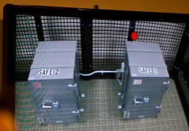
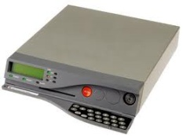
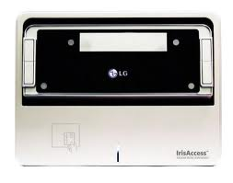
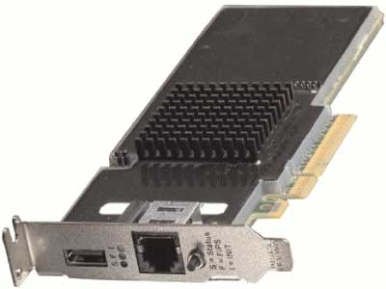
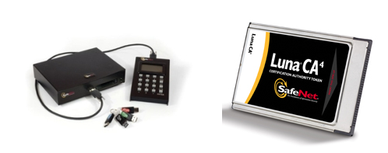
An implementation can be thi$
Notes:
FR, NZ, root, com, UK

Slide 17
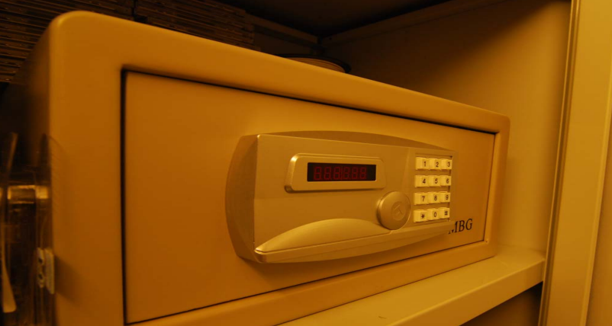
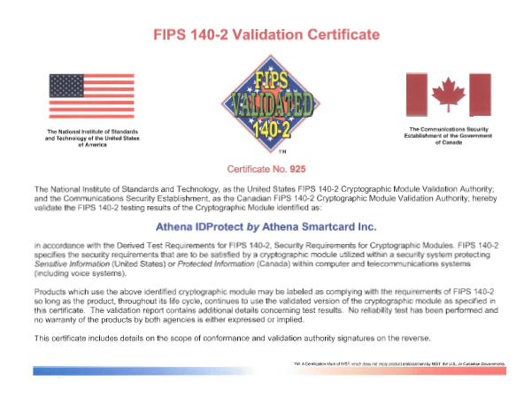
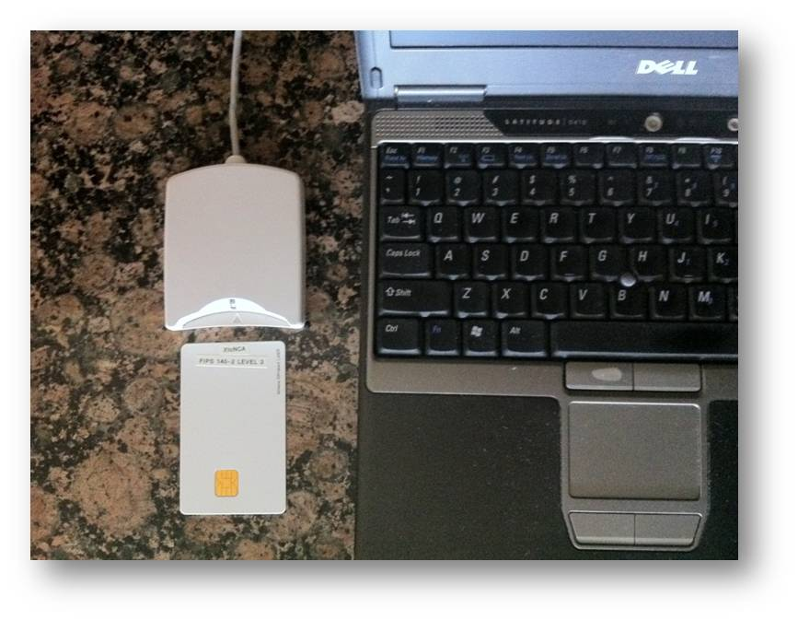
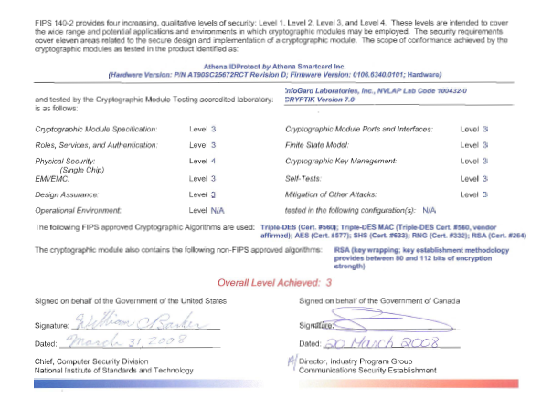
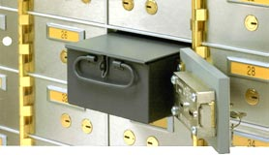
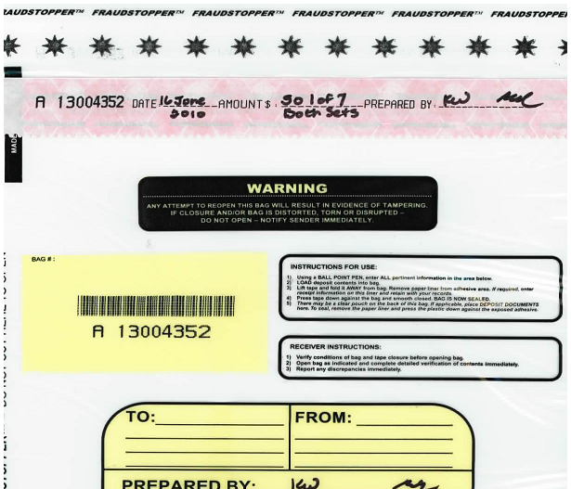
…or this
+
TPM
Notes:
JP, old SE, new CR

Slide 18
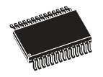
..or this (CR NIC)
Transport KSK signed DNSKEY RRsets
unsigned
zone
Sign ZSKs with KSK
Sign zones with ZSK
Offline Laptop with TPM
Online/off-net DNSSEC Signer with TPM
signed
zone
KSK
Transport public half of ZSKs
Generate KSK
ZSKs
Generate ZSKs
Secure Off-line Environment
Animated slide
Notes:
9 March 2012
…and bnonline.fi.cr
http://www.nacion.com/2012-03-15/Tecnologia/Sitios-web-de-bancos-ticos-podran-ser-mas-seguros.aspx

Slide 19
…or even this
Off-line
Off-net
DATA CENTER
CAGE
DATA CENTER
RACK
CAGE
SAFE
RACK
All in tamper evident bags
FD with public ZSKs
zonefile
ZSKs
KSK on FD
Live O/S DVD
signer
laptop
FD with KSK signed DNSKEY RRsets
firewall
hidden master
RNG
Notes:
From LACTLD training I gave in September. Notes from there on simple separation of duties and even ssss.c for M-of-N. Go thru risk analysis, threats and controls
Pull out TEBs.

Slide 20
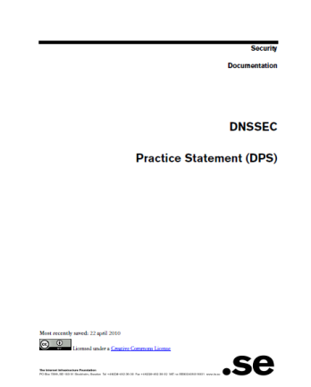
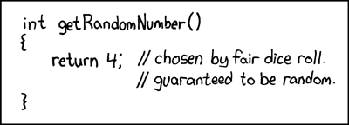
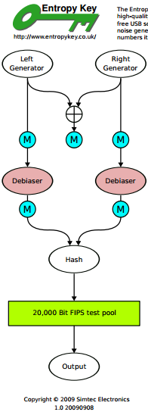
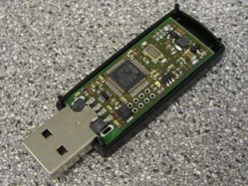
But all must have:
Published practice statement
Overview of operations
Setting expectations
Normal
Emergency
Limiting liability
Documented procedures
Multi person access requirements
Audit logs
Monitoring (e.g., for signature expiry)
Good Random Number Generators
Intel RdRand
DRBGs
FIPS 140
Useful IETF RFCs:
DNSSEC Operational Practices http://tools.ietf.org/html/draft-ietf-dnsop-rfc4641bis
A Framework for DNSSEC Policies and DNSSEC Practice Statements http://tools.ietf.org/html/draft-ietf-dnsop-dnssec-dps-framework
Notes:
CA, NZ, PCH, and others based on pioneering work by SE / Fredrik and RFC draft for DPS. I use one for my training sessions and have one translated into Spanish. I understand JPNIC has one translated into English.
http://cira.ca/knowledge-centre/technology/dnssec/practice-statement/
Recent news of bad random numbers for 10s of 1000’s of SSL certificates (15 Feb). 2 out of 1000 offer no security.
http://www.nytimes.com/2012/02/15/technology/researchers-find-flaw-in-an-online-encryption-method.html?_r=2&hp
DRBG http://csrc.nist.gov/publications/nistpubs/800-90A/SP800-90A.pdf
SysTrust similar to WebTrust – economies of similarity.
Number of SSL: 4M/200+M sites Could have many more.
Many countries use VRSN for govt dig sign. Why not own country?
DNSSEC deployment as an excuse to improve all process (ENISA)
Leverage govt interests in cyber security (+secure smart grid and other infrastructures that rely on DNSSEC) and digital identity efforts.
Opportunity to use DNSSEC requirements and current interest in digital identity systems as an excuse to improve overall DNS and identity ecosystems
DNS/DNSSEC part of all Internet ecosystems.
In order to realize the full benefits of DNSSEC, DNS operators and other entities that make up the chain of trust must embrace transparent IT security processes and practices.
Greater end user and Registrant awareness of the benefits of DNSSEC is needed to drive a virtuous cycle of effective deployment.

Slide 21
Summary
DNSSEC has left the starting gate but without greater deployment by domain name holders, support from Registrars, and trustworthy deployment by operators, we may miss the opportunity to improve overall Internet security and develop innovative new security solutions.
Notes:
APNIC, NSRC, ISOC, ICANN Training courses.
Nothing is perfect but forcing thought about secure processes and practices helps solve many exisiting problems. Doing the DPS is the mesuarble exercize that provides this.
Just Ask. I have seen them all. I am happy to do a training session here. Its my job.
Ask 1) how many have dnssec deployed on corporate domains
and 2) if any of their resolvers have validation turned on.

Slide 22
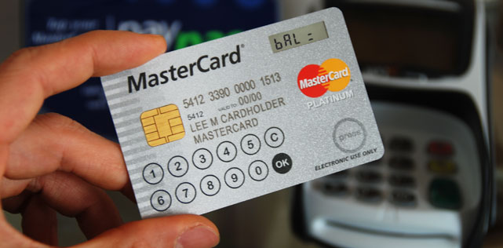
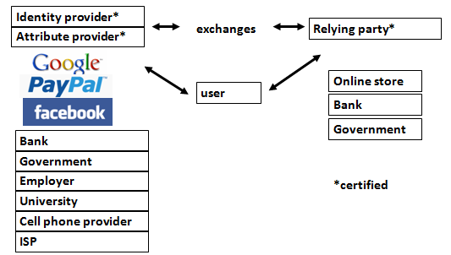
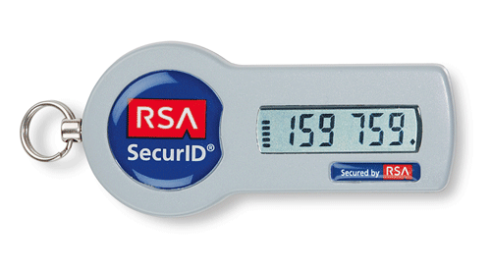
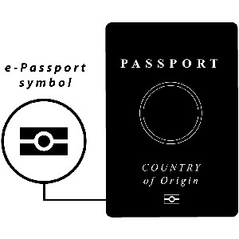
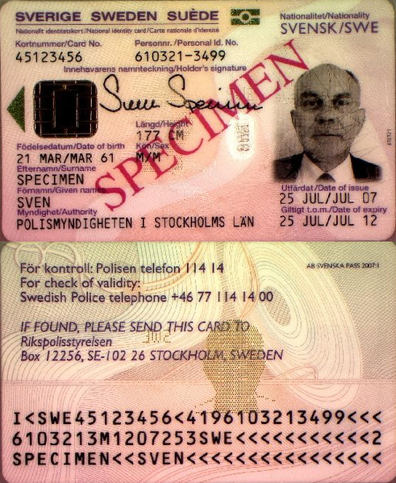
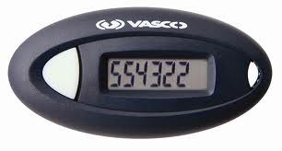
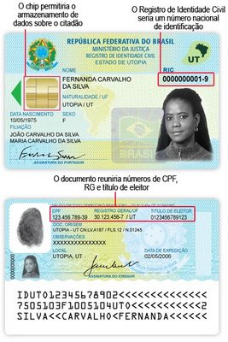
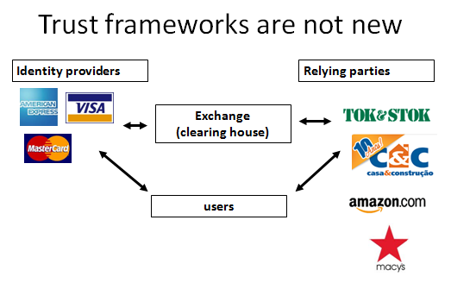
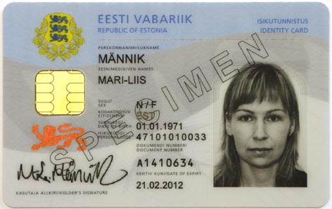
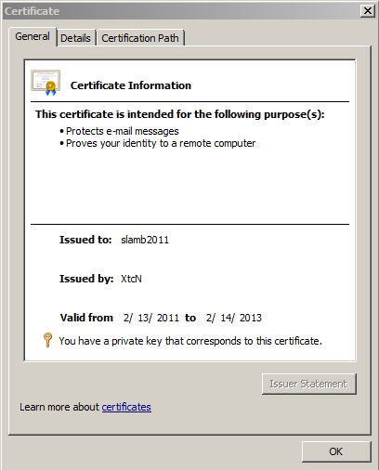
DNS is a part of all IT ecosystems
+1-202-709-5262
VoIP
US-NSTIC
OECS ID effort
Smart Electrical Grid
lamb@xtcn.com
mydomainname.com

