Slide 1

Experience from Various DNSSEC Deployments
ICANN Meeting
Singapore
18 March 2014
richard.lamb@icann.org

Slide 2
How do I sign a zone?

Slide 3
That’s it
dnssec-signzone mydomain.zone mydomain.zone.signed
www.abc.com. IN A 192.101.186.125
www.abc.com. IN A 192.101.186.125
IN RRSIG A 8 3 3600 20130926030000 20130909030000 32799 www.abc.com. N7upFHNplnIiXAEMOTefeuJrwymNxF 8D6/poAoRVDThHVOnXniaIj2WuGVbCGvUMjayDhVNk9vAQtVHUIAnxZXsIlP4ZbtIgtZ/hbTKByySx1Y0u9aRD1ik=

Slide 4
One way to do this
keys
nameserver
signer
mydomain.zone
mydomain.zone.signed

Slide 5
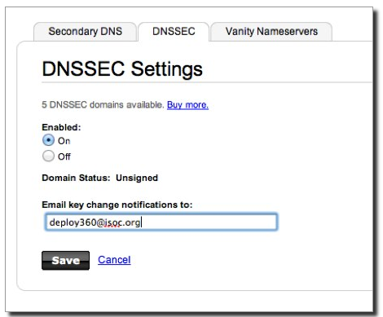
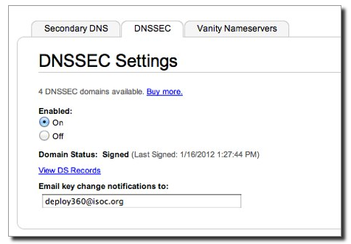
or…another
http://www.internetsociety.org/deploy360/resources/how-to-sign-your-domain-with-dnssec-using-godaddy-com/

Slide 6
It’s a question of risk / trust, but is does not have to be expensive

Slide 7
Many lessons learned
Learn from other’s mistakes
Monitor, monitor, monitor
Plan
Document and publish
Risk analysis
Learn from Certificate Author ties

Slide 8
Goals
Reliable
Trusted
Cost Effective (for you)
Notes:
Trust – learn from existing formal IT security practices like SysTrust Principles: “Security, Availability,
Processing Integrity, Confidentiality, and Privacy”

Slide 9
Cost Effectiveness

Slide 10
Cost Effectiveness
Risk Assessment
Cost Benefit Analysis

Slide 11
Business Benefits and Motivation
(from “The Costs of DNSSEC Deployment” ENISA report)
Become a reliable source of trust and boost market share and/or reputation of zones;
Lead by example and stimulate parties further down in the chain to adopt DNSSEC;
Earn recognition in the DNS community and share knowledge with TLD’s and others;
Provide assurance to end-user that domain name services are reliable and trustworthy;
Look forward to increasing adoption rate when revenue is an important driver. Deploying DNSSEC can be profitable;

Slide 12
Risk Assessment
Identify your risks
  Reputational
    Competition
    Loss of contract
  Legal / Financial
    Who is the relying party?
    SLA
    Law suits
Build your risk profile
  Determine your acceptable level of risk
Notes:
Acceptable level of risk - e.g. reputtation: no-compromise; An attack can only take place if key compromise goes unnoticed. Can recover otherwise.; Be real: will not protect against terrorist attack; internal collusion – pick a number: 1 in a million?; irrelevancy/non-use: stakeholder involvement.

Slide 13
Vulnerabilities
False expectations
Key compromise
Signer compromise
Zone file compromise
Notes:
False expectations – e.g. lack of “SLA” and or “DPS” to set expectations on compromise recovery for child key (how long) as well as for parent keying material (backup keys, how long). No one can offer perfect security. But
Involve stakeholders to minimize reputational / legal risks.
Insecure DS handling – broken chain of trust
Private key compromise: bad rng, too short; background checks?, threats, bribed -> collusion
bad Signer: unvalidated s/w; vulnerable code.
Undetermined: loss of chain of custody (careless handling, sabotage, environment, access control failure, structure weakness, collusion)

Slide 14
Cost Benefit Analysis
Setting reasonable expectations means it doesn’t have to be expensive

Slide 15
From ENISA Report
“….organizations considering implementing DNSSEC can greatly benefit from the work performed by the pioneers and early adopters.”
Few above 266240 Euros: Big Spenders: DNSSEC as an excuse to upgrade all infrastructure; embrace increased responsibility and trust through better governance.
Most below 36059 Euros: Big Savers: reuse existing infrastructure. Do minimum.

Slide 16
Anticipated Capital and Operating Expense
Being a trust anchor requires mature business processes, especially in key management;
Investment cost also depends on strategic positioning towards DNSSEC: leaders pay the bill, followers can limit their investment;
Financial cost might not outweigh the financial benefits. Prepare to write off the financial investment over 3 to 5 years, needed to gear up end-user equipment with DNSSEC.

Slide 17
Other Cost Analysis
People
  Swedebank – half a FTE
  Occasional shared duties for others
Facilities
  Datacenter space
  Safe ~ $100 - $14000
Crypto Equip ~ $5-$40000
Bandwidth ~ 4 x
http://www.internetdagarna.se/arkiv/2008/www.internetdagarna.se/images/stories/doc/22_Kjell_Rydger_DNSSEC_from_a_bank_perspective_2008-10-20.pdf
Notes:
http://www.internetdagarna.se/arkiv/2008/www.internetdagarna.se/images/stories/doc/22_Kjell_Rydger_DNSSEC_from_a_bank_perspective_2008-10-20.pdf
Too much?
Outsource all
Opportunity for some

Slide 18
Trusted

Slide 19
Trust
Transparent
Secure

Slide 20
Transparency

Slide 21
Transparency
The power of truth
    Transparency floats all boats here
Say what you do
Do what you say
Prove it

Slide 22
Say what you do
Setting expectations
Document what you do and how you do it
Maintain up to date documentation
Define Organization Roles and responsibilities
Describe Services, facilities, system, processes, parameters

Slide 23


Learn from CA successes (and mistakes)
The good:
  The people
  The mindset
  The practices
  The legal framework
  The audit against international accounting and technical standards
The bad:
  Diluted trust with a race to the bottom (>1400 CA’s)
  DigiNotar
    Weak and inconsistent polices and controls
    Lack of compromise notification (non-transparent)
    Audits don’t solve everything (ETSI audit)
Notes:
The people: e.g., Tomofumi Okubo, Fredrik Lundgren, Paul Hoffman, David Miller (AEP)
The people (those willing to share in this secret art)
The mindset (trust in process. not people)
The practices (physical, logical, cryptographic security)
The legal framework (setting expecations. liability limitations)
HEBC/USHER – US university system PKI example.
SysTrust similar to WebTrust – economies of similarity. Number of SSL: 4M/200+M sites Could have many more. Many countries use VRSN for govt dig sign. Why not own country?
ETSI failed for DigiNotar

Slide 24
Say What You Do - Learn from Existing Trust Services
Borrow many practices from SSL Certification Authorities (CA)
  Published Certificate Practices Statements (CPS)
    VeriSign, GoDaddy, etc..
  Documented Policy and Practices (e.g., key management ceremony, audit materials, emergency procedures, contingency planning, lost facilities, etc…)
Notes:
Learn from existing formal IT security practices.
CPS and instructive CA key/backup document for HEBCA: http://usher.internet2.edu/practices/ca1/cps.pdf http://tinyurl.com/34zzmne
CA’s are a good start (they know the trust business) but most of internal Practices are kept private.
Line between current CA offerings and DNS will become blurred – but real CAs provide critical value on the ground, e.g., EV certs.
Note: Cant just copy CPS – usually copyrighted.

Slide 25
Say What You Do - DNSSEC Practices Statement
DNSSEC Policy/Practices Statement (DPS)
  Drawn from SSL CA CPS
  Provides a level of assurance and transparency to the stakeholders relying on the security of the operations.
  Regular re-assessment
  Management signoff
    Formalize - Policy Management Authority (PMA)
Notes:
Policy may be used by TLD mgrs or regulatory authorities to express requirements to registry operator.
Or may simply be the registry’s own standards to follow.
May be one document or two.
RFC for DNS framework / check list in draft (Fredrik Lundgren)
Examples: SE DPS http://www.iis.se/docs/se-dnssec-dps-eng.pdf Root http://www.iana.org/dnssec
Describe PMA

Slide 26
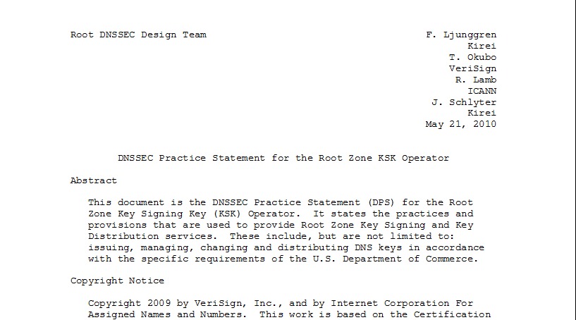
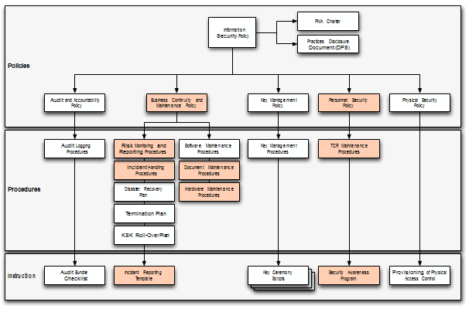
Documentation - Root
91 Pages and tree of other documents!
Root DPS
Notes:
Spells out multiparty controls (e.g., at least two)

Slide 27
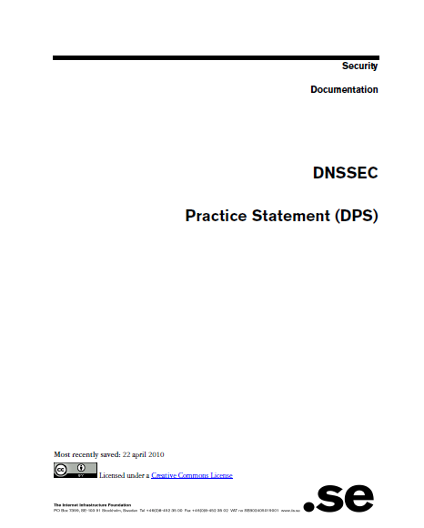
Documentation - .SE
22 pages, Creative Commons License!
.SE DPS
Notes:
Just go through and replace “SE” with “your TLD” for a great starting point for your lawyers.
**BR just had checklists. Bottom line – transparency buys trust.

Slide 28
Do what you say
Follow documented procedures / checklists
Maintain logs, records and reports of each action, including incidents.
Critical operations at Key Ceremonies
  Video
  Logged
  Witnessed

Slide 29
Key Ceremony
A filmed and audited process carefully scripted for maximum transparency at which cryptographic key material is generated or used.
Notes:
Point to root zone key ceremonies document

Slide 30

Prove it
Audits
  3rd party auditor $$
  ISO 27000 $$ etc..
  Internal

Slide 31
Prove it - Audit Material
Key Ceremony Scripts
Access Control System logs
Facility, Room, Safe logs
Video
Annual Inventory
Logs from other Compensating Controls
Incident Reports
Notes:
Some elements above may need to be attested to or signed by management as determined by auditor.
Logs should have entry/exit, open/close, removal/return.
Compensating Controls are your friend – other logs, logging, video etc…

Slide 32
Prove it
Stakeholder Involvement
  Publish updated material and reports
  Participation, e.g. External Witnesses from
      local Internet community
      Government
  Listen to Feedback

Slide 33
Prove it
Be Responsible
  Executive Level Involvement
    In policies via Policy Management Authority
    Key Ceremony participation

Slide 34
Security

Slide 35
Building in security
Getting the machinery for DNSSEC is easy (BIND, NSD/Unbound, OpenDNSSEC, etc..).
Finding good security practices to run it is not.

Slide 36
Security
Physical
Logical
Crypto

Slide 37
Physical
  Environmental
  Tiers
  Access Control
  Intrusion Detection
  Disaster Recovery

Slide 38
Physical - Environmental
Based on your risk profile
Suitable
  Power
  Air Conditioning
Protection from
  Flooding
  Fire
  Earthquake
Notes:
California reference – risk profile balances operational, cost, and environmental

Slide 39
Physical - Tiers
Each tier should be successively harder to penetrate than the last
  Facility
  Cage/Room
  Rack
  Safe
  System
Think of concentric boxes

Slide 40
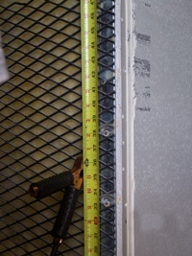
Physical - Tier Construction
Base on your risk profile and regulations
Facility design and physical security on
  Other experience
  DCID 6/9
  NIST 800-53 and related documents
  Safe / container standards
Notes:
Terrorist attack – not protected
Undetected access is worst case
Safe story
EMI – don’t care if HSM rated
Local regulations (e.g. fire)
DCID and various other hard to learn from sources: 9 gague stretched steel, real floor to real ceiling.
DNSSEC at root is rare in that we are sharing such info with public – call it a dividend to the public

Slide 41
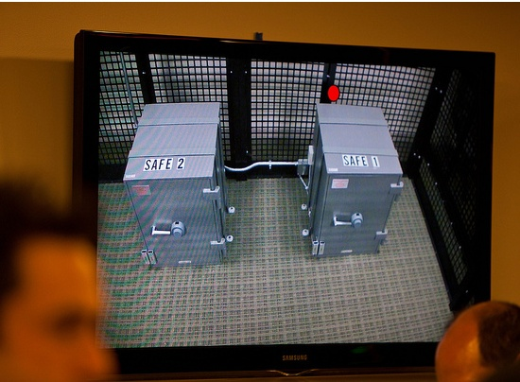
Physical – Safe Tier
Notes:
M of N was 3-of-7 plus SSSC1 SSC2 and multi-person access control to facility

Slide 42
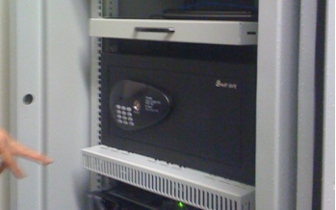
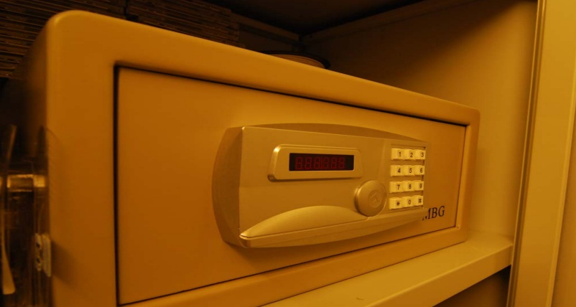
Physical – Safe Tier
Notes:
Looks like your hotel safe – huh. My suggestion – no batteries.

Slide 43
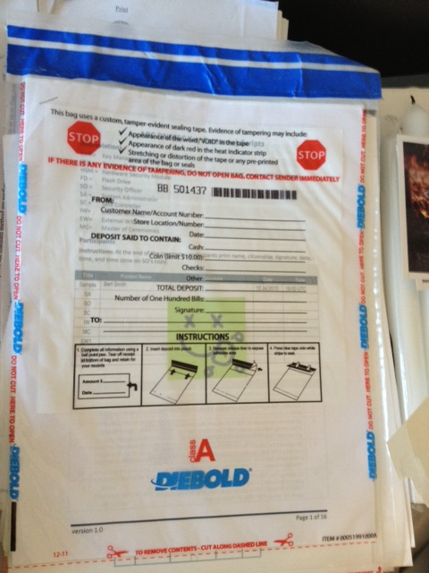
Physical – Tamper Evident Packaging

Slide 44
Physical - Access Control
Base on your risk profile
Access Control System
  Logs of entry/exit
  Dual occupancy / Anti-passback
  Allow Emergency Access
High Security: Control physical access to system independent of physical access controls for the facility
Notes:
Facility is ID + guard – log book
Safe is combination – log sheet
Tiers are card+pin+biometric – ACS logging
All filmed by at least facility

Slide 45
Physical - Intrusion Detection
Intrusion Detection System
  Sensors
  Motion
  Camera
Tamper Evident Safes and Packaging
Tamper Proof Equipment
Notes:
Facility: Manned, video monitor (and archived), monitor access to racks/cage/room
Sensors – door, seismic, water
Risk assessment – worst case: undetected/ unnoticed. So focus on detecting where total prevention is impossible. …and have mechanism to recover from compromise.

Slide 46
Physical - Disaster Recovery
Multiple sites
  Mirror
  Backup
Geographical and Vendor diversity
Notes:
Availability !!! So two sites AND backup of material.
Multiple sites from different facility providers.
Off site Backup could be a bank safe deposit box holding a smartcard in a tamper evident bag.

Slide 47
Logical
Authentication (passwords, PINs)
Multi-Party controls
Notes:
Risk:
lost/guessed password
Collusion

Slide 48
Logical - Authentication
Procedural:
  REAL passwords
  Forced regular updates
  Out-of-band checks
Hardware:
  Two-factor authentication
  Smart cards (cryptographic)
Notes:
Risk: guessed password
Password best practices can be found in various commercial standards PCI
Most of this slide is critical for the “child” user interface (that does not benefit from any physical security) for submitting DS records.
Out of band may be an automated phone call or FAX like many services (e.g. GoDaddy, name.com – “courtesy” call) do.
Pass out various embodiments…
In the case of compromise, Out-of-band authentication mechanism is necessary (e.g. should attacker use compromised key to facilitate a legitimate dnskey/ds rollover) - true for parent or child relationship

Slide 49
Logical - Multi-Party Control
Split Control / Separation of Duties
  E.g., Security Officer and System Admin and Safe Controller
M-of-N
  Built in equipment (e.g. HSM)
  Procedural: Split PIN
  Bolt-On: Split key (Shamir, e.g. ssss.c)
Notes:
Risk: Collusion
Separation of Duties: Different departments in same org or different orgs
Explain split PIN and split-key
Can combine ACS+Safe+MofN to greatly reduce collusion probability

Slide 50
Crypto
Algorithms / Key Length
Crypto Hardware

Slide 51
Crypto - Algorithms / Key Length
Factors in selection
  Cryptanalysis
  Regulations
  Network limitations

Slide 52
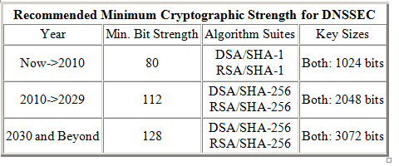
Crypto - Key Length
Cryptanalysis from NIST: 2048 bit RSA SHA256
http://csrc.nist.gov/publications/nistpubs/800-57/sp800-57_PART3_key-management_Dec2009.pdf
Notes:
NIST
http://csrc.nist.gov/publications/nistpubs/800-57/sp800-57_PART3_key-management_Dec2009.pdf
Root rollout did force resolver upgrade to sha256…

Slide 53
Crypto - Algorithms
Local regulations may determine algorithm
  GOST
  DSA
Network limitations
  Fragmentation means shorter key length is better
  ZSK may be shorter since it gets rolled often
  Elliptical is ideal – but not commonplace
Notes:
Signature churn not a problem with RSA 1024 or higher
If problems with 1024 – we have a much bigger problem than DNSSEC.
FWIW: RSA 1024 ~ 6 mo – other anecdotal notes, 10 years estimated, 2048 is ok
Elliptical is encumbered by patent rights but cryptographers love it. It may become standard after a few (>5) years
BTW GOST is elliptical…

Slide 54
Crypto - Algorithms
NSEC3 if required
  Protects against zone walking
  Avoid if not needed – adds overhead for small zones
  Non-disclosure agreement?
  Regulatory requirement?
  Useful if zone is large, not trivially guessable (only “www” and “mail”) or structured (ip6.arpa), and not expected to have many signed delegations (“opt-out” avoids recalculation).
Notes:
Use a dynamic / incremental signing solution for the large zones? BIND 9.7.x

Slide 55
Crypto - Hardware
Satisfy your stakeholders
  Doesn’t need to be certified to be secure (e.g., off-line PC)
  Can use transparent process and procedures to instill trust
  But most Registries use or plan to use HSM. Maybe CYA?
AT LEAST USE A GOOD Random Number Generator (RNG)!
Use common standards avoid vendor lock-in.
  Note: KSK rollover may be ~10 years.
Remember you must have a way to backup keys!
Notes:
Off-line PC: Your know secure64 is just a PC with a TPM chip that encrypts a bundle = FIPS 140-2 level 2
NO RNG = a vulnerability. "random numbers too important to be left for chance."
Backup keys – cant use on smartcard key gen. Bad policy if HSM vendor dies too. See CA HEBCA example.

Slide 56
Crypto - Hardware Security Module (HSM)
FIPS 140-2 Level 3
  Sun SCA6000 (~30000 RSA 1024/sec) ~$10000 (was $1000!!)
  Thales/Ncipher nshield (~500 RSA 1024/sec) ~$15000
  Ultimaco
FIPS 140-2 Level 4
  AEP Keyper (~1200 RSA 1024/sec) ~$15000
  IBM 4765 (~1000 RSA 1024/sec) ~$9000
Recognized by your national certification authority
  Kryptus (Brazil) ~ $2500
Study: http://www.opendnssec.org/wp-content/uploads/2011/01/A-Review-of-Hardware-Security-Modules-Fall-2010.pdf

Slide 57
Crypto - PKCS11
A common interface for HSM and smartcards
  C_Sign()
  C_GeneratePair()
Avoids vendor lock-in - somewhat
Vendor Supplied Drivers (mostly Linux, Windows) and some open source

Slide 58
Crypto - Smartcards / Tokens
Smartcards (PKI) (card reader ~$12)
  AthenaSC IDProtect ~$30
  Feitian ~$5-10
  Aventra ~$11
TPM
  Built into many PCs
Token
  Aladdin/SafeNet USB e-Token ~$50
Open source PKCS11 Drivers available
  OpenSC
Has RNG
Slow ~0.5-10 1024 RSA signatures per second

Slide 59
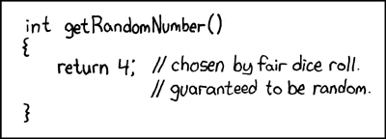

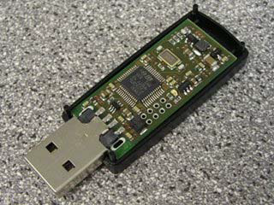
Crypto -Random Number Generator
rand()
Netscape: Date+PIDs
LavaRand
System Entropy into /dev/random (FBSD=dbrg+entropy/Linux=entropy?)
H/W, Quantum Mechanical (laser) $
Standards based (FIPS, NIST 800-90 DRBG)
Built into CPU chips

Slide 60
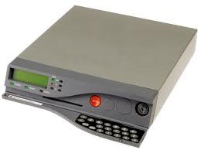
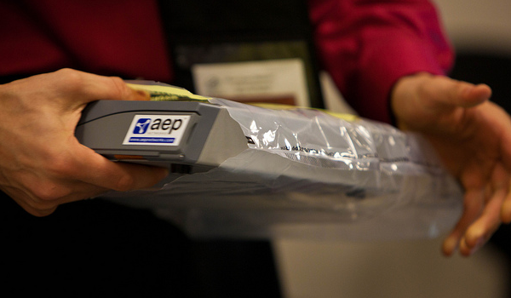
Crypto - FIPS 140-2 Level 4 HSM
Root, .FR, .CA …

Slide 61
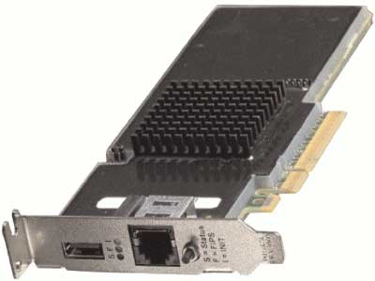
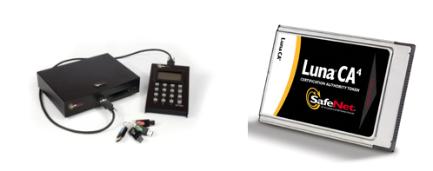
Crypto – FIPS Level 3 HSM
But FIPS 140-2 Level 3 is also common
Many TLDs using Level 3 .com , .se, .uk, .com, etc… $10K-$40K

Slide 62

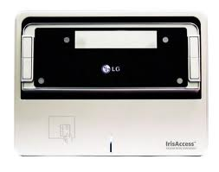
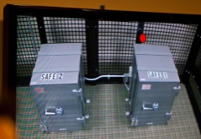
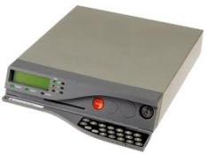
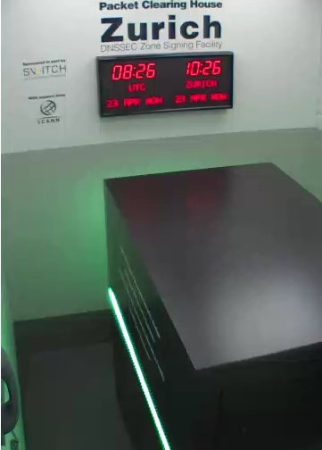
An implementation can be thi$
Notes:
FR, NZ, root, com, UK, DCID 6/9
http://www.pch.net/dnssec/zrh

Slide 63
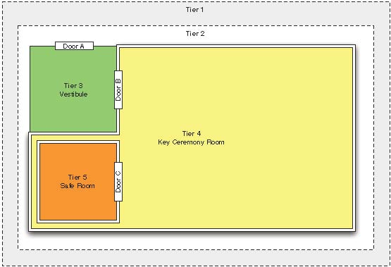
Physical Security

Slide 64
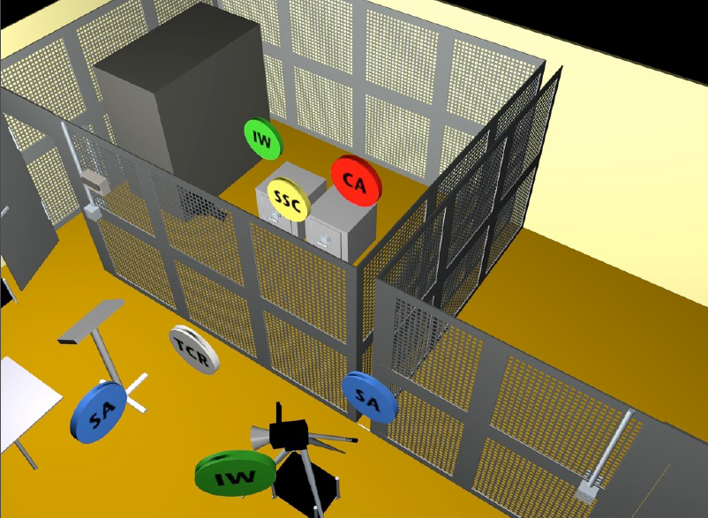

Slide 65
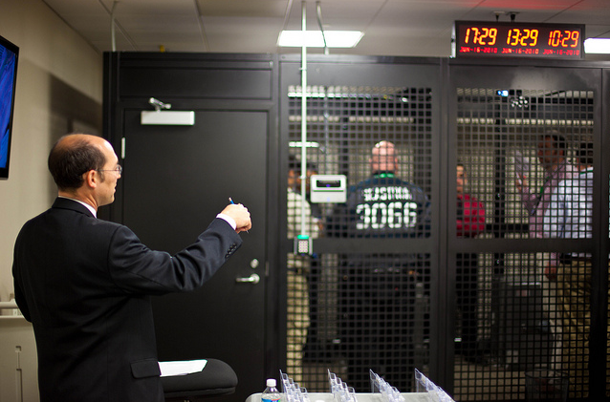
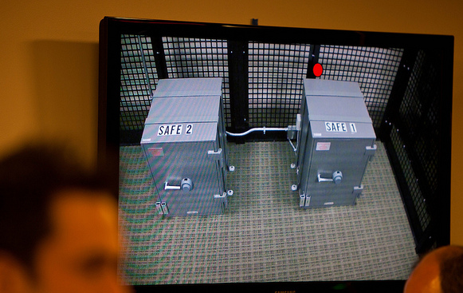
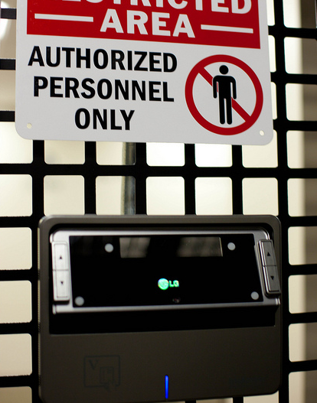
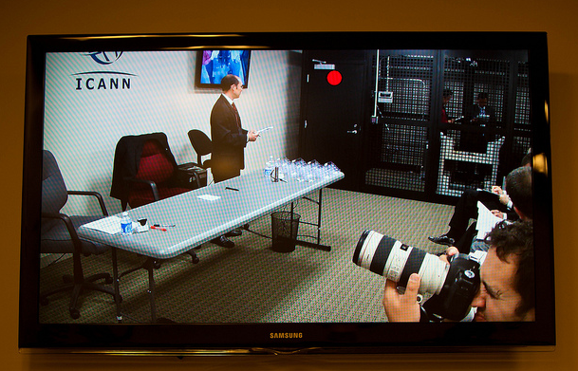
http://www.flickr.com/photos/kjd/sets/72157624302045698/

Slide 66
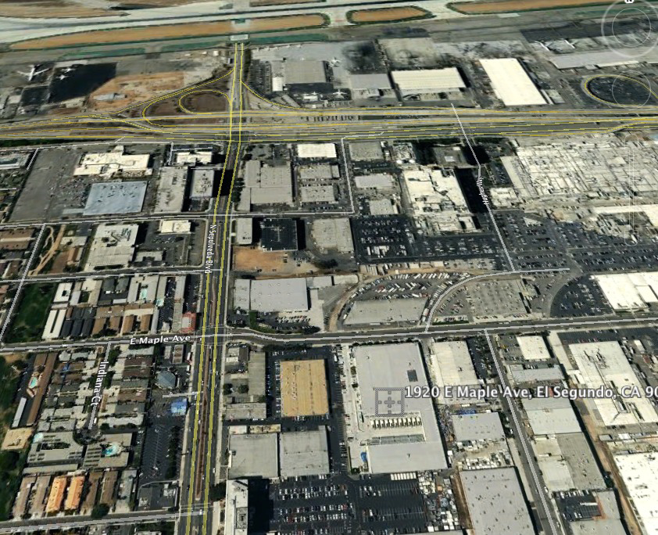

Slide 67
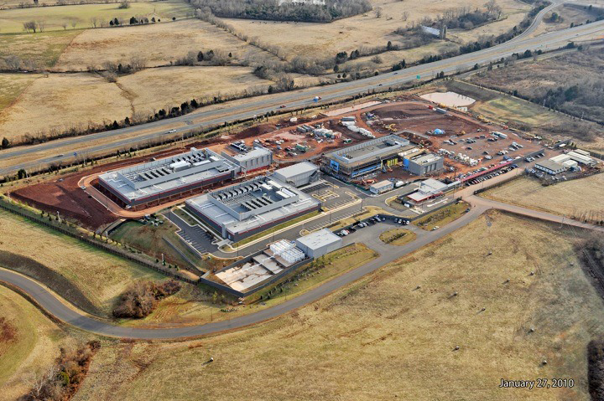

Slide 68
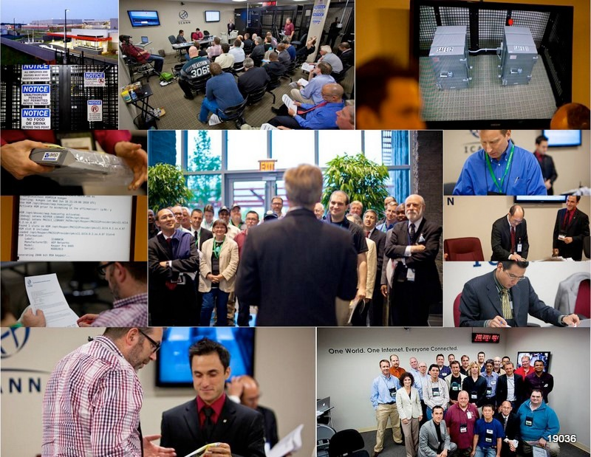
Notes:
Fips 140-2 level 4
Gsa class 5
Biometrics
Multi-person control
Publicly documented
Draw from CA
Dcid 6/9 9 gauge mesh drywall

Slide 69


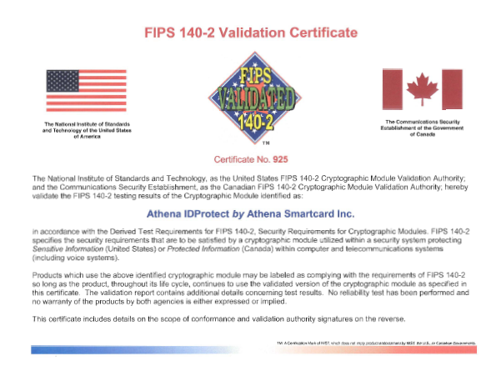
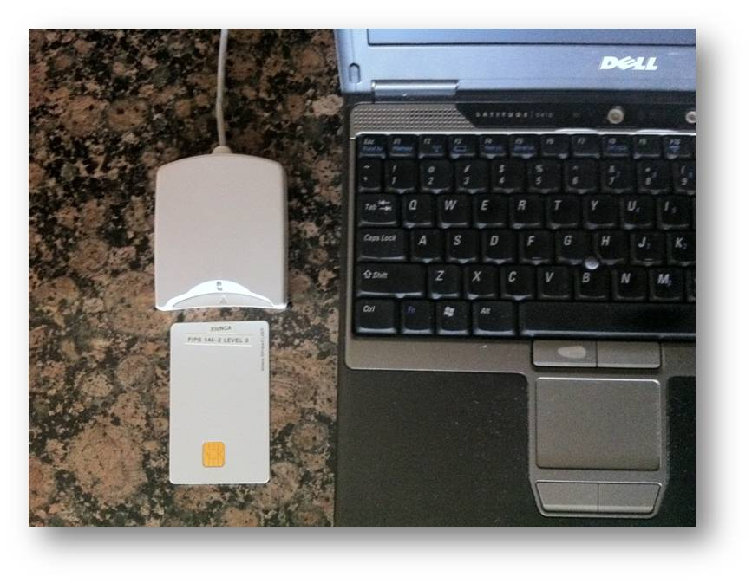
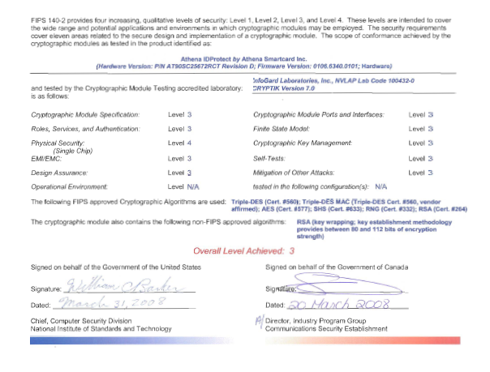
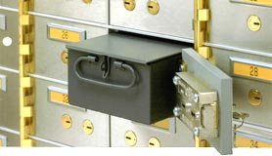
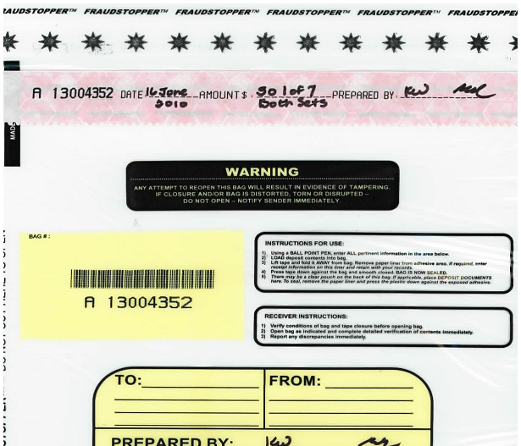
…or this
+
TPM
Notes:
JP, old SE, new CR

Slide 70
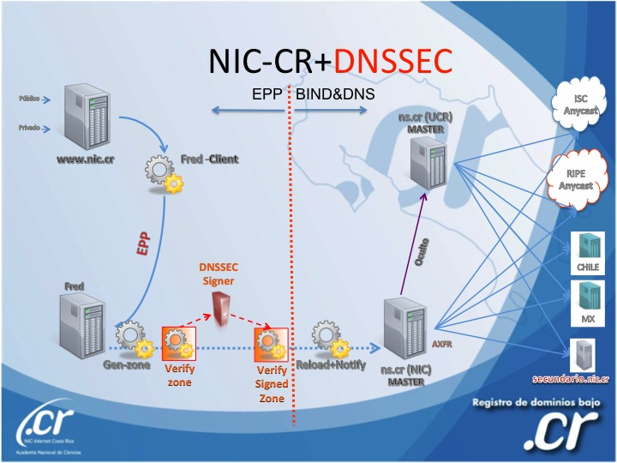
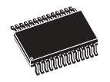
..or this (from .cr)
Transport KSK signed DNSKEY RRsets
unsigned
zone
Sign ZSKs with KSK
Sign zones with ZSK
Offline Laptop with TPM
Online/off-net DNSSEC Signer with TPM
signed
zone
KSK
Transport public half of ZSKs
Generate KSK
ZSKs
Generate ZSKs
Secure Off-line Environment
Animated slide
Notes:
9 March 2012
…and bnonline.fi.cr
http://www.nacion.com/2012-03-15/Tecnologia/Sitios-web-de-bancos-ticos-podran-ser-mas-seguros.aspx

Slide 71
…or even this
Off-line
Off-net
DATA CENTER
CAGE
DATA CENTER
RACK
CAGE
SAFE
RACK
All in tamper evident bags
FD with public ZSKs
zonefile
ZSKs
KSK on FD
Live O/S DVD
signer
laptop
FD with KSK signed DNSKEY RRsets
firewall
hidden master
RNG
Notes:
From LACTLD training I gave in September. Notes from there on simple separation of duties and even ssss.c for M-of-N. Go thru risk analysis, threats and controls
Pull out TEBs.

Slide 72

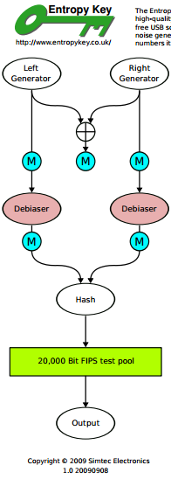
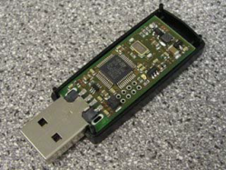
But all must have:
Published practice statement
  Overview of operations
  Setting expectations
    Normal
    Emergency
  Limiting liability
Documented procedures
Multi person access requirements
Audit logs
Monitoring (e.g., for signature expiry)
Good Random Number Generators
Intel RdRand
DRBGs
FIPS 140
Useful IETF RFCs:
DNSSEC Operational Practices http://tools.ietf.org/html/draft-ietf-dnsop-rfc4641bis
A Framework for DNSSEC Policies and DNSSEC Practice Statements http://tools.ietf.org/html/draft-ietf-dnsop-dnssec-dps-framework
Notes:
CA, NZ, PCH, and others based on pioneering work by SE / Fredrik and RFC draft for DPS. I use one for my training sessions and have one translated into Spanish. I understand JPNIC has one translated into English.
http://cira.ca/knowledge-centre/technology/dnssec/practice-statement/
Recent news of bad random numbers for 10s of 1000’s of SSL certificates (15 Feb). 2 out of 1000 offer no security.
http://www.nytimes.com/2012/02/15/technology/researchers-find-flaw-in-an-online-encryption-method.html?_r=2&hp
DRBG http://csrc.nist.gov/publications/nistpubs/800-90A/SP800-90A.pdf
SysTrust similar to WebTrust – economies of similarity.
Number of SSL: 4M/200+M sites Could have many more.
Many countries use VRSN for govt dig sign. Why not own country?
DNSSEC deployment as an excuse to improve all process (ENISA)
Leverage govt interests in cyber security (+secure smart grid and other infrastructures that rely on DNSSEC) and digital identity efforts.
Opportunity to use DNSSEC requirements and current interest in digital identity systems as an excuse to improve overall DNS and identity ecosystems
DNS/DNSSEC part of all Internet ecosystems.
In order to realize the full benefits of DNSSEC, DNS operators and other entities that make up the chain of trust must embrace transparent IT security processes and practices.
Greater end user and Registrant awareness of the benefits of DNSSEC is needed to drive a virtuous cycle of effective deployment.

